Slide 1


Slide 2

Dear Heavenly Father - I recognize that some of what I believe - does not line up with your truth about me. These lies have created patters of behavior -and I want to change them. Knowing that you have already made me new - gives me courage to break these negative strongholds. Teach me tonight how to renew my mind.
In Jesus' name, Amen.

Slide 3
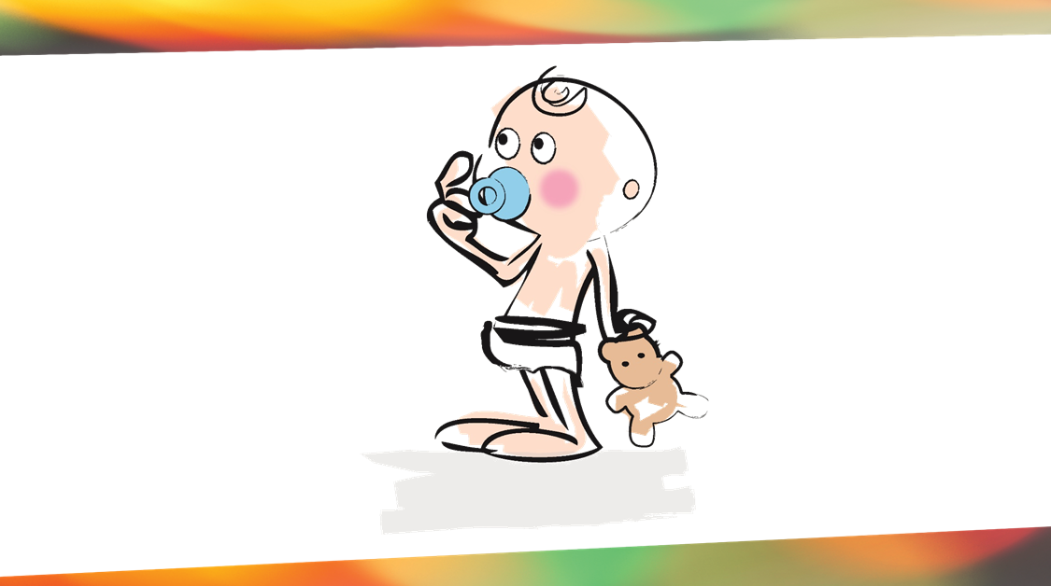

Slide 4
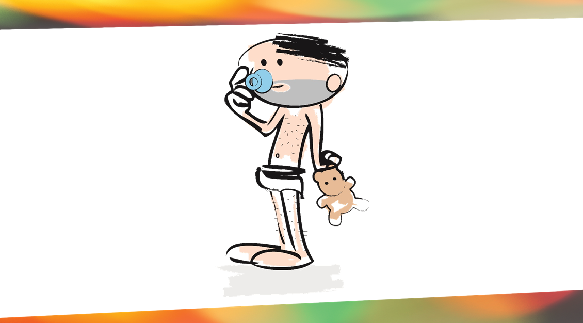
Notes:
Maturity
1 Corinthians 14:20 ESV / 418 helpful votes
Brothers, do not be children in your thinking. Be infants in evil, but in your thinking be mature.
1 Corinthians 13:11 ESV / 342 helpful votes
When I was a child, I spoke like a child, I thought like a child, I reasoned like a child. When I became a man, I gave up childish ways.
Ephesians 4:14-15 ESV / 258 helpful votes
So that we may no longer be children, tossed to and fro by the waves and carried about by every wind of doctrine, by human cunning, by craftiness in deceitful schemes. Rather, speaking the truth in love, we are to grow up in every way into him who is the head, into Christ,
Ephesians 4:13 ESV / 152 helpful votes
Until we all attain to the unity of the faith and of the knowledge of the Son of God, to mature manhood, to the measure of the stature of the fullness of Christ,
Hebrews 5:12-13 ESV / 146 helpful votes
For though by this time you ought to be teachers, you need someone to teach you again the basic principles of the oracles of God. You need milk, not solid food, for everyone who lives on milk is unskilled in the word of righteousness, since he is a child.
2 Peter 3:18 ESV / 120 helpful votes
But grow in the grace and knowledge of our Lord and Savior Jesus Christ. To him be the glory both now and to the day of eternity. Amen.
Hebrews 6:1-3 ESV / 111 helpful votes
Therefore let us leave the elementary doctrine of Christ and go on to maturity, not laying again a foundation of repentance from dead works and of faith toward God, and of instruction about washings, the laying on of hands, the resurrection of the dead, and eternal judgment. And this we will do if God permits.
1 Peter 2:2 ESV / 94 helpful votes
Like newborn infants, long for the pure spiritual milk, that by it you may grow up into salvation—
Hebrews 5:12-14 ESV / 93 helpful votes
For though by this time you ought to be teachers, you need someone to teach you again the basic principles of the oracles of God. You need milk, not solid food, for everyone who lives on milk is unskilled in the word of righteousness, since he is a child. But solid food is for the mature, for those who have their powers of discernment trained by constant practice to distinguish good from evil.

Slide 5
³ For though we live in the world, we do not wage war as the world does. ⁴ The weapons we fight with are not the weapons of the world. On the contrary, they have divine power to demolish strongholds. ⁵ We demolish arguments and every pretension that sets itself up against the knowledge of God, and we take captive every thought to make it obedient to Christ.
2 Corinthians 10:3-5

Slide 6
What are spiritual strongholds?

Slide 7
“Strongholds are habit patterns of thought that are contrary to God’s word (The Truth), that produce ongoing sinful behaviors that are seemingly impossible to break.”

Slide 8
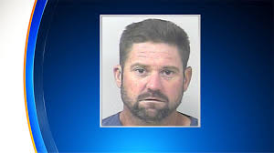
A Florida man was released from jail. It took only 15 minutes for him to get back in.
Notes:
Florida man Casey Michael Lewis was free for all of 15 minutes before he was marched right back into a jail cell.
St. Lucie deputies didn’t have to go very far to catch Lewis who, they say, was released from the St. Lucie County Detention Facility in Fort Pierce on Thursday. That’s because he never left the grounds where he had been held after being charged with grand theft.
According to the arrest affidavit, two deputies — John O’ Connell and Ramon Lopez — saw Lewis, 37, on surveillance video “walking around the parking lot acting suspicious and checking vehicle doors.”
The deputies say they saw Lewis “clearly” looking into cars and checking door handles to see if they were unlocked. According to the affidavit, Lewis entered a silver car from the driver’s side and sat inside for more than two minutes. Deputies say he got out of that car, walked from the front of the parking lot “all the way” to the exit gate, and repeated the process of lifting latches and peering into cars.
ewis, who had appeared “upset” when first released because he had been stripped of his cigarettes, must have realized he was busted because he handed Lettman a brown paper bag with property deputies say he removed from the silver car.
Deputies said the bag contained an iPhone 7, four packs of Blue King cigarettes, a lighter, a Visa bank debit card, a Florida driver’s license and $547 in cash.
Lewis was “re-booked into the jail on MORE burglary charges and released AGAIN on a bond of $11,250,”

Slide 9
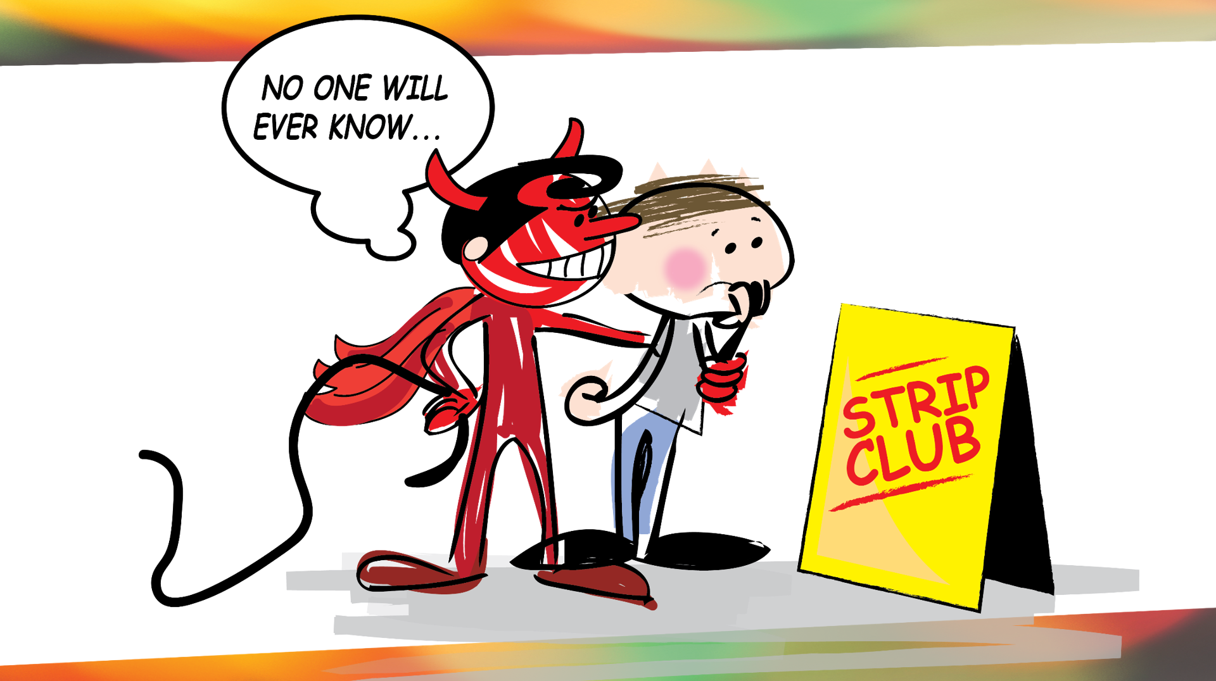

Slide 10
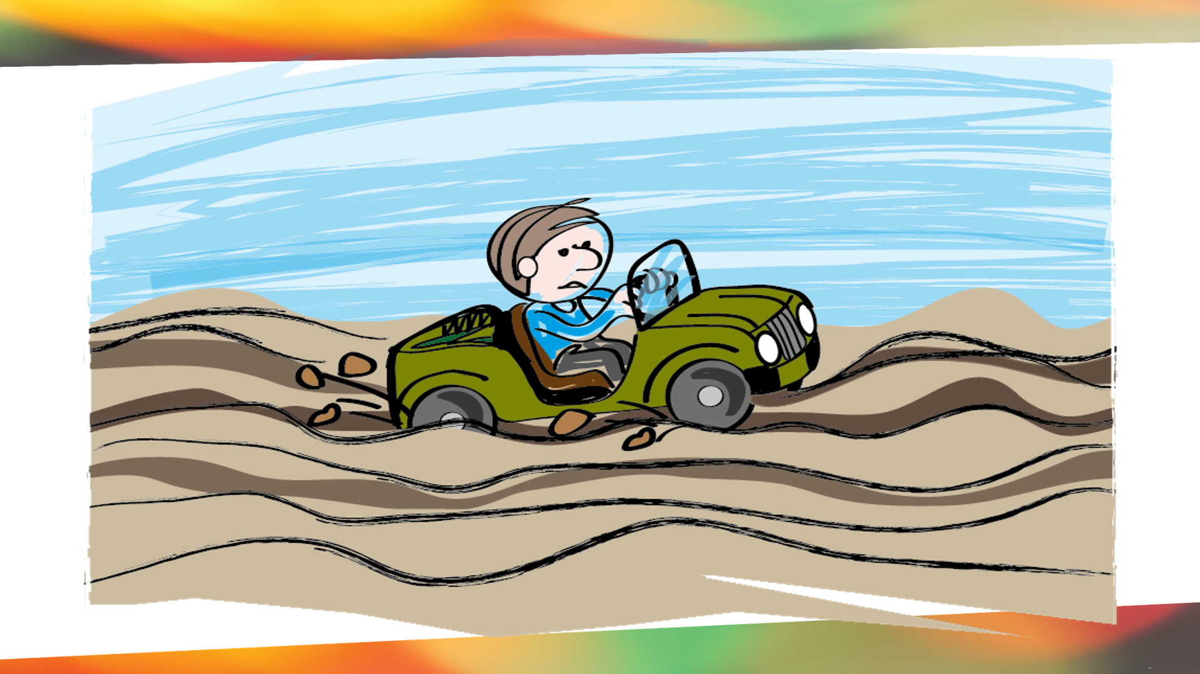

Slide 11
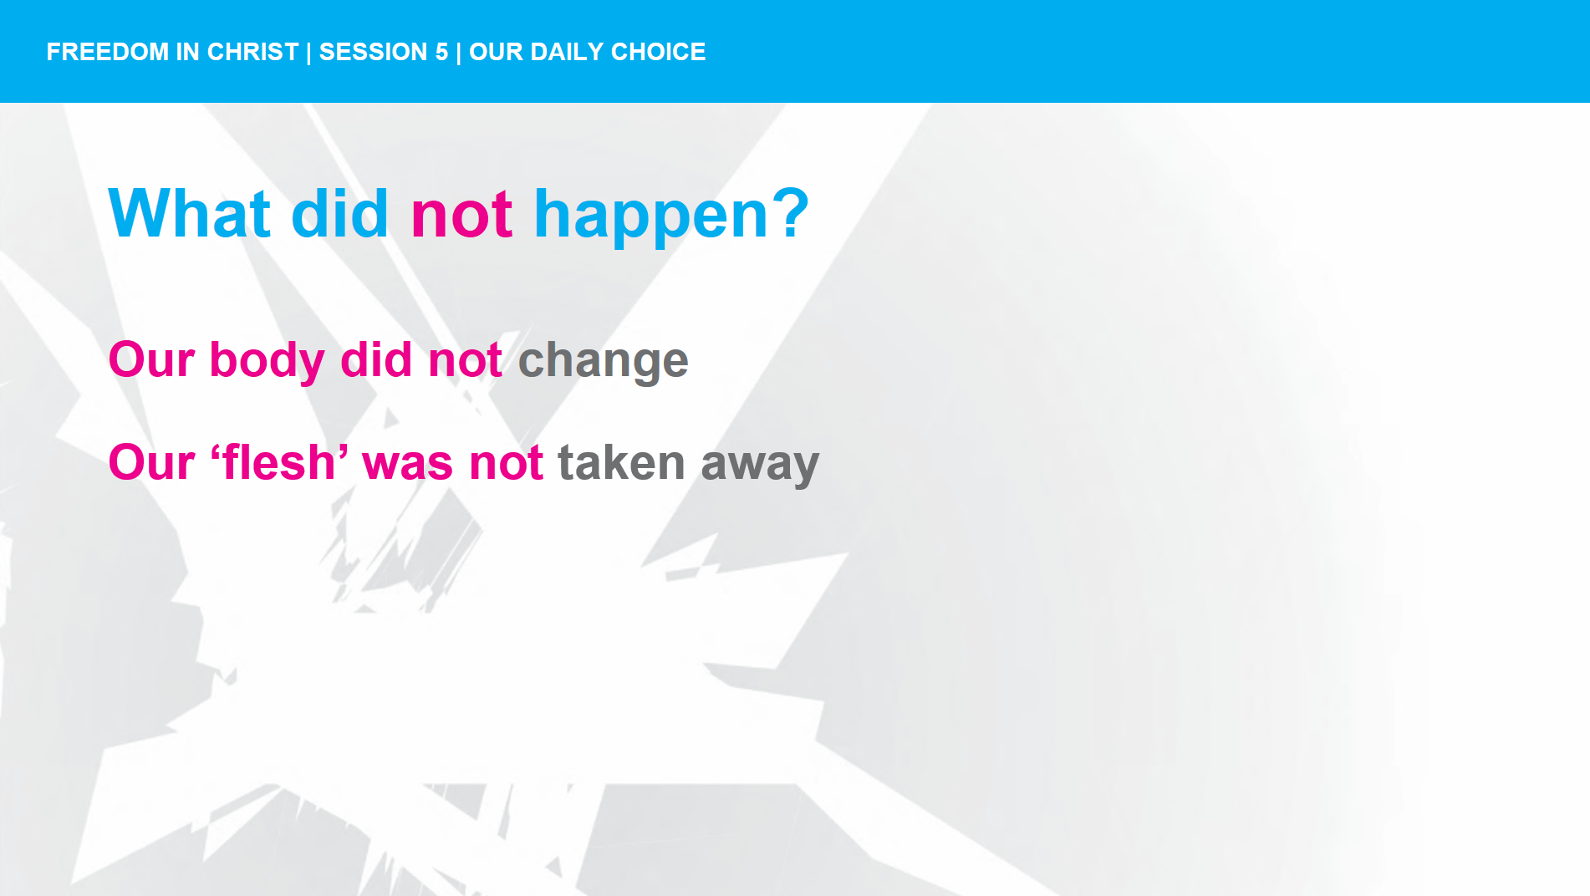
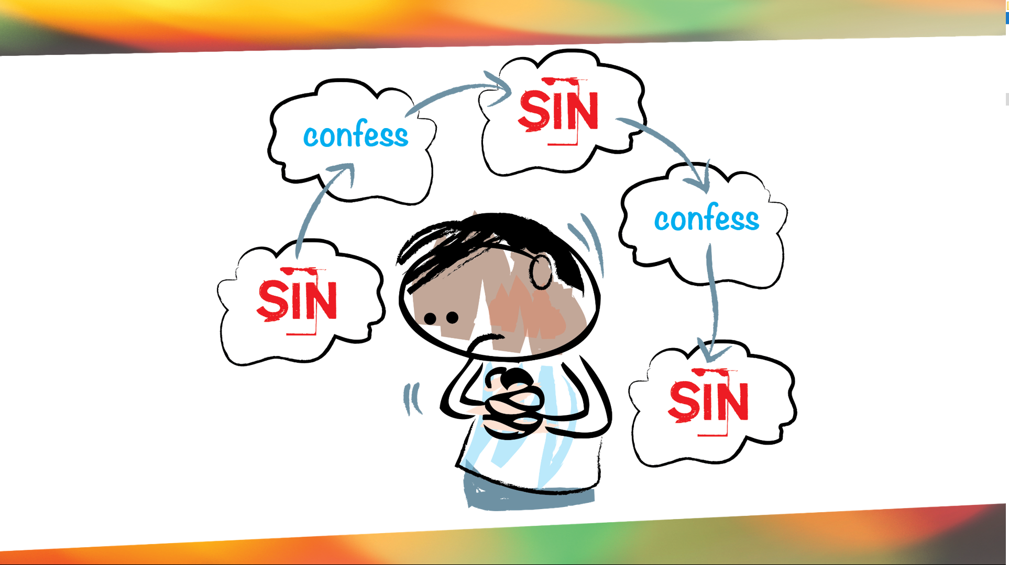
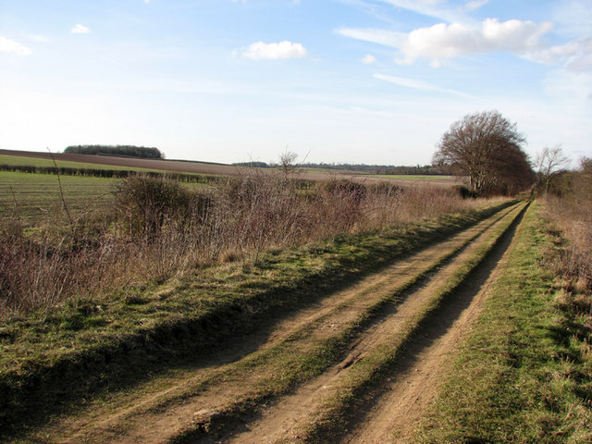

Slide 12
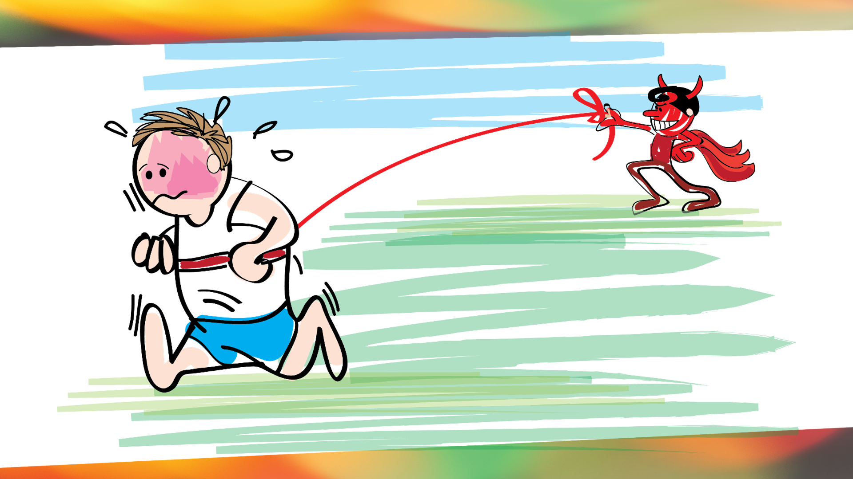


Slide 13
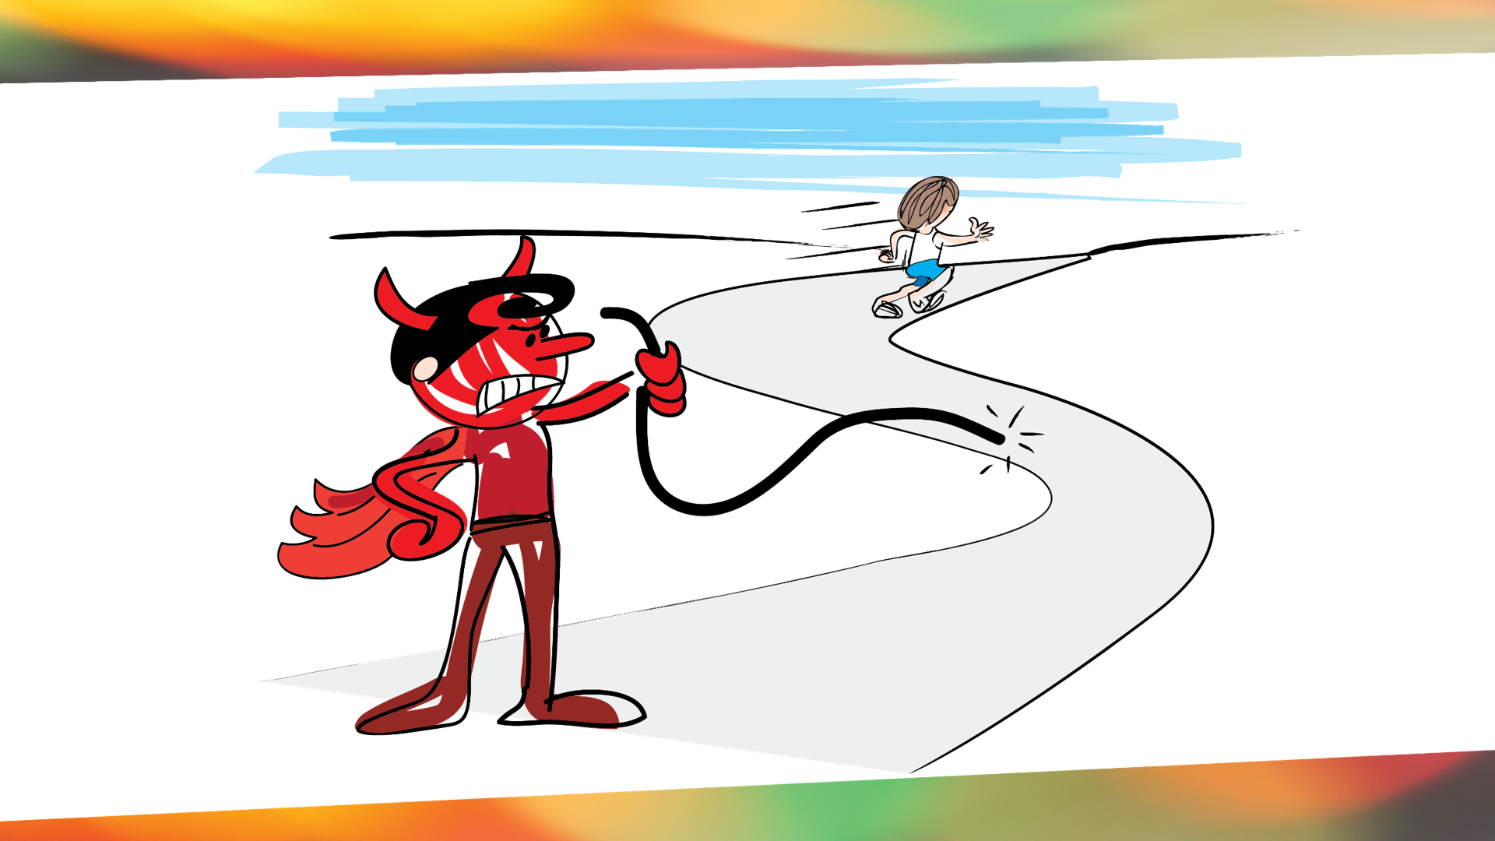

Slide 14
Romans 12:2
Do not conform to the pattern of this world, but be transformed by the renewing of your mind. Then you will be able to test and approve what God’s will is—his good, pleasing and perfect will.
Notes:
However if it doesn’t stack up with what God says is true, we must reject the world’s “truth” and bring our beliefs into line with what is ultimately true.

Slide 15
Sin
Godly Sorrow
Brokenness
Confession
&
Repentance
Forgiveness
Freedom

Slide 16
³ His divine power has granted to us all things that pertain to life and godliness, through the knowledge of him who called us to his own glory and excellence, ⁴ by which he has granted to us his precious and very great promises, so that through them you may become partakers of the divine nature, having escaped from the corruption that is in the world because of sinful desire.
2 Peter 1:3-5

Slide 17
Stronghold-Busting
Case Studies

Slide 18

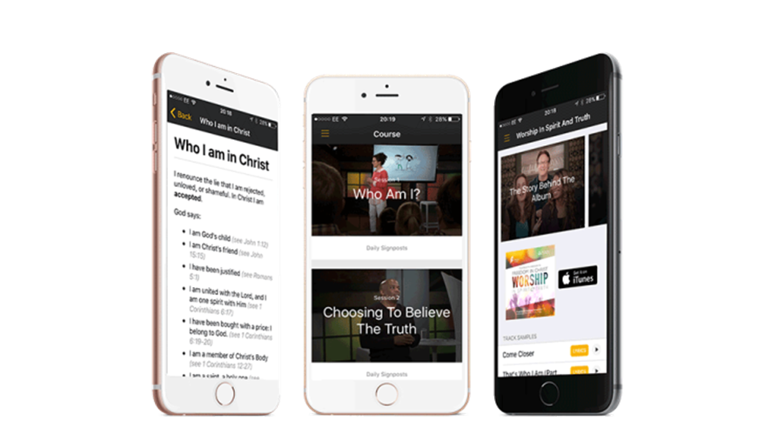

How to build a stronghold buster

Slide 19
Identify The Lie
Identify a lie that you are often believing and what it’s costing you in your relationship with God and people.
Some examples:
I’m always driven to __________. Therefore I have a tendency to hurt people and not love them.
I’m always fearful about __________. Therefore, I have a tendency to be negative and feel I push God and others away.
Giving into __________ temptation will make me happy. But I always end up more alone and angry. I hate myself.

Slide 20
Proclaim the Truth (verses)
Choose 2-3 verses that speak truth to the lie you’ve chosen to combat.
  You can ask a trusted fellow Christian.
  You can use Google or a topical Bible search tool for assistance.

Slide 21
Write Prayer/Declaration
Formulate your stronghold-buster prayer by following these steps.
State the lie. (I renounce the lie that….)
State how the lie is affecting you or how your life would be different without this faulty belief.
Use the scriptures you chose to speak truth to this area. (I announce the truth that….)

Slide 22
Stronghold-Buster Example
The lie: I’m always driven to __________. Therefore I have a tendency to hurt people and not love them.
The Truth:
Psalms 127:2 “It is vain for you to rise up early, to stay up late, eating the bread of toil; for he gives sleep to his loved ones”
Ecclesiastes 4:4 “Then I saw all the labor and achievement that is the envy of a man’s neighbor. This also is vanity and a striving after the wind.

Slide 23
Prayer/Declaration
I renounce the lie that my efforts make me worthy or valuable. I accept the truth that Christ has done all I need for a full life. My efforts are just vanity. Chasing after the wind will never bring contentment or satisfaction.

Slide 24
Set a time for a reminder to appear on your phone each day.
Each day for the next 40 days, you will get a reminder to read aloud your Stronghold-Buster. Stay with this process even when it seems pointless. You will begin to catch the lie and quickly recall the truths from scripture that combat it. Over time, this particular stronghold will no longer hold you.

Slide 25
³ For though we live in the world, we do not wage war as the world does. ⁴ The weapons we fight with are not the weapons of the world. On the contrary, they have divine power to demolish strongholds. ⁵ We demolish arguments and every pretension that sets itself up against the knowledge of God, and we take captive every thought to make it obedient to Christ.
2 Corinthians 10:3-5

Slide 26
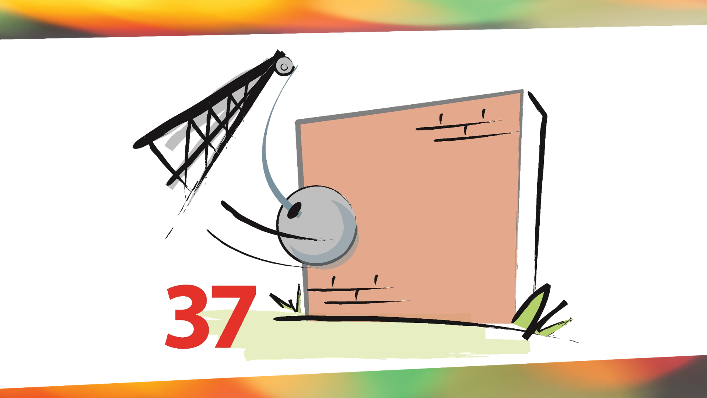

Slide 27
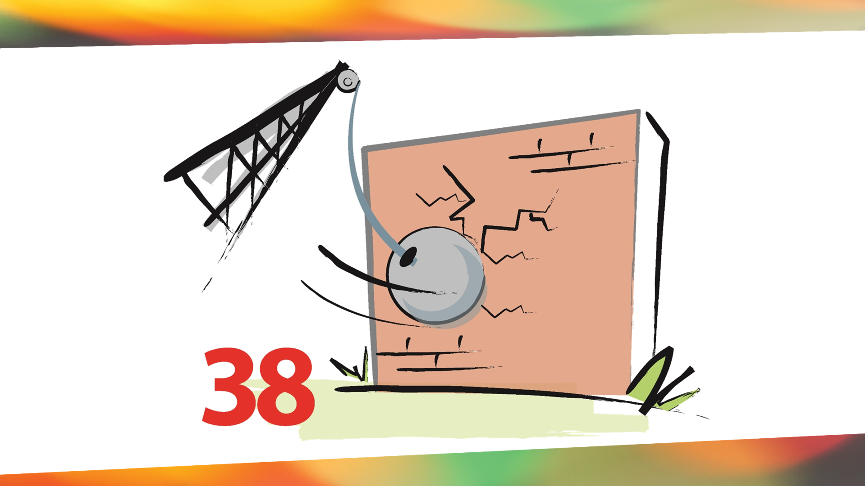

Slide 28
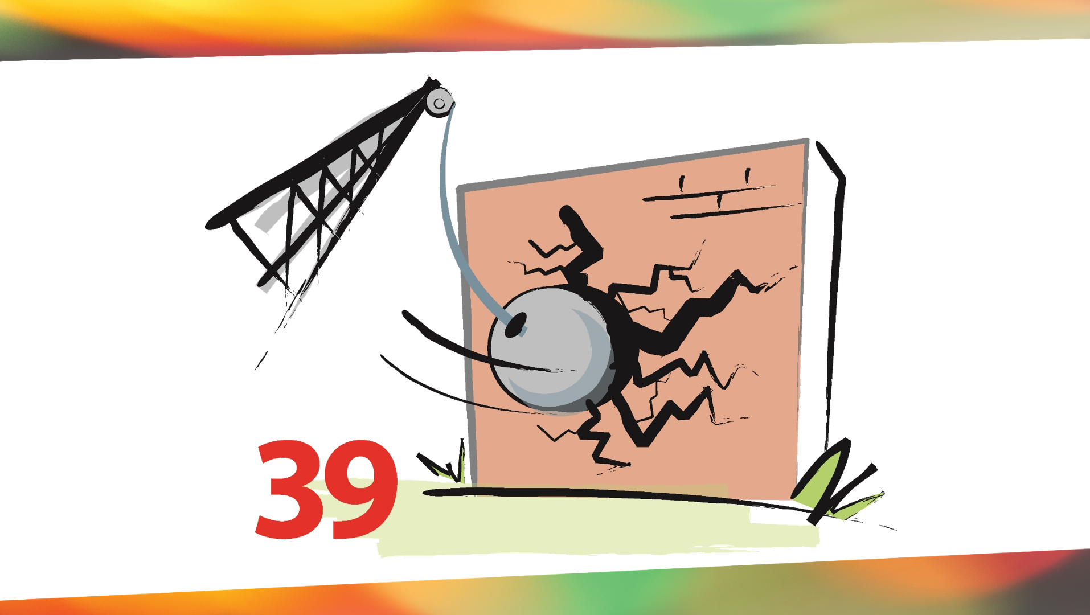

Slide 29
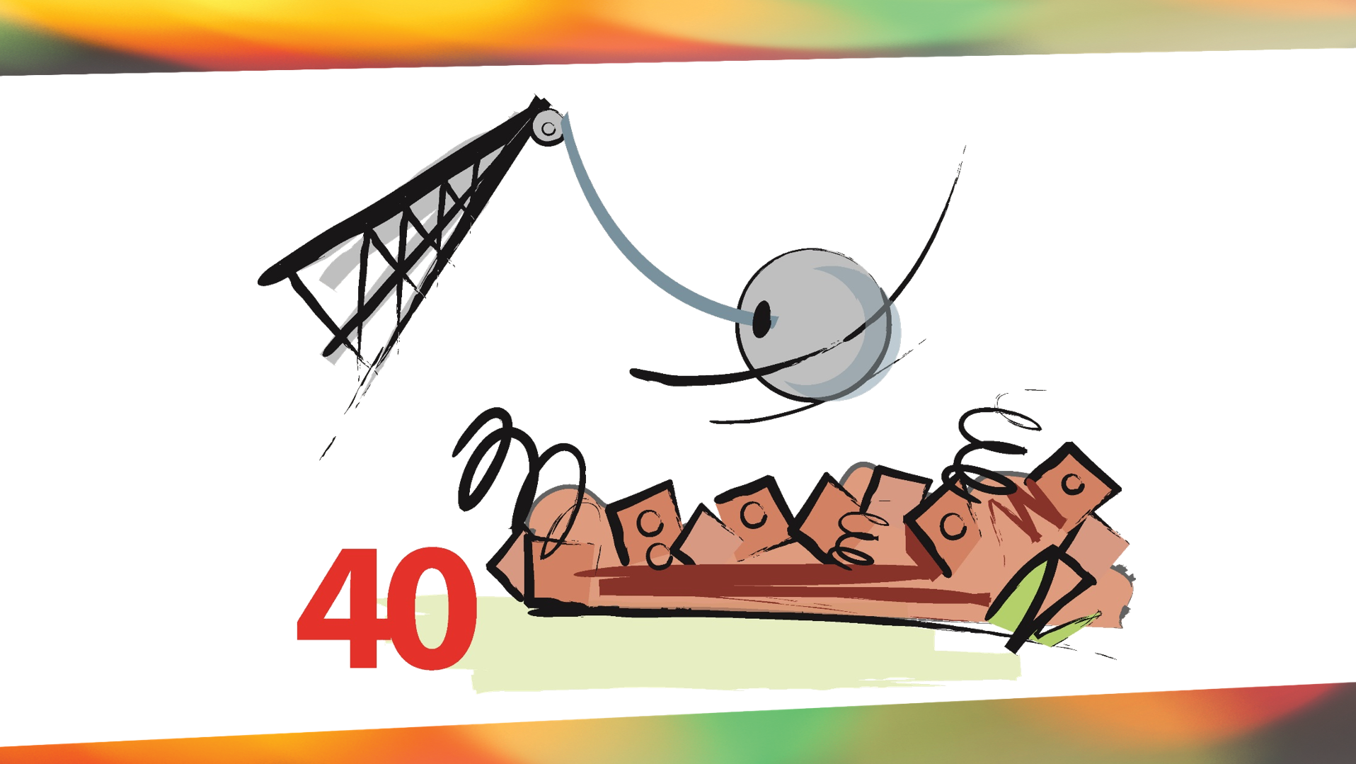

Slide 30
