Slide 1


Slide 2

ATTITUDE
Notes:
Know Who You are In Jesus

Slide 3
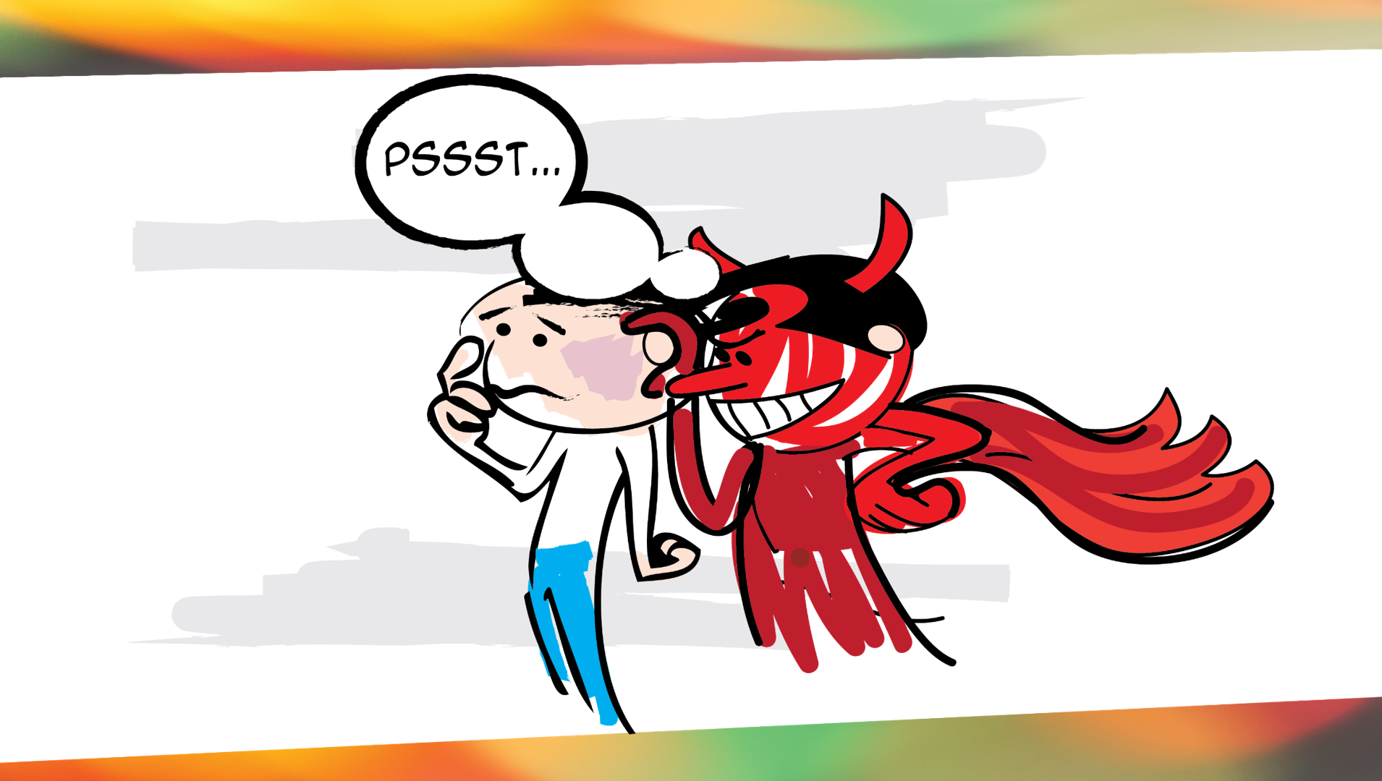
KNOWLEDGE
Notes:
Resolve the Battle for Your Mind
Resolve Spiritual and Personal Issues (Steps to Freedom)

Slide 4
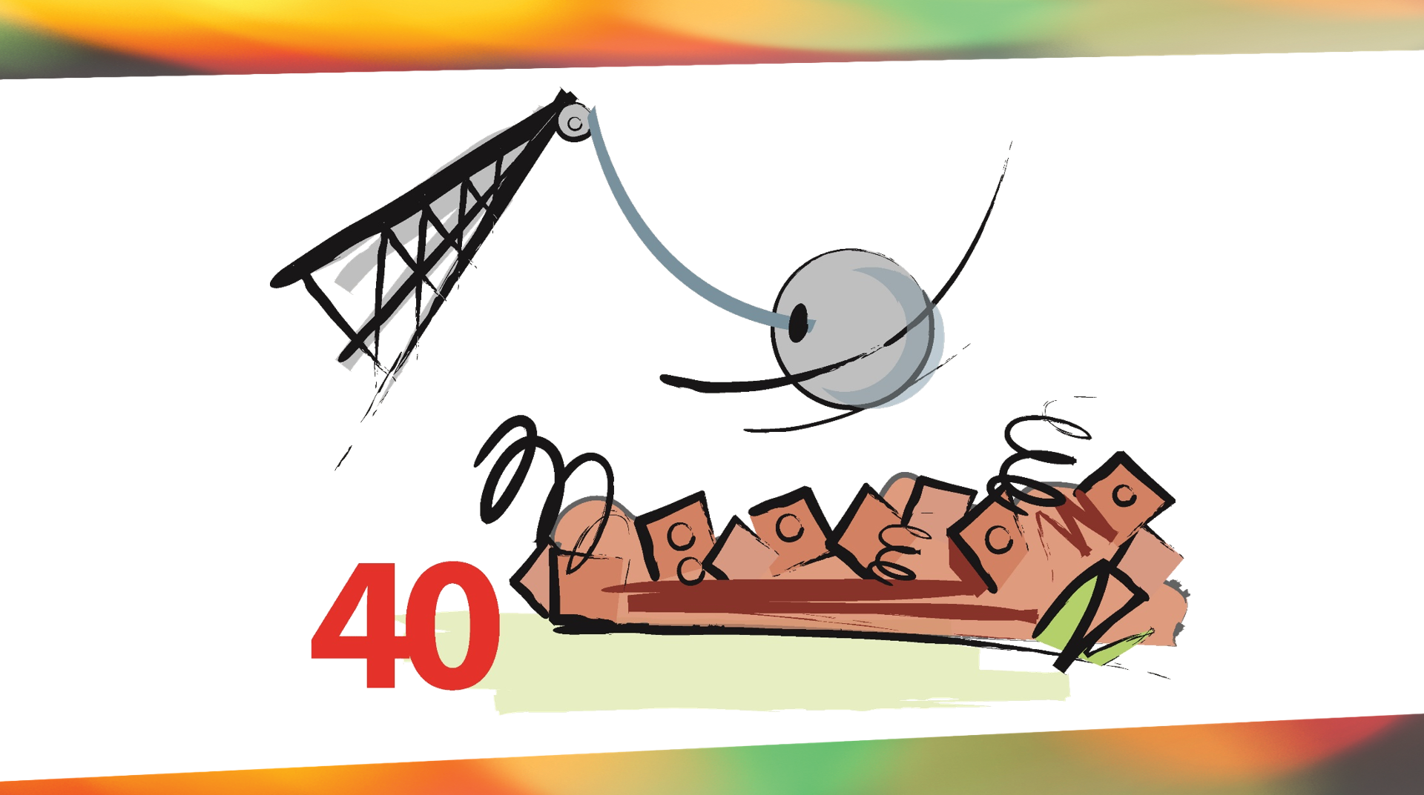
SKILL
Notes:
Skill – Be Transformed by the Renewing of Your Mind
Stronghold Busting

Slide 5

Pause for Thought
What things, in this course, has been most helpful to you?

Slide 6

The Road Ahead
LIFE GOALS

Slide 7

What Do I Believe?
Survey on page 184

Slide 8

Notes:
We looked in session 6 how our emptions specially anger, anxiety and depression can (Not always) be the signal that we have unhealthy life goals that depend on other people or circumstances that we have no right or ability to control.
Examples
Tons of examples for Pandemic. No graduation, not Sports, Not seeing family
Me Easter Sunday - Blocking my goal of getting to church onetime
Pastor who wants to reach the community for Christ
Parent wans to have a happy and Harmonious Family

Slide 9

Godly Goals
Vs
Godly Desires
Notes:
Remember the parent whose life goal was to have a happy Christian family? What if they made their goal “To become the person (spouse, parent, etc) that God wants them to become? Wouldn’t that grealy increase the chances of them having a happy, harmonius family?
In the garden, before the cross, Jesus prayed, not my will, but FATHER yours been done.

Slide 10
I would be more significant if….

Slide 11

Notes:
SIGNIFICANCE COMES FROM A PROPER USE OF TIME
Jim Elliot said “He is no fool who gives up what he can never keep, to gain what he can never loose”
What is forgotten in time of is little significance. What is remembered for eternity is of great significance.
So if you want to increase the significance of how you spend your time, focus on things that will make an eternal difference.

Slide 12
I would be more fulfilled if….

Slide 13
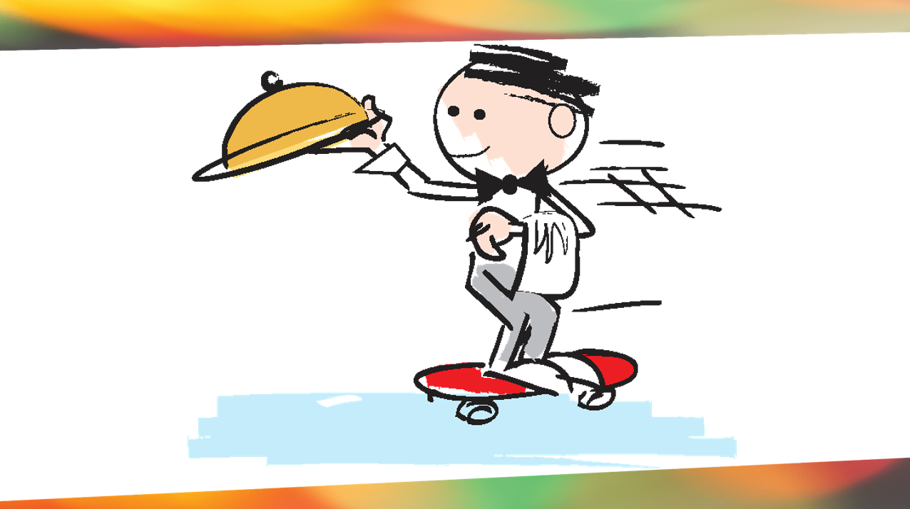
Notes:
Fulfilment comes from Serving Others
Peter write that each person should use whatever gifts he has received to serve others. 1 Peter 4:10
Jesus said the greatest among you would be the servant of all.
God is call is followers in ever every of society business, indstury, education, art, healthcare, what ever ti is, is a high and holy clling where you are to make an eternal difference.
Podcast Dr Kent, Serving people for their sakes, not my own.

Slide 14
I would be more satisfied if….

Slide 15
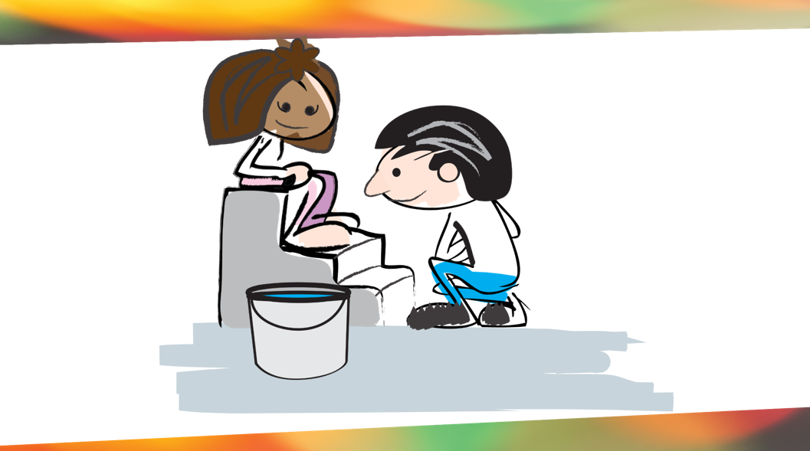
We can often fell overwhelmed by the many things that demand our time. How can focusing on doing a few things well, rather than many things in a hasty way, bring greater satisfaction?
Notes:
SATISFACATION COMES FROM LIVING A QUALITY LIFE (not quantity)
The minimalistic generation has come from a group of young adults who have sing all the things and unhappiness that money can buy. So they are choosing to have a less clustered life.
Seek FIRST the kingdom of God and his Righteousness (Hebrews)
Through of everything and the sin that entangles us in the Race (Hebrews)
We achieve greater satisfaction from doing a few things well than from doing many things in a haphazard or hasty way. Even relationally. We may have many friends but there are on a smaller group of truer friends. Jesus ministered to the masses, the 70, the 12 disciples got most of his focus.

Slide 16
We can often fell overwhelmed by the many things that demand our time. How can focusing on doing a few things well, rather than many things in a hasty way, bring greater satisfaction?
Notes:
SATISFACATION COMES FROM LIVING A QUALITY LIFE (not quantity)
The minimalistic generation has come from a group of young adults who have sing all the things and unhappiness that money can buy. So they are choosing to have a less clustered life.
Seek FIRST the kingdom of God and his Righteousness (Hebrews)
Through of everything and the sin that entangles us in the Race (Hebrews)
We achieve greater satisfaction from doing a few things well than from doing many things in a haphazard or hasty way. Even relationally. We may have many friends but there are on a smaller group of truer friends. Jesus ministered to the masses, the 70, the 12 disciples got most of his focus.

Slide 17
I would be more content if….

Slide 18
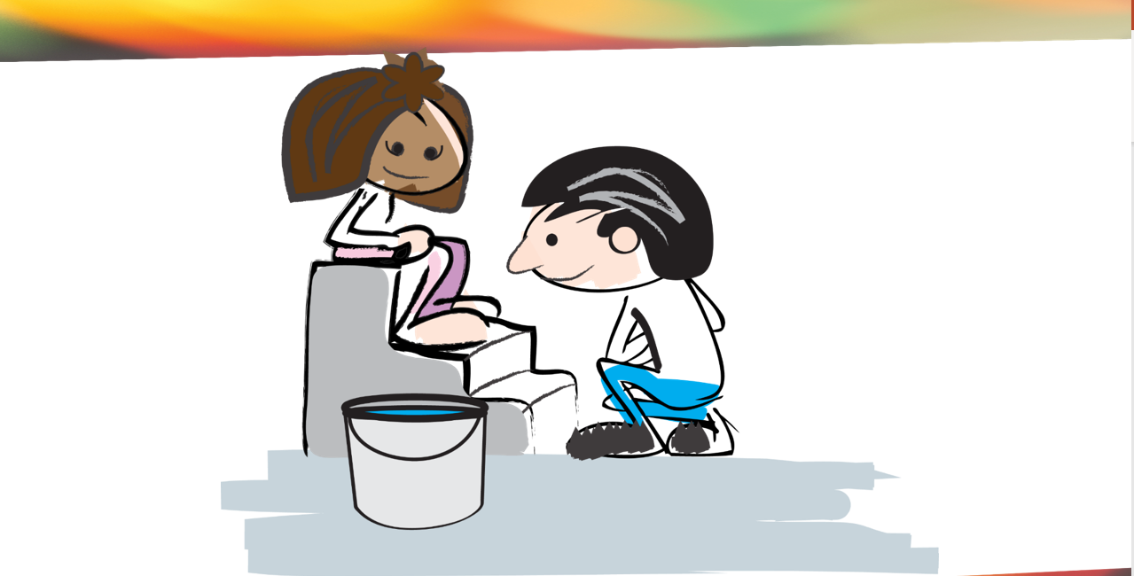

Notes:
HAPPINES COMES FROM WANTHING WHAT WE HAVE
In other words contentment.
I’m content with what I have until I get online, or walk through Sams Club, or see someone’s new SVU, or Truck.
Paul wrote to Timothy “Godliness with contentment is grate gain. For we brought nothing into the world, and we can take nothing out of it. But if we have food and clothing, we will be content with that. (1 Tim 6:6-8)
In other words happiness isn’t about having what you want. Its about wanting what you already have.
More importantly, if you have a relationship with the Son of God, you have enteral life. You have ever spiritual blessings. He has promised to meet all of our needs. What else could we REALLY NEED?
Like David we should be able to say. “The Lord is my Shepheard. I shall not want (I lake no good thing). Psalm 23

Slide 19
I would enjoy more of life if….

Slide 20
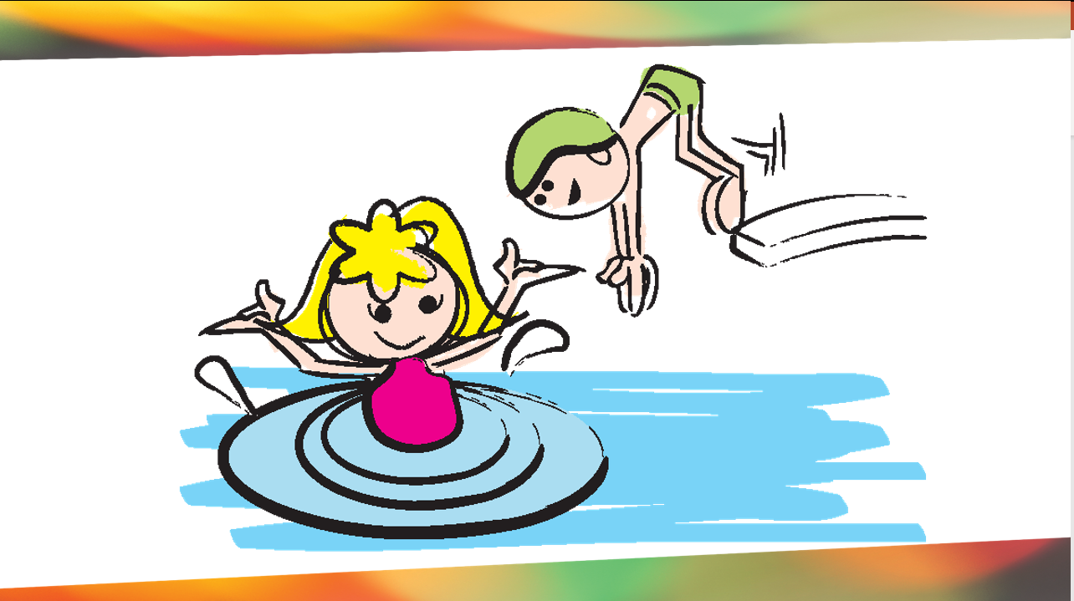
Notes:
FUN COMES FROM ENJOING LIFE MOMENT-BY-MOMENT
Back to the goals. When we spend so much time planning to have fun, we may never get around to having fun. Often the good times spontaneously happen in the margins of life.
When David had the Ark of LORD retruend, after it had been stolen by the Philistines, he broke out in a dance. I dare say David had planned the dance.
We all need routine and order, but Enjoyment often comes when we are open to being interrupted.

Slide 21
I would be more secure if….

Slide 22
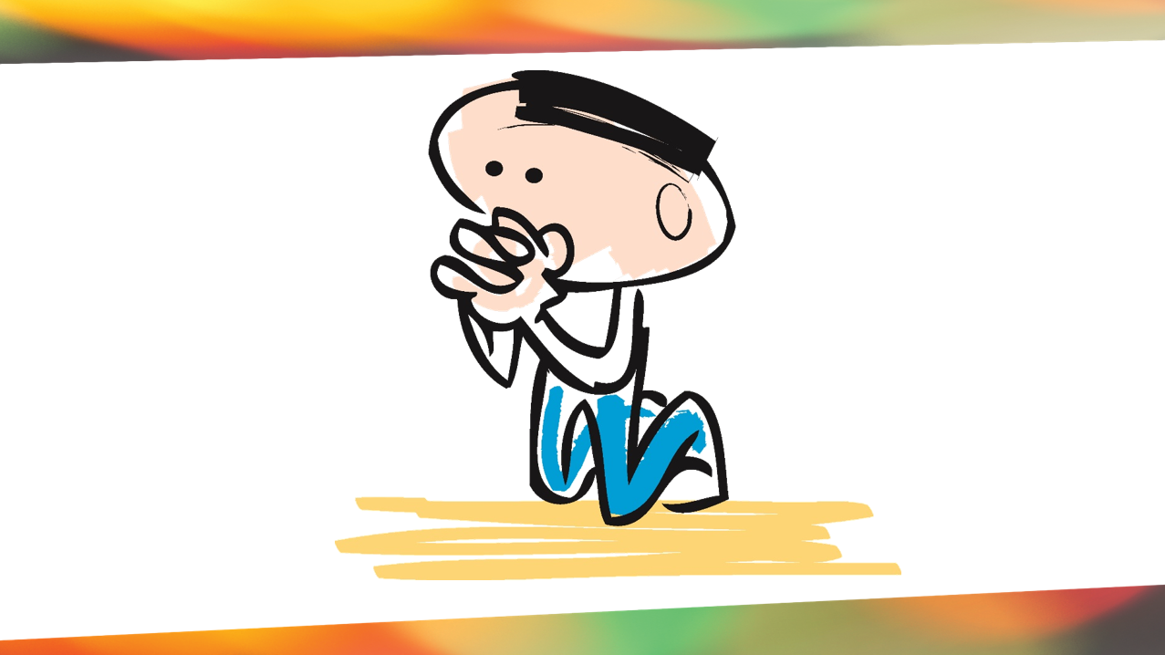
Notes:
SECRUITY COMES FROM FOUCSING ON ETERNAL VALUES
The World has gotten a wakeup call with the COVID 19 Virus. All temporary things seem very insecure..
But Spiritually you can never be more secure that you are right ow. Jesus said in John 27 that no one could snatch us out of His hand. Paul declared that nothing (look at the list!) can separate us from the love of God is Christ (Romans 8:35)

Slide 23
I would have more peace if….

Slide 24
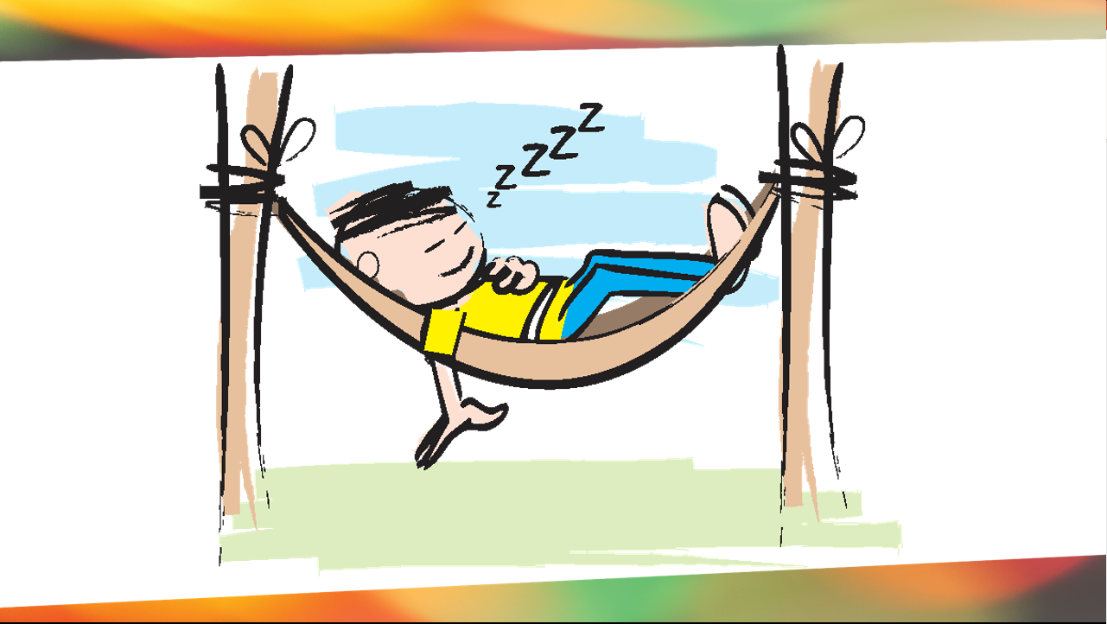
Notes:
PEACE COMES FROM QUIETIING THE INNER STORM
We are to separate not from the world, but for the world. We draw away, just like Jesus to be alone. Sabbath and rest, so we can be fruitful.
It only occurred to me in the past few years that God made man on the 6th day of creation and then rested on the 7th. Mans’s first day was a day of rest. So it is with us.
We should not expect to enjoy the fruit of peace that Jesus Givies (The peace of God) (John 14:27) if we haven’t taken time to cultivate it in our life.

Slide 25
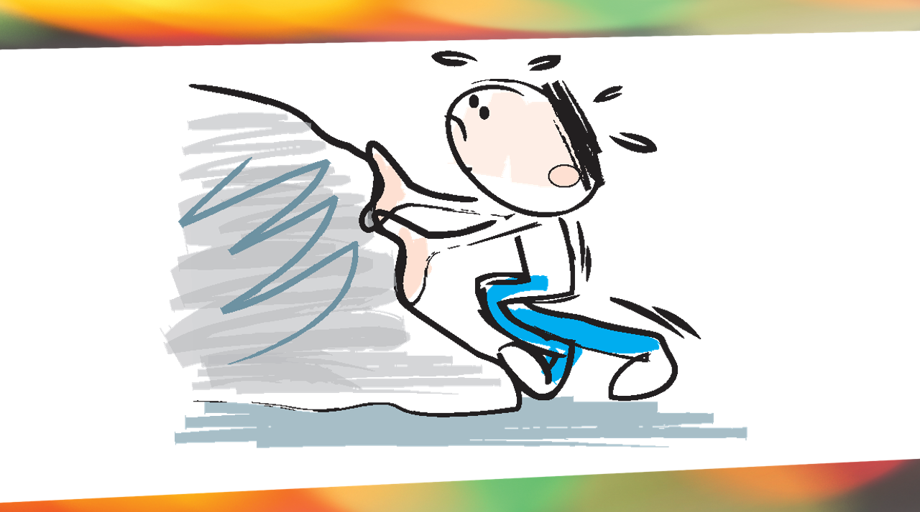
Nothing and no one can stop you from becoming the person God wants you to be!
Genesis 3
Notes:
DIFFICULTIES HELP US TOWARD THE GOAL
You may think that your past or present circumstances are so difficult that they are topping you from becoming the person God wants you to be, but actually the opposite is true.
Paul wrote in Romans 5:3-4 “we know that suffering produces perseverance; perseverance, character; and character, hope.
James offered similar words in James 1:2-4
“Consider it pure joy, my brothers and sisters, whenever you face trials of many kinds, because you know that the testing of your faith produces perseverance. Let perseverance finish its work so that you may be mature and complete, not lacking anything.
So many people FEEL HOPLESS. Marriage gets hard, so we try changing spouses. Others feel their jobs or churches are hopeless so they move on. Only to discover the next spouse, job, church is just as hopeless.
Let me give it to you straight? I’m not saying there is NEVER a time to change, but for most of we need to “STAY and GROW”. If we are running from our own immaturity it will follow us wherever we go
We all desire Mountain top experiences, but the fertile soil of growth is in the valley.

Slide 26
Weekly Sabbath
A Day of Contentment

Slide 27

Notes:
The future is bright. YES we are all going to die. But for a life surrender to Christ we can say with the Apostle Paul “For me to live is Christ and to die is gain.” Phil 1:21
If we try getting our IDENTITY (Significance, Security, and Acceptace ) If we try to get it from anthing or anyone else, in the end we will losue our self, our Soul, our identity. But walk Free in Christ, we can enjoy something we can never loose. Knowing and being Known by the God who created it all and is bring it all to a ultimate conclusion oneday.
Its OK if you don’t feel like you are very far down the road. Maybe you justed started. But you should leave here knowing that nothing and no one can stop you from becoming the peson God wants you to be. Remember its who you are (Character) not what you do that He is after.

Slide 28

https://ficmississippi.org/support/

Slide 29
Dear Heavenly Father, I choose to let go of any disappointments I have developed towards you from establishing wrong goals for my life.
I reject the lie from Satan that you are not good.
I embrace the one life you have given me.
I now recognize that my life is not my own.
Develop in me the Christ-like character you desire for me to have. In Jesus' name, Amen.

Slide 30
Tonight : surrender your life to Jesus and the right he has to you.

Slide 31
³ His divine power has granted to us all things that pertain to life and godliness, through the knowledge of him who called us to his own glory and excellence, ⁴ by which he has granted to us
2 Peter 1:3-5

Slide 32
his precious and very great promises, so that through them you may become partakers of the divine nature, having escaped from the corruption that is in the world because of sinful desire.
2 Peter 1:3-5

Slide 33
2 Peter 1:5-7
⁵ For this very reason, make every effort to supplement your faith with virtue, and virtue with knowledge, ⁶ and knowledge with self-control, and self-control with steadfastness, and steadfastness with godliness, ⁷ and godliness with brotherly affection, and brotherly affection with love.
Genesis 3

Slide 34
2 Peter 5:8-9
⁸ For if these qualities are yours and are increasing, they keep you from being ineffective or unfruitful in the knowledge of our Lord Jesus Christ. ⁹ For whoever lacks these qualities is so nearsighted that he is blind, having forgotten that he was cleansed from his former sins.
Genesis 3

Slide 35

2 Peter 1:5-7
make every effort to supplement your faith with
NIV
Genesis 3
Godliness
mutual affection
love
goodness
knowledge
self-control
perseverance
Notes:
WE already have what w need.
We share God’s nature
Starting with Faith as the foundation.
Now Supplement with these
Here we have a list of character qualities. This is where we begin o understand God’s goal for our lives.
His primary concern is not so much what we DO but what we are LIKE. What we DO will flow from who we ARE
Jesus is the only person who has ever perfectly reflected these character qualities. However GODs will for us is that we be “conformed to the image of his Son” Romans 8:29
That means that God doesn’t want us to look like pictures of Jesus and 30 year old middle eastern man from the 1st century. NO He Wants to change in Character

