Slide 1
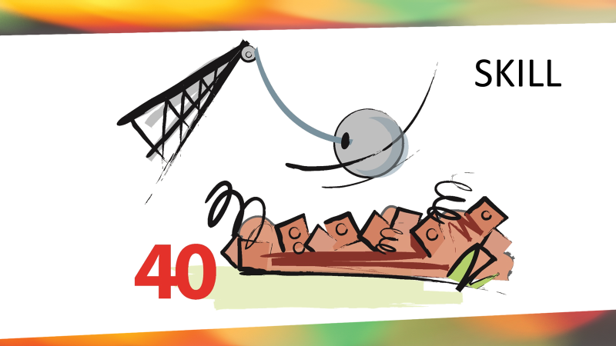
How’s your Stronghold Buster going?

Slide 2
Video
Notes:
It’s not the nail.

Slide 3
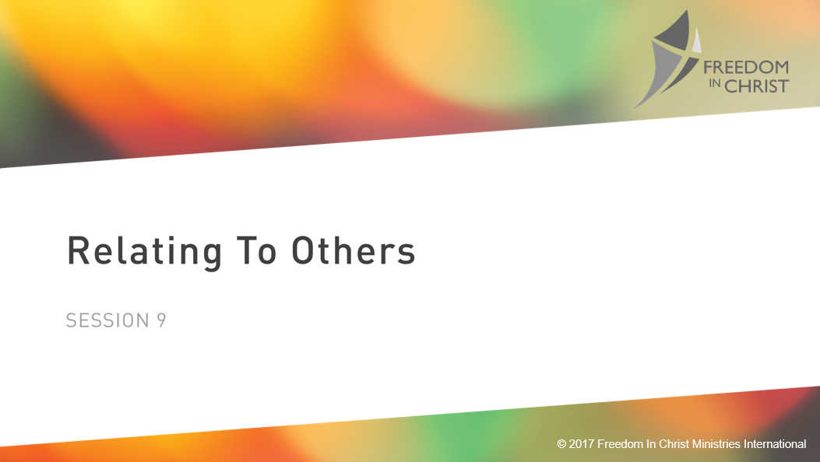

Session 9:
Relating to Others

Slide 4
John 13:34-35
“A new command I give you: Love one another. As I have loved you, so you must love one another. By this everyone will know that you are my disciples, if you love one another.”
Genesis 3
Notes:
JESUS Speaking
This wasn’t new, but People were being spiritual but hatting each other. Not seeking the best for each other. Jesus commandment wasn’t new, but it was new to them.
These teaching aren’t new, they just may be new to you.

Slide 5
1 Peter 4:8
Above all, love each other deeply, because love covers over a multitude of sins.
Genesis 3

Slide 6
1 John 4:20
Whoever claims to love God yet hates a brother or sister is a liar.
Genesis 3

Slide 7
Charity

Slide 8
1 Corinthians 13
⁴ Love is patient, love is kind. It does not envy, it does not boast, it is not proud. ⁵ It does not dishonor others, it is not self-seeking, it is not easily angered, it keeps no record of wrongs.
Genesis 3

Slide 9
1 Corinthians 13
6 Love does not delight in evil but rejoices with the truth. 7 It always protects, always trusts, always hopes, always perseveres.
8 Love never fails.
Genesis 3

Slide 10
The Importance of Love and Unity
in Relationships
Notes:
Being free in our relationship with Jesus allows us to purse healthy relationships. And the bible teaches that a sign of health relationships is having uniy.
Jesus High Priestly Prayer in John 17 for those of us who believe maybe one , as I and the father are one.
John 13:34-35 Love one another, so that all men will know you are my disciples.
Psalm 133 How good and pleasant when God’s people live together in unity
Ephesians 4:3 Paul said “Make every effort to keep the unity of the Spirit through the bond of peace.

Slide 11
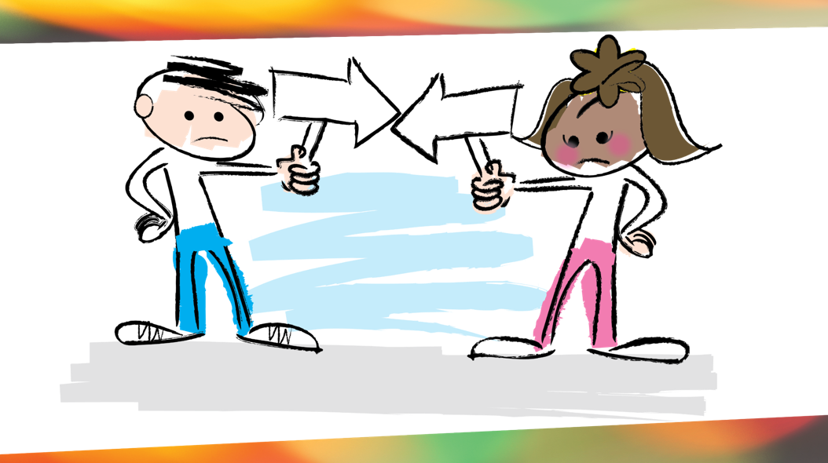
Notes:
Problems begin when our focus becomes controlling other behavior, instead of focusing on our own.
These two are blaming each other for everything. They are focusing on their rights in this relationship, not their responsibilities.
Relationships that stay in this state will either disintegrate and cannot grow in love, closeness, or intimacy

Slide 12
Philippians 2:3-4
in humility value others above yourselves, not looking to your own interest but each of you to the interest of others.
Genesis 3

Slide 13
Romans 14:4
Who are you to judge someone else’s servant? To their own master, servants stand or fall.
Genesis 3

Slide 14
James 3:16
For where jealousy and selfish ambition exist, there will be disorder and every vile practice.
Genesis 3

Slide 15
Notes:
All of this contributes to division.

Slide 16
We Are Responsible For Our Own Character and Other’s Needs
Notes:
Pastor Johnathan Guerry “You Before Me”
We tend to judge ourselves by our intentions and others by their actions. We need to work on the person we see in the mirror each morning. On the character of being the same person on the outside that we are on the inside. To let the Spirit of Jesus permeate us and grow Spiritual Fruit.
And we see in others some difference in their intentions and their actions we should be GRACEFUL recognizing that we ourselves have those same discrepancies.
Not only do I have no right to expect my needs to be meet by others, I have a responsibility to meet their needs.

Slide 17

Let’s focus on responsibilities vs rights in the following relationships:
Employee, Church Member,
Spouse, Parent, Child
Notes:
Speed Round. Use white board. Give then 2 minutes and then lets list them as a large group.

Slide 18
Judgment (Character), No
BUT…
Discipline (Behavior), Yes
Notes:
Jesus was clear that while we shouldn’t judge character, we are to discipline bad behavior, in society, in the church, in the family

Slide 19
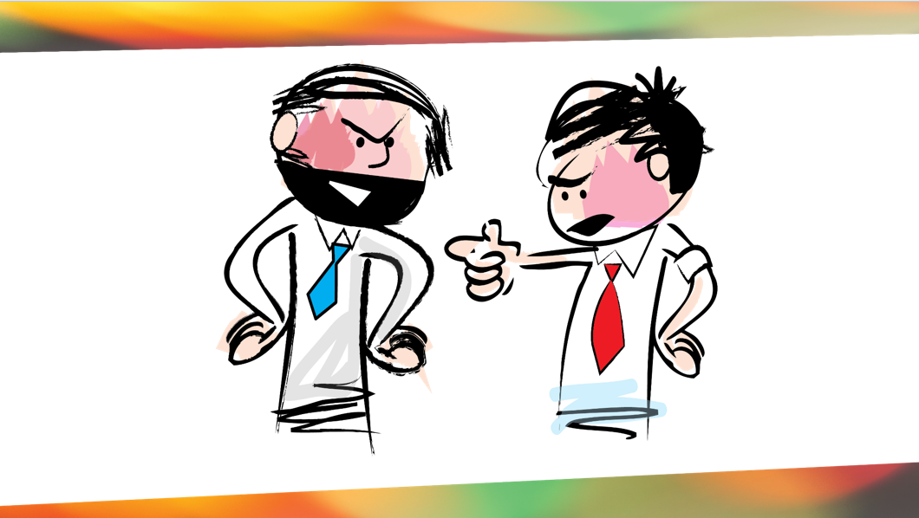
Notes:
For example suppose I catch a fellow Christian telling an obvious law in a confront them. I could say “you're a liar!” But that would be judgment because I have questioned their character. It would be much better to ask “Did you just tell a lie?
“that calls to attention their behavior not their character. Better yet you might continue with “you know you're not a liar why would you tell a lie” The truth is they are a child of God who just acted out of character.
The first expression implies they have a character of a liar at their core . It doesn't give them the power to change and puts them on a defensive posture. To call out their behavior is to point out something that is sinful behavior that they can change.
Any Comments on this one?
So lets talk about being defensive. WE OFTEN FAIL TO LISTEN BECAUSE WE ARE TRYING TO DEFNED OURSELVES.

Slide 20
Because we often confuse critique with character we can wrongly defend ourselves.
Notes:
See Freedom Mississippi Resouces and look for Document on False and Unhealthly Ways we defend ourselves.

Slide 21
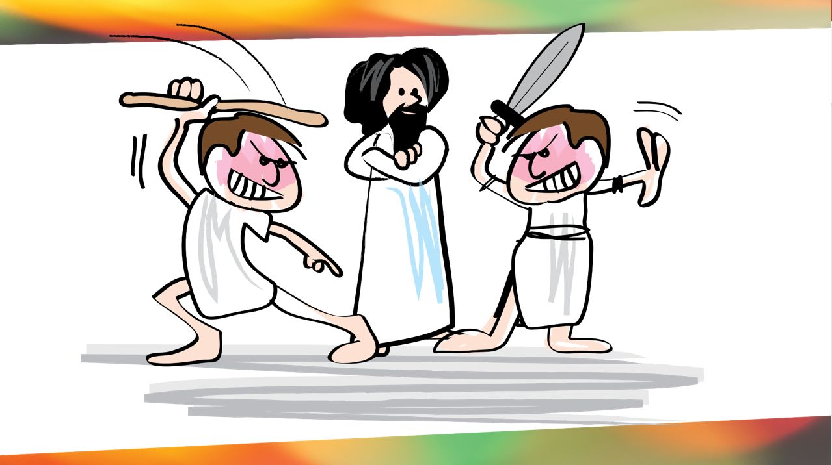
Notes:
Pull up wrong ways we defend ourselves.

Slide 22
When Accused We Either:
Don’t have a defense (apologize)
Don’t need a defense
Notes:
The reason we know of our identity with God we can deal with our sin and the behavior level and not the character level.
See Freedom Mississippi Resources and look for Document on False and Unhealthily Ways we defend ourselves.
Jesus said changed Sauls name to Peter (rock) before he had what it took.
American Standard of Romans 4:17

Slide 23
How can not reacting defensively create an opportunity to help someone who is being difficult?
Notes:
1 Peter 2:23
“When they hurled insults at him, he did not retaliate; when he suffered, he made no threats. Instead, he entrusted himself to him who judges Justly”
Romans 12:18 If it is possible, as far as it depends on you, live at peace with everyone”.
Note as far as it depends on you. It’s not always possible. We live in a fallen world. We won’t always have happy harmonious relationships with others.
CONFLICT is a normal pat of life. Expect it.
But its how we handle it that can redeem it.

Slide 24
In Closing ☺
Notes:
1 Peter 2:23
“When they hurled insults at him, he did not retaliate; when he suffered, he made no threats. Instead, he entrusted himself to him who judges Justly”
Romans 12:18 If it is possible, as far as it depends on you, live at peace with everyone”.
Note as far as it depends on you. It’s not always possible. We live in a fallen world. We won’t always have happy harmonious relationships with others.
CONFLICT is a normal pat of life. Expect it.
But its how we handle it that can redeem it.

Slide 25
I dethrone God in my heart if I demand that He act in ways that satisfy my idea of justice. It is the same spirit that taunted,
"If Thou be the Son of God, come down from the Cross."
Genesis 3

Slide 26
There is unbelief, there is even rebellion, in the attitude that says,
"God has no right to do this!”
But God is God. And if He is God,
He is worthy of my worship and my service.
Genesis 3

Slide 27
I will find rest nowhere but in His will, and that will is infinitely, immeasurably, unspeakably beyond my largest notions of what He is up to.”
― Elisabeth Elliot
Genesis 3

Slide 28

Notes:
Adrian Rodgers. Story… The Me I See, is the Me I’ll Be
He thought his emotions got away with him.

Slide 29

The Road Ahead
LIFE GOALS

Slide 30
Before Session 10
Complete Survey on page 184

Slide 31
Dear Heavenly Father, I choose to let go of any disappointments I have developed towards you from establishing wrong goals for my life.
I reject the lie from Satan that you are not good.
I embrace the one life you have given me.
I now recognize that my life is not my own.
Develop in me the Christ-like character you desire for me to have. In Jesus' name, Amen.

