Slide 1
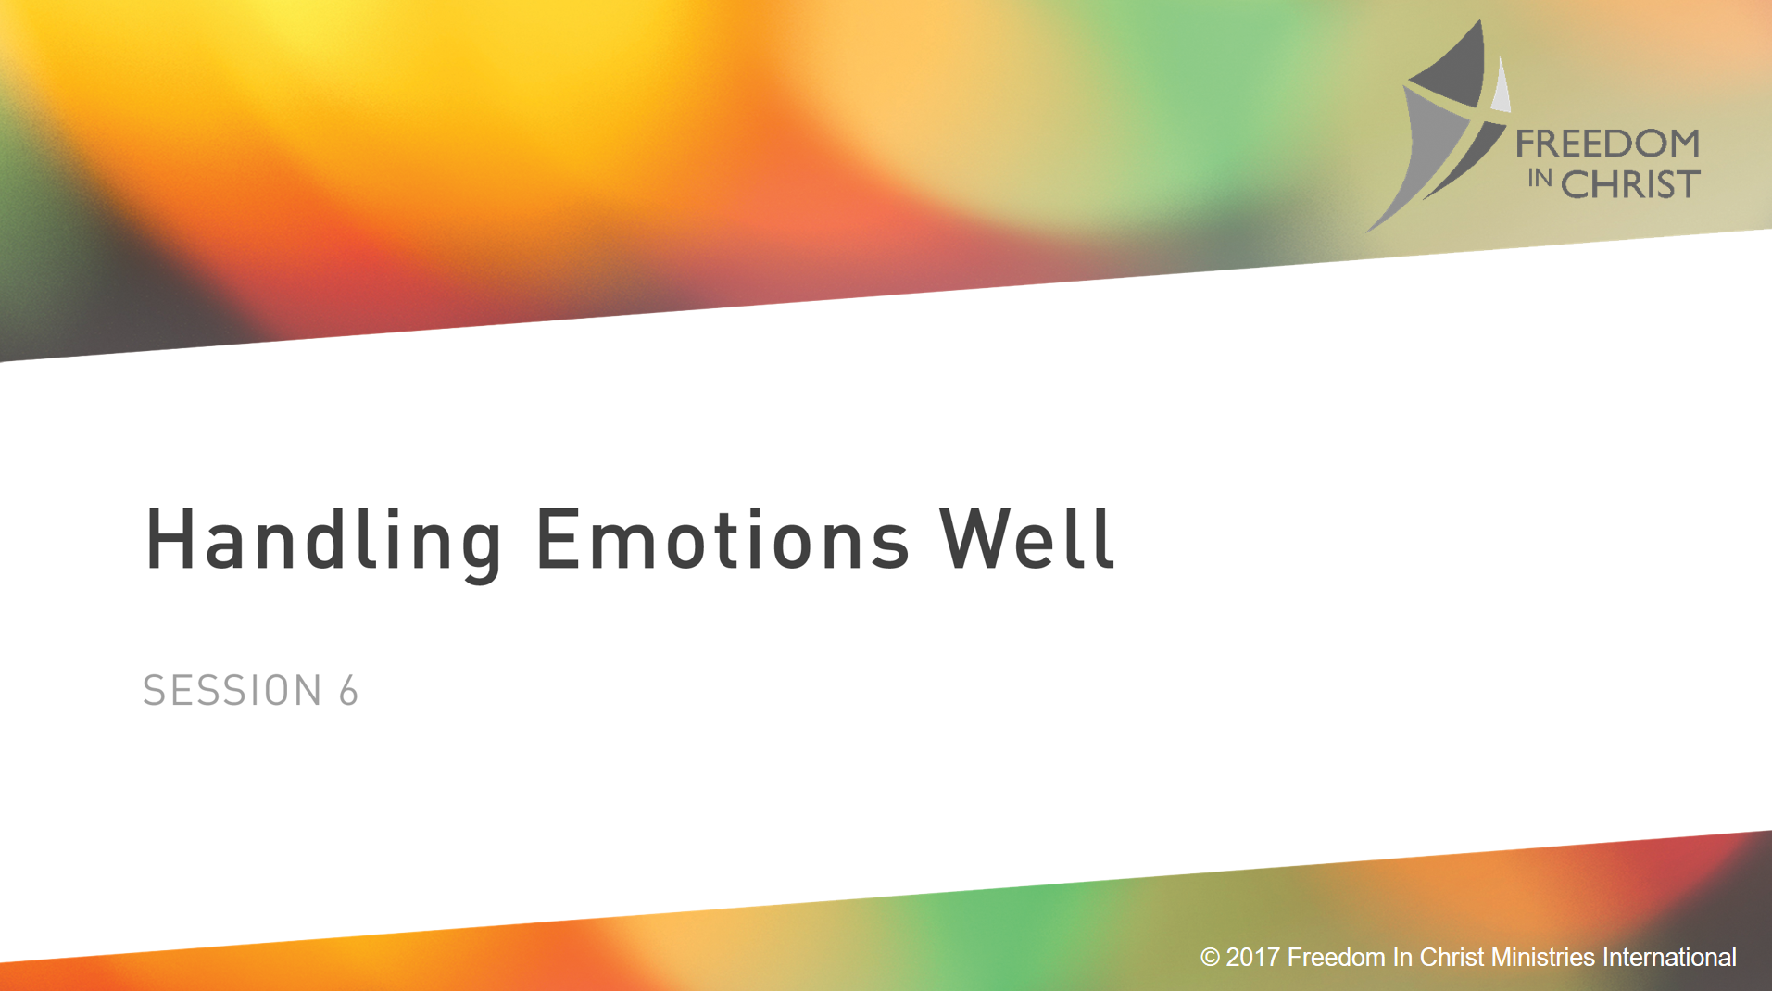
Page 95
Notes:
Adrian Rodgers. Story… The Me I See, is the Me I’ll Be
He thought his emotions got away with him.

Slide 2
Heavenly Father, too often I have allowed my emotions to rule my life. The truth is that you care for me, so tonight I choose to trust you and to cast all of my anxieties on you (1 Peter 5:7).
I recall to my mind that you are for me and not against me (Romans 8:31) . I now focus my attention on your love for me and the power of your promises. In Jesus Name, Amen

Slide 3
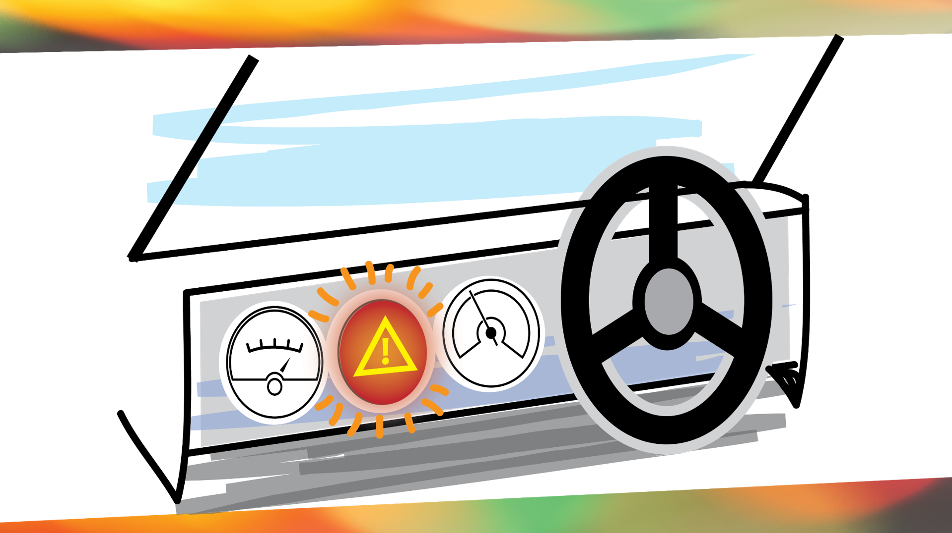

Slide 4
The Bible Describes God with Emotional Language
God is a jealous God (Ex 34:14)
You can grieve the Holy Spirit (Eph 4:30
Jesus wept (John 11:35)
Genesis 3

Slide 5
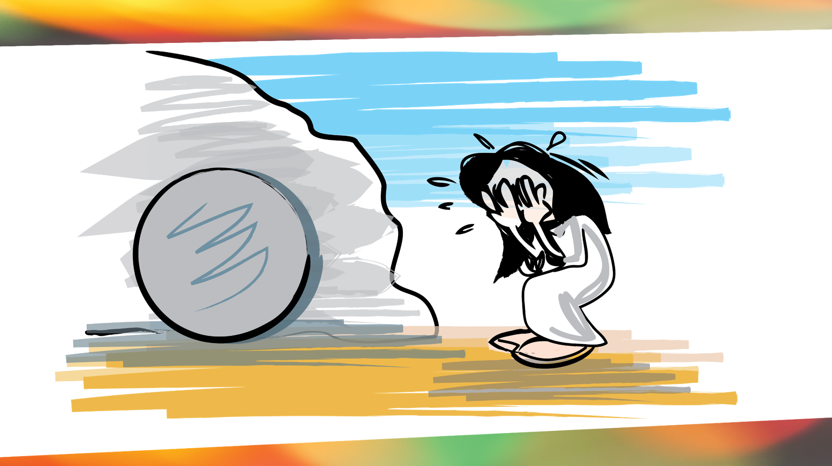
Notes:
^{We are emotional creatures}
^{John 20:}
¹¹ Now Mary stood outside the tomb crying. As she wept, she bent over to look into the tomb ¹² and saw two angels in white, seated where Jesus’ body had been, one at the head and the other at the foot.
¹³ They asked her, “Woman, why are you crying?”
“They have taken my Lord away,” she said, “and I don’t know where they have put him.” ¹⁴ At this, she turned around and saw Jesus standing there, but she did not realize that it was Jesus.
¹⁵ He asked her, “Woman, why are you crying? Who is it you are looking for?”
Thinking he was the gardener, she said, “Sir, if you have carried him away, tell me where you have put him, and I will get him.”
¹⁶ Jesus said to her, “Mary.”
She turned toward him and cried out in Aramaic, “Rabboni!” (which means “Teacher”).

Slide 6
“If what you believe does not reflect the truth, then what you feel won’t reflect reality.”
Genesis 3

Slide 7

There Are No Apps for Emotions
Notes:
There is no app that will allow you to directly control you emotions.
Although we can’t control emotions directly, what we feel is a general sense of the results of what we believe or CHOOSE to think.

Slide 8
Circumstances + Beliefs= Emotions
Genesis 3
Notes:
Which one of these do you have direct control over?
C(Circumstances)+B(Beliefs)=E(Feelings)
Example: Company downsizing. You get an email saying you of a meeting schedule with your boss for the end of the week. You get angry on Wednesday, Depressed on Thursday, Scared on Friday. Congrats were giving you a raise. Since your feelings are based falsehood you live in reality

Slide 9
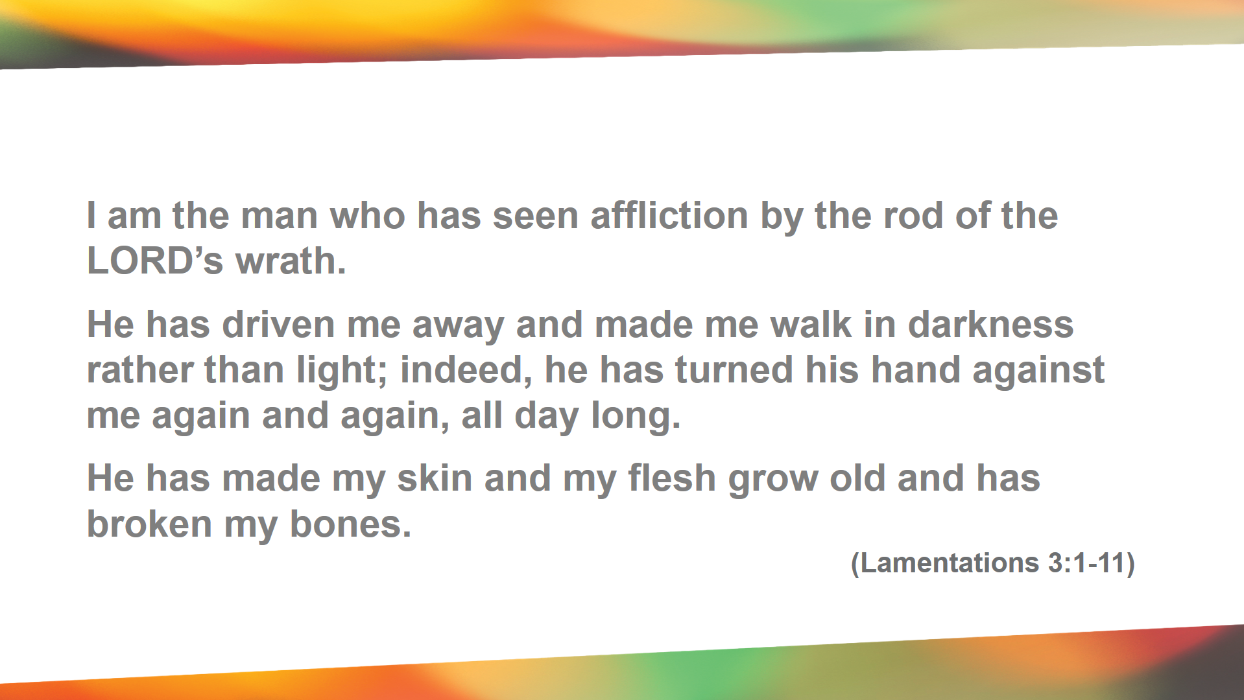

Slide 10
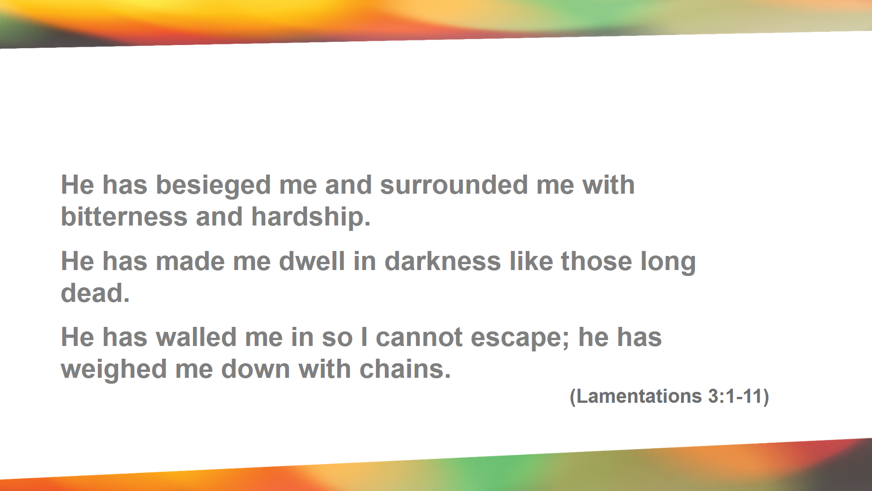

Slide 11
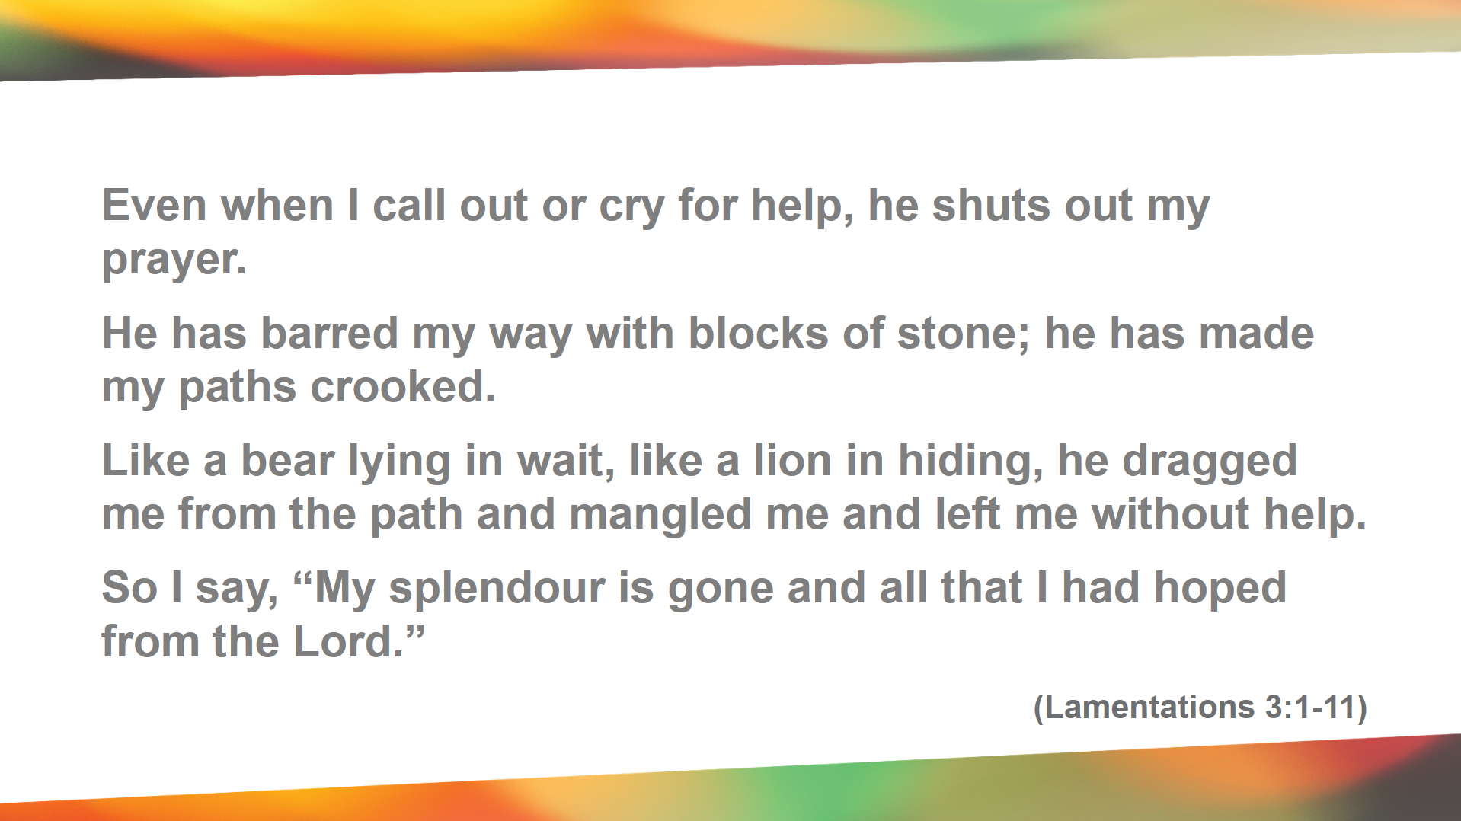

Slide 12
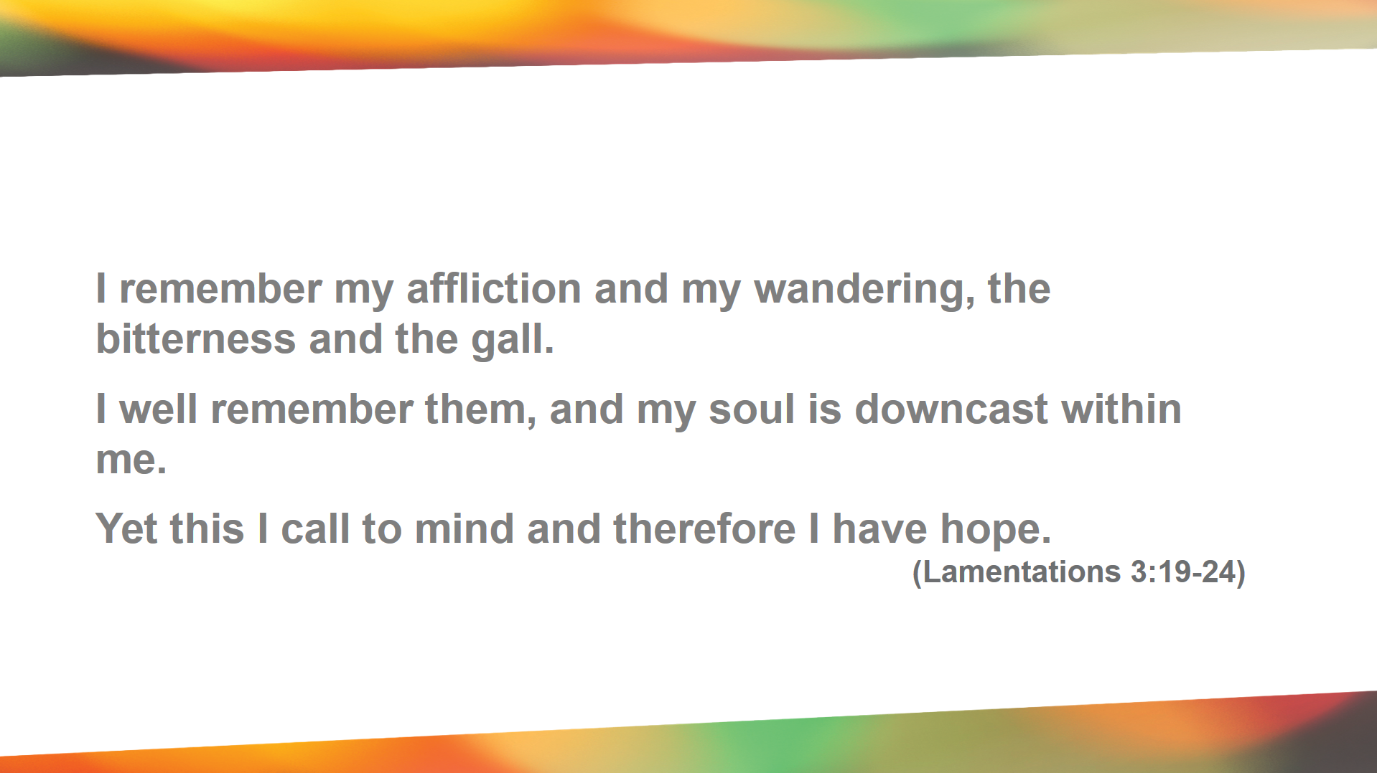

Slide 13


Slide 14
Circumstances + Beliefs= Emotions
Genesis 3
Notes:
Which one of these do you have direct control over?
C(Circumstances)+B(Beliefs)=E(Feelings)
Example: Company downsizing. You get an email saying you of a meeting schedule with your boss for the end of the week. You get angry on Wednesday, Depressed on Thursday, Scared on Friday. Congrats were giving you a raise. Since your feelings are based falsehood you live in reality

Slide 15
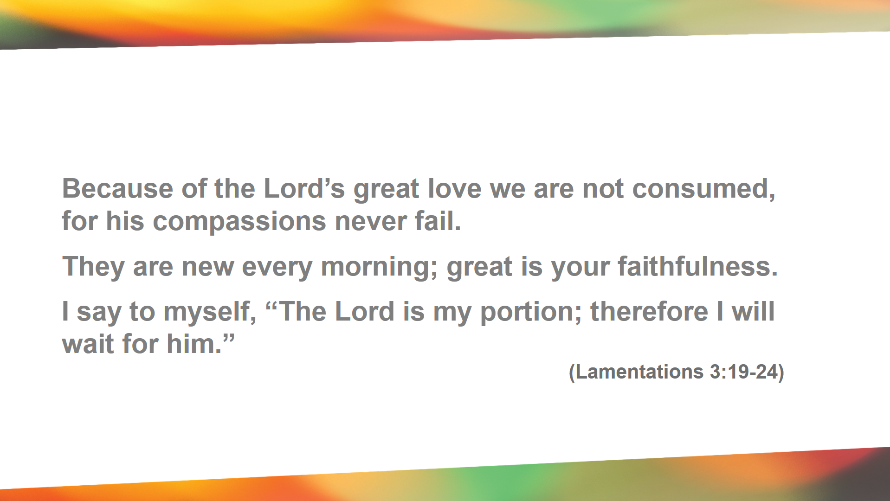
Notes:
This is why we preach identity. This is why you must fight you feelings with words of truth. We can’t do it for each other. WE must do war with thse emtions and thought and fight them with the WORD of TRUTH!

Slide 16

Pause for Thought
Why is it difficult to believe truth during emotional situations?

Slide 17
Freedom Video Teaching
Genesis 3

Slide 18
Discuss this statement
“Children of God are not primarily products of their past In contrast, they are products of Christ’s work on the cross and His resurrection. Nobody can change our past, but we can choose to walk free from it.”

Slide 19
NEXT WEEK
Keys to Emotional Health
Knowing God as Father
Genesis 3

Slide 20
Review Last Week
Handling Emotions Well
Genesis 3

Slide 21
Notes:
^{We are emotional creatures}
^{John 20:}
¹¹ Now Mary stood outside the tomb crying. As she wept, she bent over to look into the tomb ¹² and saw two angels in white, seated where Jesus’ body had been, one at the head and the other at the foot.
¹³ They asked her, “Woman, why are you crying?”
“They have taken my Lord away,” she said, “and I don’t know where they have put him.” ¹⁴ At this, she turned around and saw Jesus standing there, but she did not realize that it was Jesus.
¹⁵ He asked her, “Woman, why are you crying? Who is it you are looking for?”
Thinking he was the gardener, she said, “Sir, if you have carried him away, tell me where you have put him, and I will get him.”
¹⁶ Jesus said to her, “Mary.”
She turned toward him and cried out in Aramaic, “Rabboni!” (which means “Teacher”).

Slide 22
“If what you believe does not reflect the truth, then what you feel won’t reflect reality.”
Genesis 3

Slide 23
Circumstances + Beliefs= Emotions
Genesis 3
Notes:
Which one of these do you have direct control over?
C(Circumstances)+B(Beliefs)=E(Feelings)
Example: Company downsizing. You get an email saying you of a meeting schedule with your boss for the end of the week. You get angry on Wednesday, Depressed on Thursday, Scared on Friday. Congrats were giving you a raise. Since your feelings are based falsehood you live in reality

Slide 24
Quick Question
What are the dangers of not handling emotions well?

Slide 25
2 Peter 5:7-8
⁷ casting all your anxieties on him, because he cares for you.
Genesis 3

Slide 26
2 Peter 5:7-8
⁷ casting all your anxieties on him, because he cares for you. ⁸ Be sober-minded; be watchful. Your adversary the devil prowls around like a roaring lion, seeking someone to devour.
Genesis 3

Slide 27
2 Corinthians 2:10-11
what I have forgiven, if I have forgiven anything, has been for your sake in the presence of Christ, ¹¹ so that we would not be outwitted by Satan; for we are not ignorant of his designs.
Genesis 3

Slide 28
Three Keys to Emotional Health
Be Emotionally Honest
Know Who you are in Christ
Commit to Believing the Truth
Genesis 3

Slide 29
Three Keys to Emotional Health
Be Emotionally Honest
Commit to Believing the Truth
Know Who you are in Christ
Genesis 3

Slide 30
Be Emotional Honest
Don’t Cover it Up (Suppression)
Don’t Explode (unhealth expression)
Do Be Honest (acknowledgement)
Genesis 3
Notes:
Psalm 109:6-15

Slide 31
Three Keys to Emotional Health
Be Emotionally Honest
Commit to Believing the Truth
Know Who you are in Christ
Genesis 3

Slide 32
God does not want emotional pain from our past to influence us negatively today.
Nobody can change our past, but we can choose to walk free from it.”

Slide 33
Pause for Thought
How can past experiences lead us to believe lies about our self, God, & Satan?

Slide 34
OBJECTION
“You don’t know what’s been done to me.”
TRUTH
It doesn’t change who you are in Christ.
Notes:
Recognize Shame

Slide 35
OBJECTION
“You don’t know what I’ve done.”
TRUTH
It doesn’t change who you are in Christ.
Notes:
Recognize Guilt

Slide 36
OBJECTION
“You don’t know how I’ve failed as a Christian.”
TRUTH
Christ loved you when you were still a sinner. That hasn’t stopped now that you’re His.
.

Slide 37
OBJECTION
“But I’m scared I will fail again in a major way.”
TRUTH
When Christ died once for all our sins (Romans 6:10) How many of your sins were yet to be committed?
.
Notes:
Recognize Fear

Slide 38
OBJECTION
Wouldn’t I be filled with pride if I believed these things about myself?”
No you won’t be prideful if you believe these truths, but you WILL be defeated if you don’t believe them.
TRUTH

Slide 39
FREEDOM BONDAGE
Feelings
Truth
Belief
Disobedience
Truth
Belief
Obedience
Feelings

Slide 40
Hold on to the TRUTH!
You don’t feel your way into proper beliefs. You believe your way into proper feelings.

Slide 41
“Children of God are not primarily products of their past In contrast, they are products of Christ’s work on the cross and His resurrection.

Slide 42
Three Keys to Emotional Health
Be Emotionally Honest
Commit to Believing the Truth
Know Who you are in Christ
Genesis 3
Notes:
Christ revealing God as Father.

Slide 43
Pause for Thought
Describe the kind of relationship that you have with your Dad?

Slide 44
How has your relationship with Dad effected your relationship with your “Heavenly Father?
Pause for Thought

Slide 45
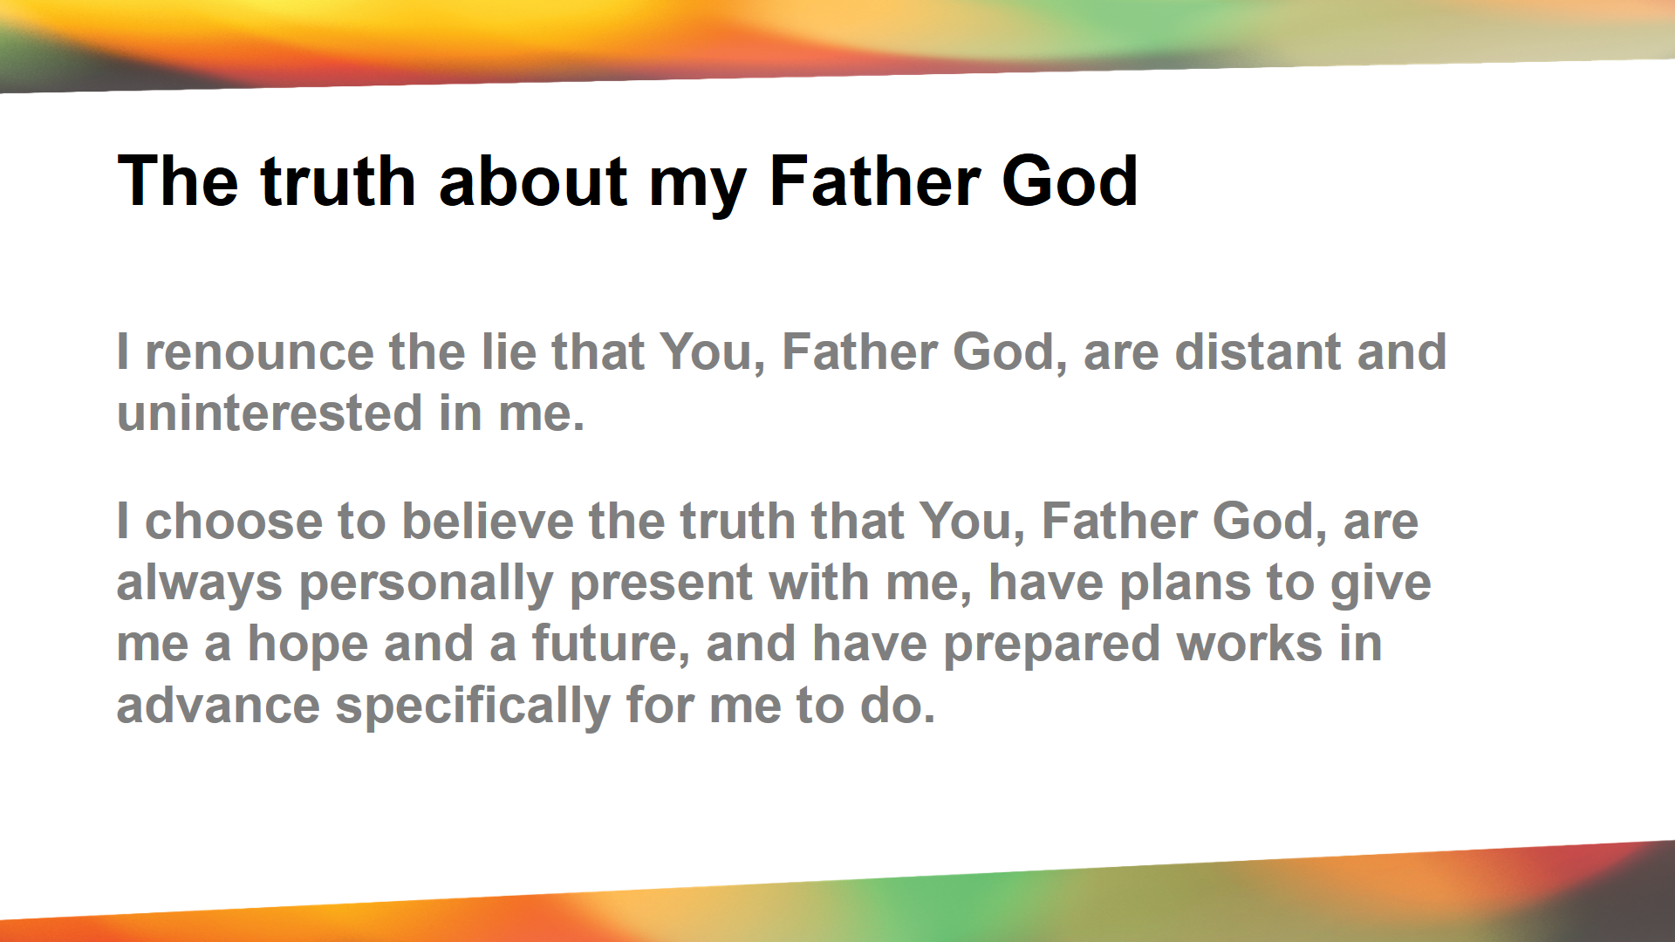

Slide 46
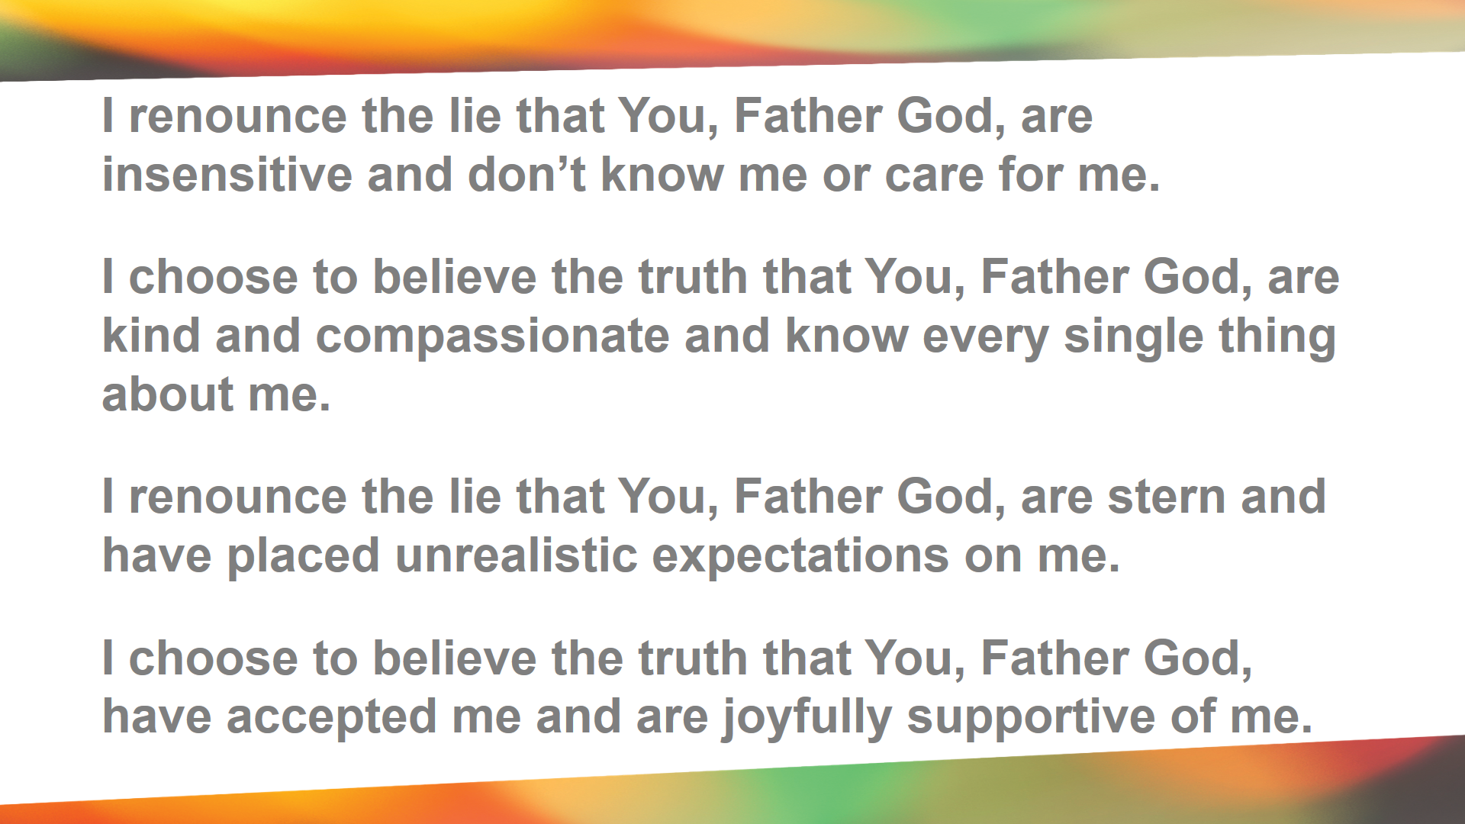

Slide 47
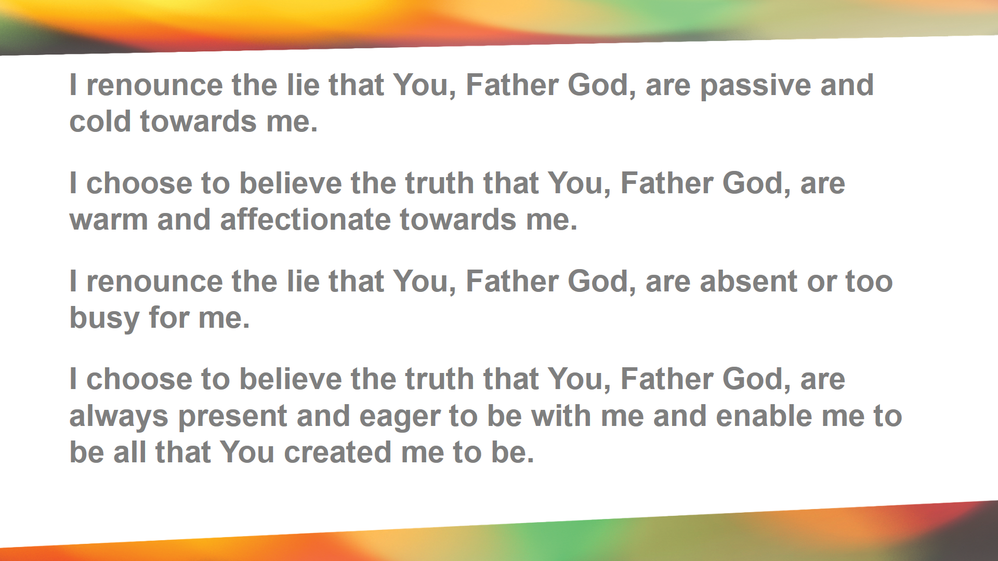

Slide 48
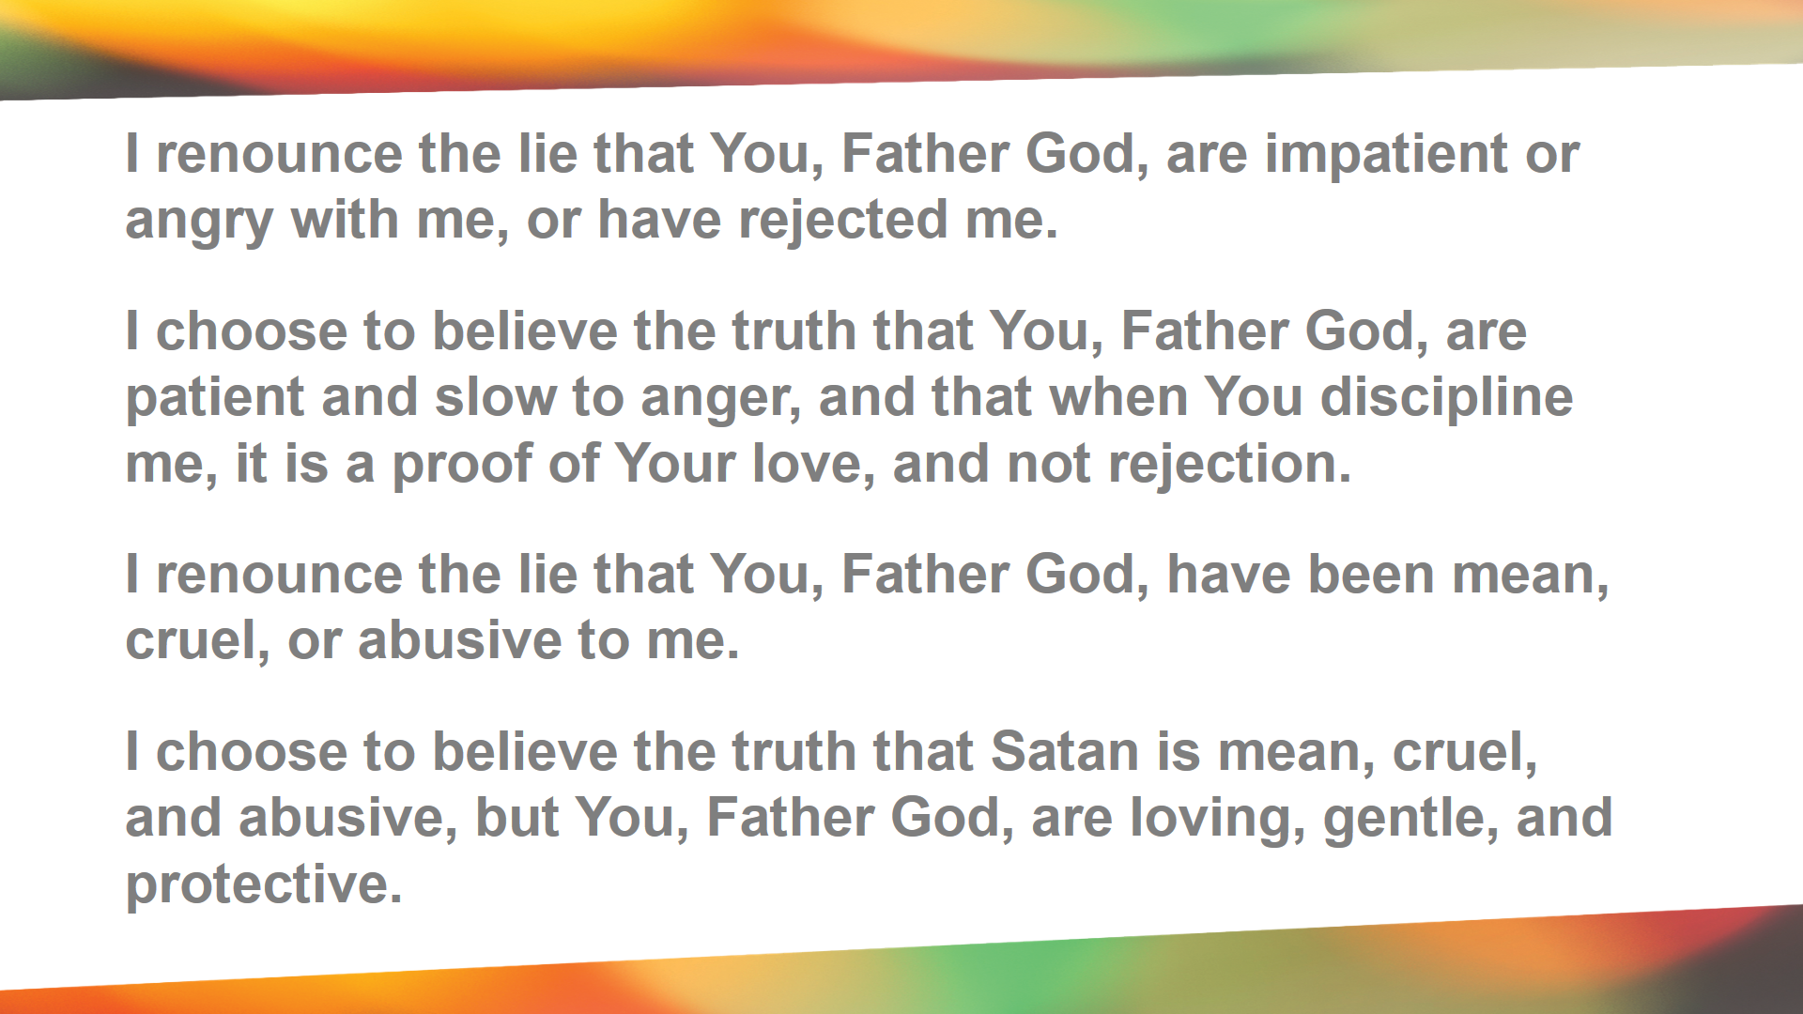

Slide 49
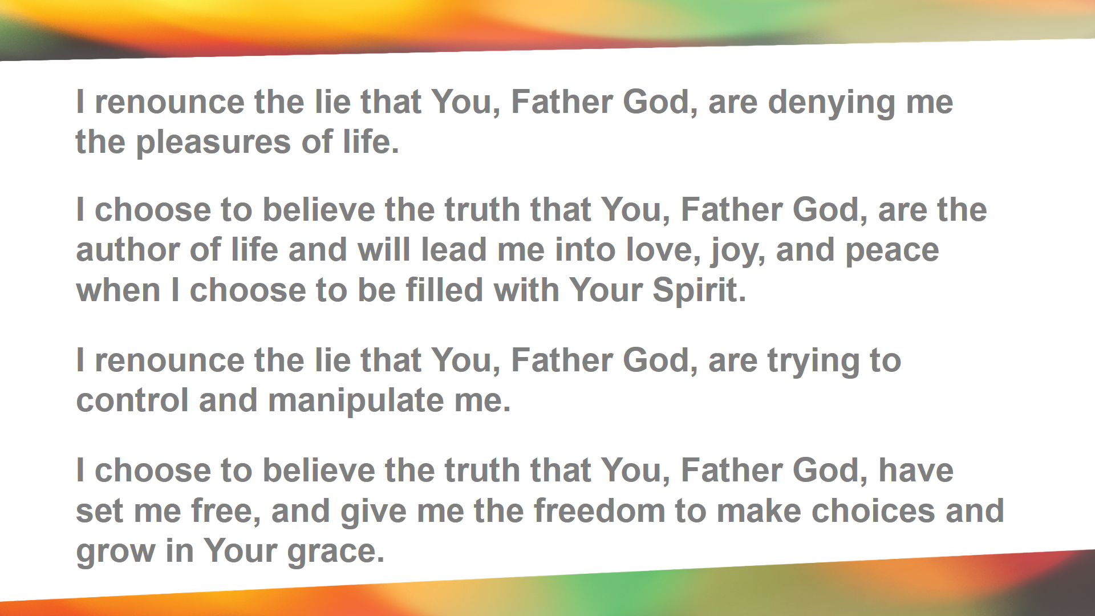

Slide 50
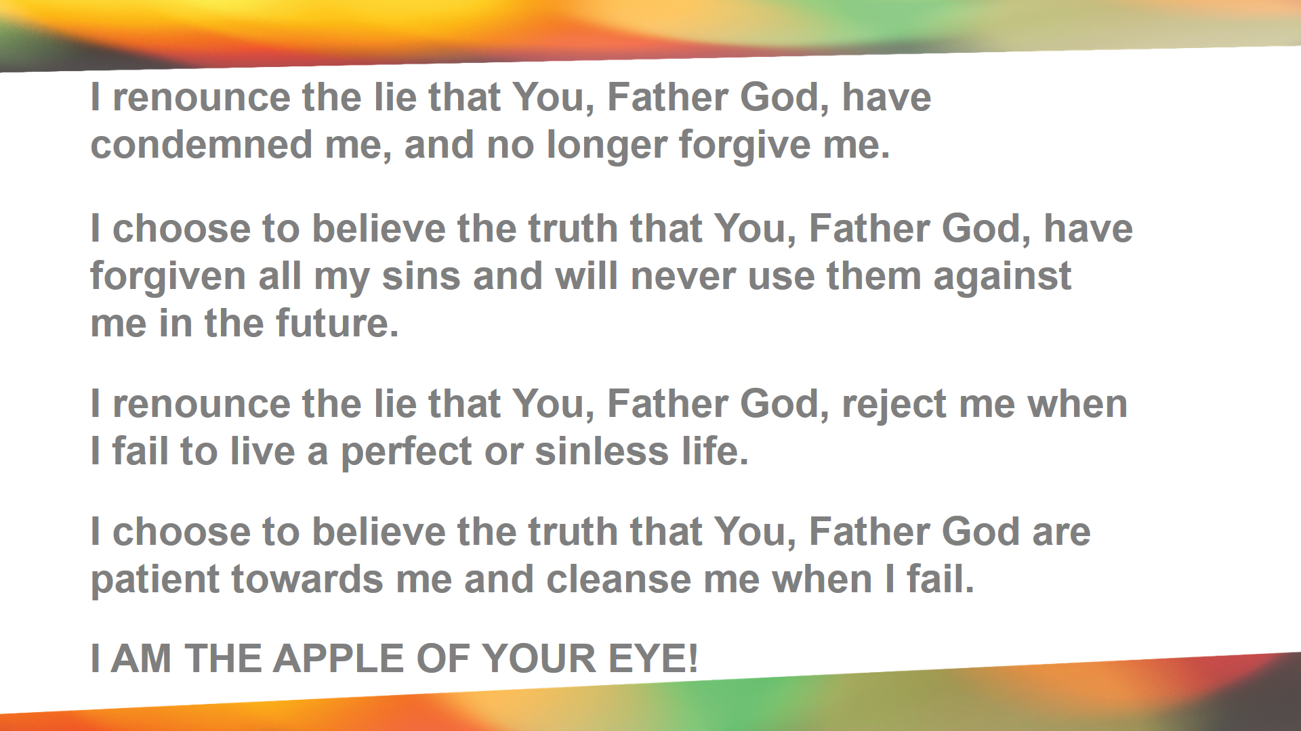

Slide 51
FREEDOM IN CHRIST
Yet to all who received him, to those who believed in his name, he gave the right to become children of God-- ¹³ children born not of natural descent, nor of human decision or a husband's will, but born of God. John 1:12-13 (NIV)

Slide 52
FREEDOM IN CHRIST
How great is the love the Father has lavished on us, that we should be called children of God! And that is what we are! The reason the world does not know us is that it did not know him. ² Dear friends, now we are children of God, and what we will be has not yet been made known. But we know that when he appears, we shall be like him, for we shall see him as he is. 1 John 3:1-2 (NIV)

Slide 53
¹⁵ For you did not receive a spirit that makes you a slave again to fear, but you received the Spirit of sonship. And by him we cry, "Abba, Father." ¹⁶ The Spirit himself testifies with our spirit that we are God's children. ¹⁷ Now if we are children, then we are heirs--heirs of God and co-heirs with Christ, if indeed we share in his sufferings in order that we may also share in his glory. Romans 8:15-17 (NIV)

Slide 54
¹⁷ Every good and perfect gift is from above, coming down from the Father of the heavenly lights, who does not change like shifting shadows. ¹⁸ He chose to give us birth through the word of truth, that we might be a kind of first fruits of all he created. James 1:17-18 (NIV)

Slide 55
Our father you art in heaven
Mat 7:11 How much more will your heavenly father give good gifts

