Slide 1


Slide 2
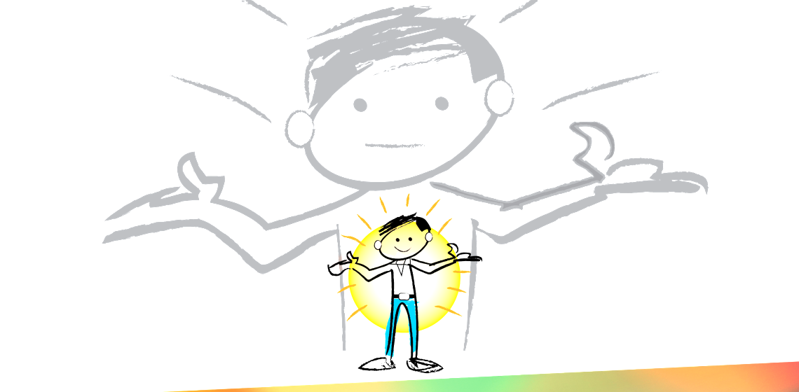
Heavenly Father, tonight I choose to take responsibility for the life you have given me. Please reveal to me any lies that I wrongly believe. Show me how break old thought patters and
to make the daily choice to believe your truth.
Fill me with your Spirit. I believe that my freedom comes from you alone.
In Jesus Name, Amen
Genesis 3
Notes:
We were created with this God given needs. Eve before sin entered the world these are legitimate needs that are at the core of us. Men and women are searching for these. All social media post are answering these needs. These are not wrong, but as we will see how we go about trying to get this meet are the root cuase of much of our struggle.

Slide 3


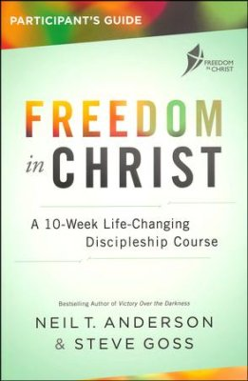
^{Sessions}
A
Who Am I?
Choosing to Believe the Truth
The World’s View of Truth
Our Daily Choice p.64
The Battle For Our Minds
Handling Emotions Well
Forgiving from the Heart
Renewing the Mind
Relating To Others
What Next?
B
C
D
Notes:
P33 Who I am Statements
P44 Twenty Cans of Faith

Slide 4
Why Do We Struggle?
The World (System)
The Flesh (Our Old Patterns)*
The Devil (Fallen Spiritual Beings)

Slide 5
What Changed
Genesis 3
New Spirit
New Life
New Boss of Me
Notes:
Go over Who I Am In Christ. Identity is about being not doing. Most of our teaching can be all about doing.
IF YOU AREN”T SICK OF SAYING IT THEY PROBOBLY HAVEN”T HEARD YOU. (Kids and employees)

Slide 6
"Until we know our position (our identity) in the risen Lord Jesus, we can never really face up to the sinfulness of our old man. But “hidden with Christ in God,” we can both face up to and face away from our sin.” JB Stoney
Genesis 3
Notes:
We were created with this God given needs. Eve before sin entered the world these are legitimate needs that are at the core of us. Men and women are searching for these. All social media post are answering these needs. These are not wrong, but as we will see how we go about trying to get this meet are the root cuase of much of our struggle.

Slide 7
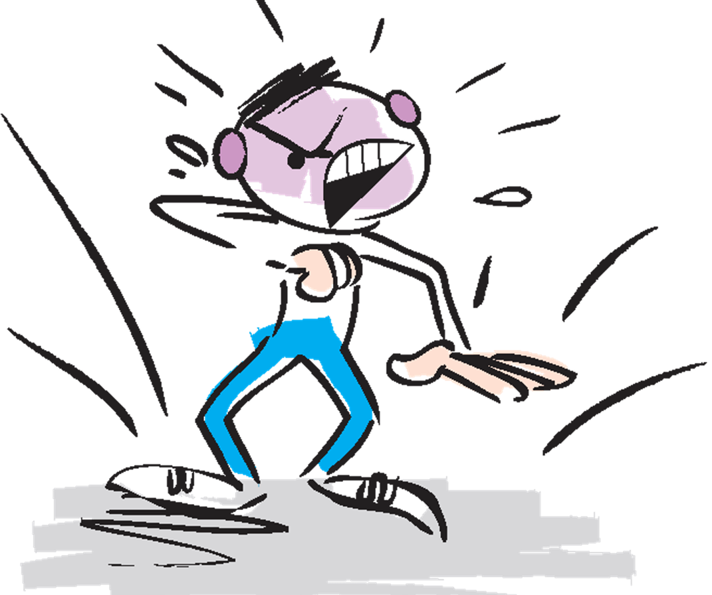
What Did Not Change
Our Flesh Was Not Taken Away
Flesh-Not
“Sinful Nature”
Notes:
Old Nature
Old Man
Adam
Behavior patters developed over time.

Slide 8
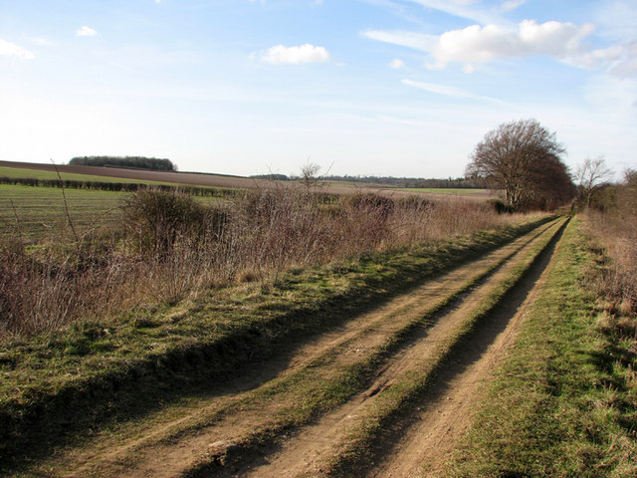
Genesis 3
Notes:
We grew up independent of God. Learned Indepedance.
We learned to react , cope and think without God.
When you come to Christ your Spirit is born again, You are a new person. But your Flesh, which is informed by your thinking. You maybe a believe but you still have things in your deleted items bin of your mind, that can’t be permantely removed. God’s answer to is overwrite your memories by how you think and we will talk about this more next week.

Slide 9
What Did Not Change
Our Flesh Was Not Taken Away
Sin Did Not Die
Notes:
The end of a relationship, but not of an existence. I still have memories. Good and Bad
When my grandfather died withn I was 13, that was the end of our relationship in this life, but not the end of what had existed with him.
I still have memories of him of holding his had in his hospital bed. Those are very real to me and when I think about them they effect me. But he died
We died to sin, but sin still exists it is still familiar to us.

Slide 10
FREEDOM IN CHRIST Romans 7
14 For we know that the law is spiritual, but I am of the flesh, sold under sin. 15 For I do not understand my own actions. For I do not do what I want, but I do the very thing I hate. 16 Now if I do what I do not want, I agree with the law, that it is good. 17 So now it is no longer I who do it, but sin that dwells within me.
Notes:
Chrisitans are no longer in the flesh (or in Adam) they are in the Spriti (In Christ);
But as we’ve seen we can live according to the flesh.

Slide 11
FREEDOM IN CHRIST Romans 7
18 For I know that nothing good dwells in me, that is, in my flesh. For I have the desire to do what is right, but not the ability to carry it out. 19 For I do not do the good I want, but the evil I do not want is what I keep on doing. 20 Now if I do what I do not want, it is no longer I who do it, but sin that dwells within me.
The Holy Bible: English Standard Version. (2016). (Ro 7:18–20). Wheaton, IL: Crossway Bibles.
Notes:
Chrisitans are no longer in the flesh (or in Adam) they are in the Spriti (In Christ);
But as we’ve seen we can live according to the flesh.

Slide 12
FREEDOM IN CHRIST Romans 7
21 So I find it to be a law that when I want to do right, evil lies close at hand. 22 For I delight in the law of God, in my inner being, 23 but I see in my members another law waging war against the law of my mind and making me captive to the law of sin that dwells in my members. 24 Wretched man that I am! Who will deliver me from this body of death?
The Holy Bible: English Standard Version. (2016). (Ro 7:21–24). Wheaton, IL: Crossway Bibles.
Notes:
Chrisitans are no longer in the flesh (or in Adam) they are in the Spriti (In Christ);
But as we’ve seen we can live according to the flesh.

Slide 13

Pause for Thought
Have you ever experienced conflicted desires like the Apostle Paul expressed in Romans Chapter 7? How do competing desires (flesh vs. Spirit) make a person feel?
Notes:
Amazing Grace and “Saved a Wretch Like Me”

Slide 14
Wretch: Definition
a miserable person : one who is profoundly unhappy or in great misfortune. 2 : a base, despicable, or vile person.

Slide 15
Works of the Flesh
Galatians
5:19-21
(The Message)
Notes:
Galatians 5:19-21
¹⁹⁻²¹ It is obvious what kind of life develops out of trying to get your own way all the time: repetitive, loveless, cheap sex; a stinking accumulation of mental and emotional garbage; frenzied and joyless grabs for happiness; trinket gods; magic-show religion; paranoid loneliness; cutthroat competition; all-consuming-yet-never-satisfied wants; a brutal temper; an impotence to love or be loved; divided homes and divided lives; small-minded and lopsided pursuits; the vicious habit of depersonalizing everyone into a rival; uncontrolled and uncontrollable addictions; ugly parodies of community. I could go on.
This isn’t the first time I have warned you, you know. If you use your freedom this way, you will not inherit God’s kingdom.

Slide 16
When are you the most vulnerable to the temptations of the flesh?
Pause for Thought

Slide 17
FREEDOM IN CHRIST Romans 7-8
24 Wretched man that I am! Who will deliver me from this body of death? 25 Thanks be to God through Jesus Christ our Lord! So then, I myself serve the law of God with my mind, but with my flesh I serve the law of sin. 8:1 There is therefore now no condemnation for those who are in Christ Jesus.
Notes:
Chrisitans are no longer in the flesh (or in Adam) they are in the Spriti (In Christ);
But as we’ve seen we can live according to the flesh.

Slide 18
FREEDOM IN CHRIST Romans 8
2 For the law of the Spirit of life has set you free in Christ Jesus from the law of sin and death. 3 For God has done what the law, weakened by the flesh, could not do. By sending his own Son in the likeness of sinful flesh and for sin, he condemned sin in the flesh,
Notes:
Chrisitans are no longer in the flesh (or in Adam) they are in the Spriti (In Christ);
But as we’ve seen we can live according to the flesh.

Slide 19
FREEDOM IN CHRIST Romans 8
4 in order that the righteous requirement of the law might be fulfilled in us, who walk not according to the flesh but according to the Spirit. 5 For those who live according to the flesh set their minds on the things of the flesh, but those who live according to the Spirit set their minds on the things of the Spirit
The Holy Bible: English Standard Version. (2016). (Ro 8:5). Wheaton, IL: Crossway Bibles.
Notes:
Chrisitans are no longer in the flesh (or in Adam) they are in the Spriti (In Christ);
But as we’ve seen we can live according to the flesh.

Slide 20
FREEDOM IN CHRIST Romans 8
6 For to set the mind on the flesh is death, but to set the mind on the Spirit is life and peace.
The Holy Bible: English Standard Version.
Notes:
Chrisitans are no longer in the flesh (or in Adam) they are in the Spriti (In Christ);
But as we’ve seen we can live according to the flesh.

Slide 21

Rules
Flesh “I”
Sight
Grace
Spirit “I”
Faith
Notes:
Even though sin has no power over us, we can choose to give in to sin.

Slide 22
Pause for Thought
How can we walk (live) according to the Spirit?

Slide 23
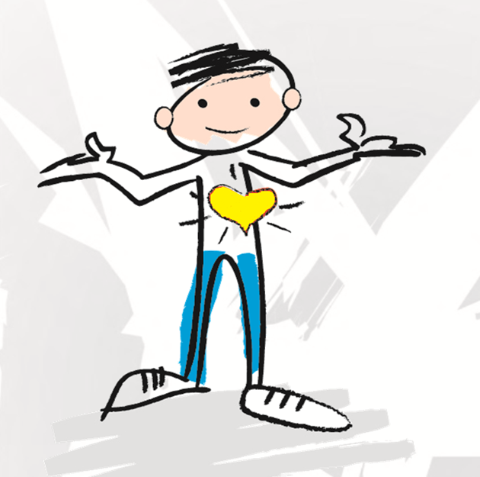
Rules
Flesh “I”
Sight
Grace
Spirit “I”
Faith
Notes:
Even though sin has no power over us, we can choose to give in to sin.

Slide 24
Faith is finding out what is already true and making the CHOICE to believe it; whether if feels true or not.
Genesis 3

Slide 25
Pause for Thought
Have someone read
“Sin Did Not Die”p.67 at your table.

Slide 26
Fruit of the Spirit
Galatians
5:22-23
(The Message)
Notes:
Walking by the Spirit is not
Just a Good Feeling
A Liscense to do what I want. (2 Peter 2:19 People are Slaves to whatever controls them)
²²⁻²³ But what happens when we live God’s way? He brings gifts into our lives, much the same way that fruit appears in an orchard—things like affection for others, exuberance about life, serenity. We develop a willingness to stick with things, a sense of compassion in the heart, and a conviction that a basic holiness permeates things and people. We find ourselves involved in loyal commitments, not needing to force our way in life, able to control and direct our energies wisely.

Slide 27
Barriers to Growth
Genesis 3

Slide 28
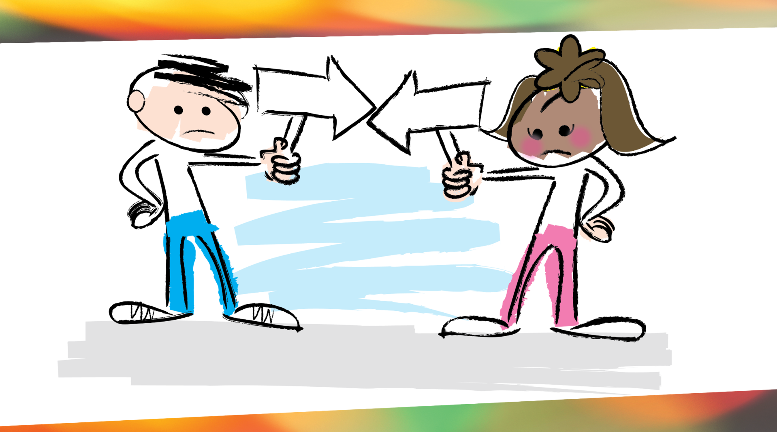
Notes:
Failure to take personal responsibility
Tullian Tavigian
But as shocking as all of my self-imposed losses were, my instinctive response shocked me even more. Rather than blaming myself for all the hurt I caused, I blamed everyone else for all the losses I was experiencing. The self-pity, the rage, the self-justified resentment, the deluded rationalization, the deep selfishness, the perverted sense of entitlement—it was all there. Everyday. All day.
As I’ve said elsewhere, I was lost, undone and angry at God, others, and myself—doing everything I could to “rescue” myself from the wreckage I caused. I was in full self-salvation mode. What should have been my wake-up call to a newfound humility and dependence on God became my excuse to dig in my heels even deeper. I was heading off into the far country…
JJ Podcast this week that Women are more likely to blame themselves; while men are more likely to blame others. NO because women do this as well.

Slide 29
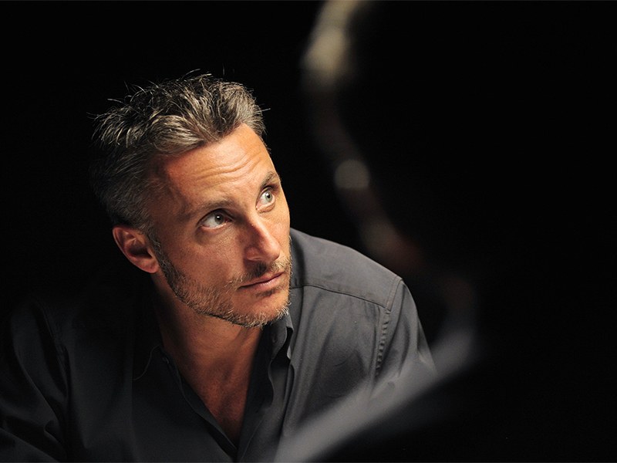
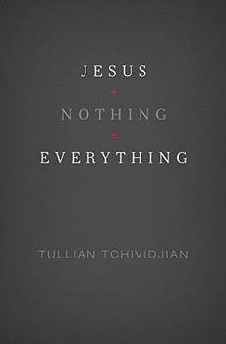
Tullian Tchividjian
Notes:
But as shocking as all of my self-imposed losses were, my instinctive response shocked me even more. Rather than blaming myself for all the hurt I caused, I blamed everyone else for all the losses I was experiencing. The self-pity, the rage, the self-justified resentment, the deluded rationalization, the deep selfishness, the perverted sense of entitlement—it was all there. Everyday. All day.
As I’ve said elsewhere, I was lost, undone and angry at God, others, and myself—doing everything I could to “rescue” myself from the wreckage I caused. I was in full self-salvation mode. What should have been my wake-up call to a newfound humility and dependence on God became my excuse to dig in my heels even deeper. I was heading off into the far country…

Slide 30
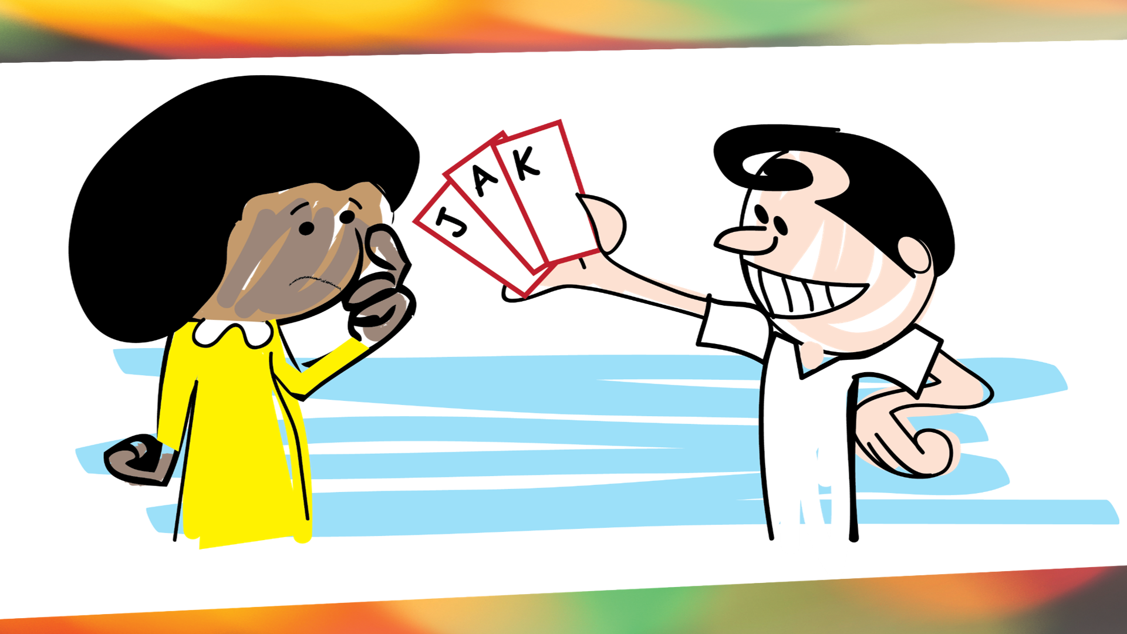
Notes:
DECEPTION
"The first objective of Satan is to remain hidden. The true nature of a conflict becomes apparent when lies are exposed and when we start working toward resolution."
Take away the passy from the child, move toward life without it. Then you will see conflict. (I’m not comparing kids to strongholds only giving an illisration)

Slide 31
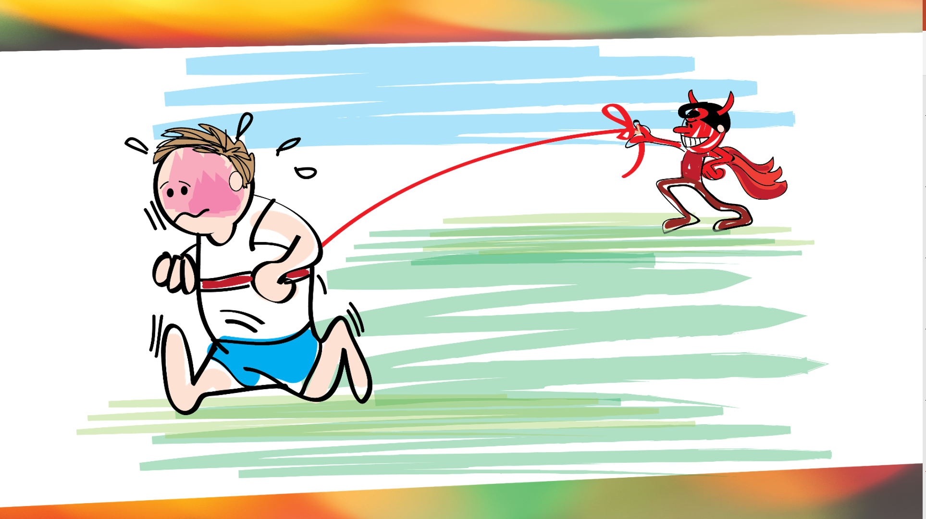
Notes:
Strongholds – Workshop coming up on Nov 17 in here. Damaging or sinful behavior patterns that are difficult to break.
Continually operating in the flesh over time leads to strongholds. These are areas that are not easily reliquised by Satan because will have allowed him to gain a strategic advantage.
These have to be torn down / up rooted over time.

Slide 32

Next Week
John and Stephanie Mayfield

Slide 33
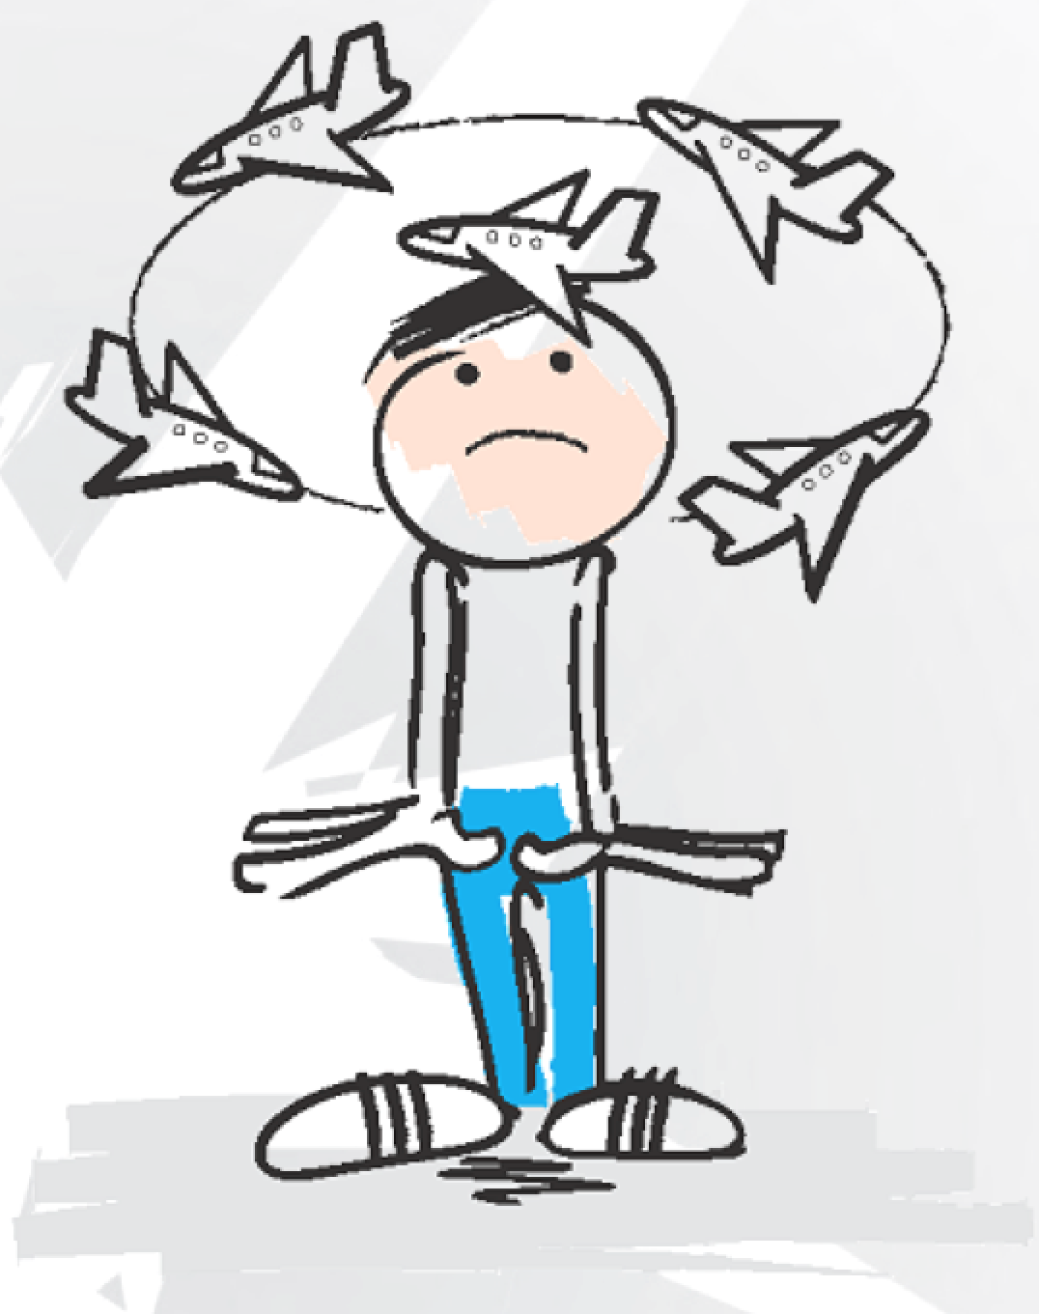
Next Week
The Battle for
Our Minds
Genesis 3

Slide 34
So How Do Christians
“Walk in the Spirit?”
____________
Genesis 3

Slide 35

So How Do Christians
“Walk in the Spirit?”
They Choose To
Genesis 3

Slide 36
How should we respond when we feel so alive to sin?
(aka when we are tempted)
“That’s not true, I’m New”
“In Christ”
Genesis 3
Notes:
Its not a mantra, but belief of the truth is transformational. Many often give into sin, because we asumm this temptation is really what we want. But how can a dead man want a nice meal. We may fell altive to sn, but Romans 6:11 Consider your self dead to sin and alive to God

Slide 37
Notes from Fall 2019
Snake Analogy, Cut off the head, but the body still moves
The Flesh is “the urge to do what comes natural to the person you used to be.”
Walking in the Spirit is going in the right direction and the right place (Slow down TD).

Slide 38
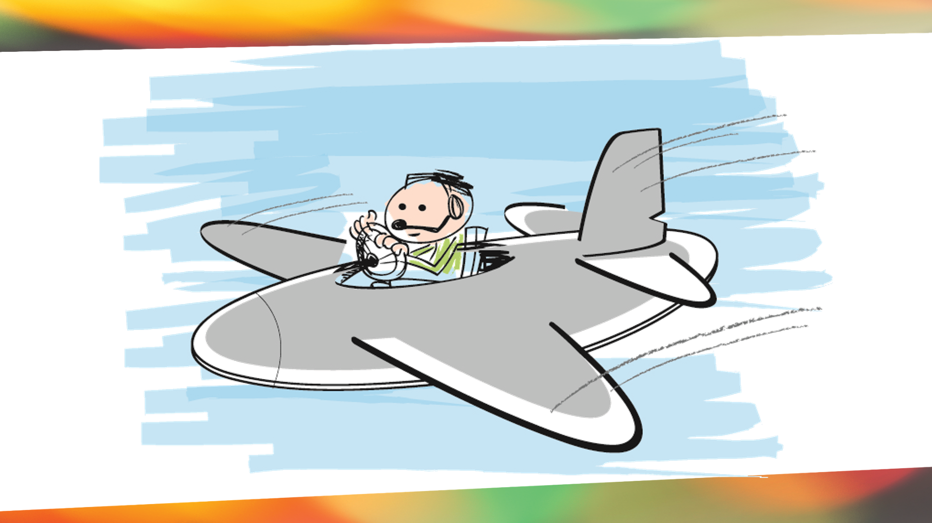
FREEDOM IN CHRIST Romans 8
Romans 8:2 Through Christ Jesus the law of the Spirit of life set me free from the law of sin and death.
Notes:
? By a greater law. Romans 8:2 says “Through Christ Jesus the law of the Spirit of life set me free from the law of sin and death.” The law of the Spirit of life that’s now at work in me as a child of God is far greater than the law of sin and death. Before I became a child of God, a saint, a holy one, I had no choice but to stay on the ground in my sin, but now in Christ I have the power to choose to fly above the law of sin and death!

