Slide 1


Slide 2
Lord God,
I acknowledge that I have often allowed
the world system to influence me more than you.
Tonight open my eyes to the world around me.
Show me things as they really are.
I choose to believe You are the ultimate reality.
I desire to walk in my freedom in Christ.
In The Name of Jesus I pray! Amen

Slide 3



^{Sessions}
A
Who Am I?
Choosing to Believe the Truth
The World’s View of Truth p.50
Our Daily Choice
The Battle For Our Minds
Handling Emotions Well
Forgiving from the Heart
Renewing the Mind
Relating To Others
What Next?
B
C
D
Notes:
P33 Who I am Statements
P44 Twenty Cans of Faith

Slide 4

What are some obstacles that keep people from experiencing their new identity in Christ?
Pause for Thought

Slide 5
Why Do We Struggle?
The World [Christless Systems]
The Flesh [Our Harmful Behavior Patterns]
The Devil(s) [Fallen Spiritual Beings]

Slide 6

Why is it important for us to be made aware of these obstacles?
Quick Question

Slide 7
1 John 2:15-17
15 Do not love the world or the things in the world. If anyone loves the world, the love of the Father is not in him. 16 For all that is in the world— the lust of the flesh and the lust of the eyes and the pride of life—is not from the Father but is from the world. 17 And the world is passing away along with its desires, but whoever does the will of God abides forever.

Slide 8
Lust is a desire for more than God has designed us for.
Notes:
Lust can never lead to enjoyment or satisfaction, because by definition it always wants MORE!

Slide 9
The World’s Appeal
Lust of the Flesh
Lust of the Eyes
The Pride of Life
Notes:
Lust is a desire for more than is God has designed us for .
Lust of Flesh – Bodily desires that have been hijacked because of sin and are now harmful
Food, Comfort, Rest, Sexual Experience
Lust of the Eye – emotional/spiritual (a longing for beautify) desires that have been corrupted
Accomplishment, Conquest, Beauty, Acquisition or Obtainment
Pride of Life –
he boastful pride of life NASB
pretentious confidence in one’s resources or in the stability of earthly things Amplified Bible
he pride in one’s lifestyle HCSB
pride in our achievements and possessions. NLT (Achievements both intellectual as well as material)

Slide 10
Genesis 3:6(ESV)
6 So when the woman saw that the tree was good for food, and that it was a delight to the eyes, and that the tree was to be desired to make one wise, she took of its fruit and ate, and she also gave some to her husband who was with her, and he ate.
Notes:
The tree was good for food – lust of the flesh
That it was a delight to the eyes – lust of the eye
And that is was desired to make one wise – pride of life

Slide 11
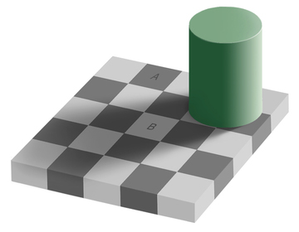
FREEDOM IN CHRIST
Which Square is darker A or B?

Slide 12
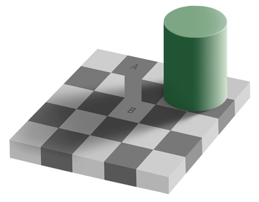
FREEDOM IN CHRIST
Which Square is darker A or B?

Slide 13
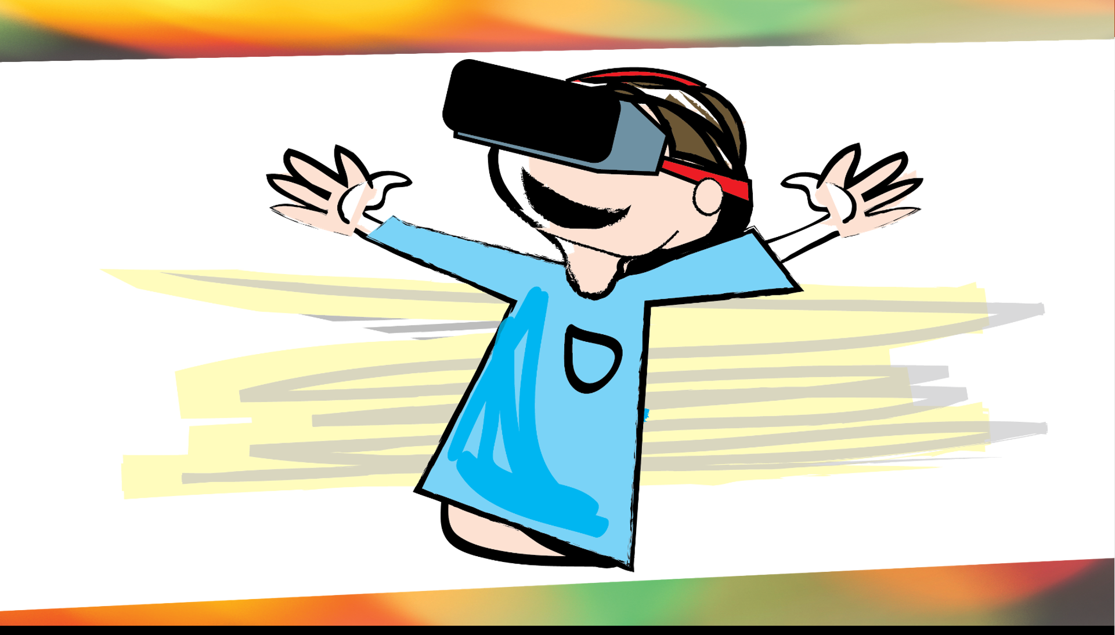
Notes:
This present world we place supreme value of what we see, but what we see is not always trustuworth.
We are obssed with seeing. Seeing is believing but our seeing can’t always be trusted.
The bible says as Christians we are to live by faith ,not by sight. 2 Cor 5:7
We currently seem dimly as through a (distorted mirror) 1 13:12
“The holy thing worse that being blind is having sight but no vision” Helen Keller

Slide 14
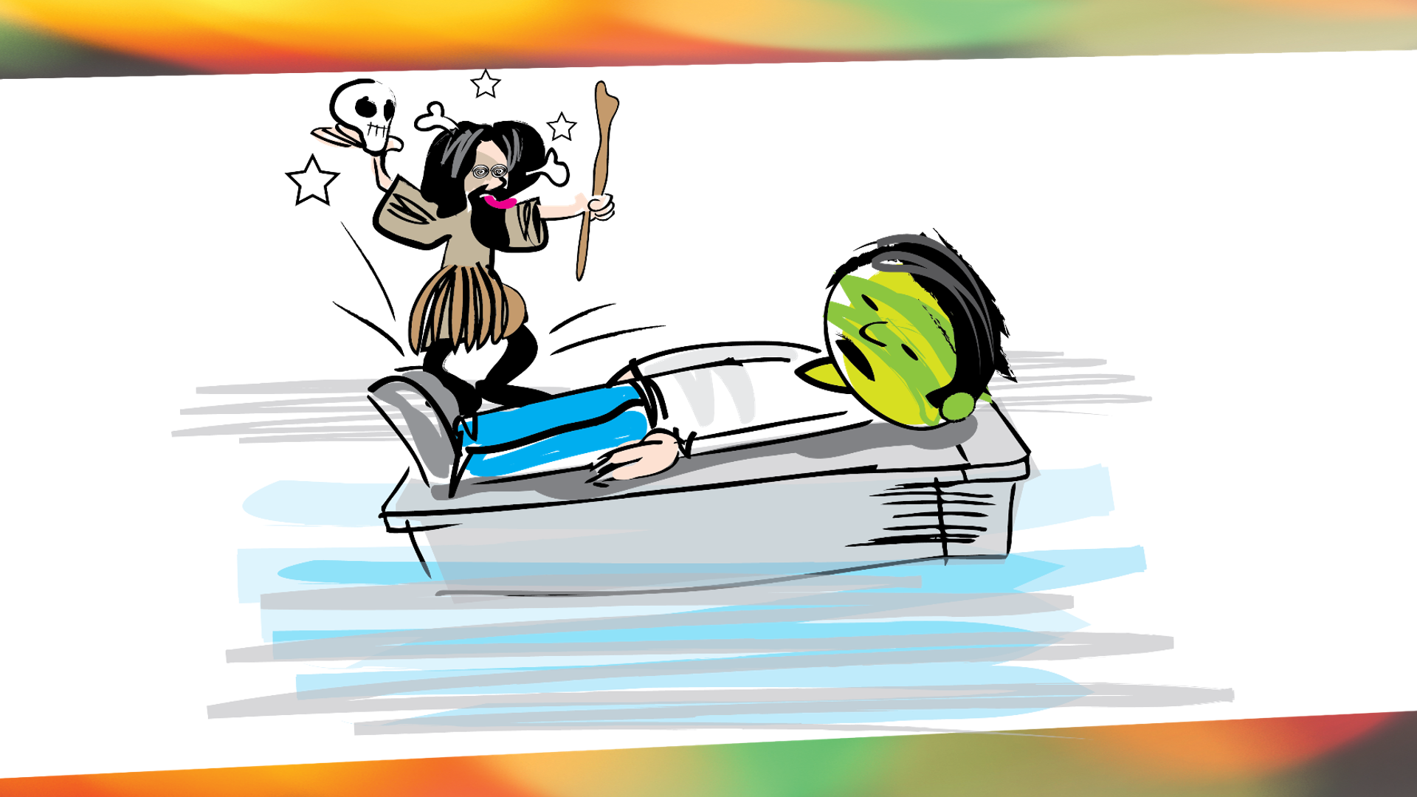
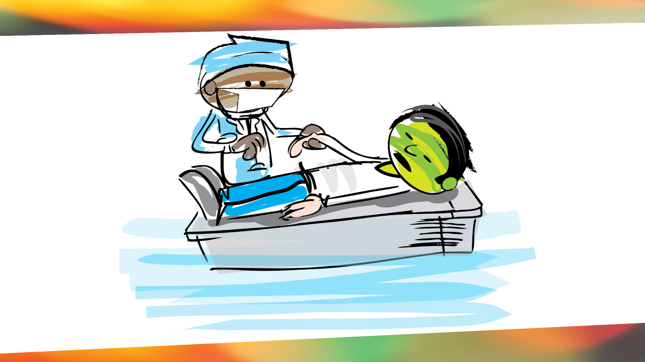
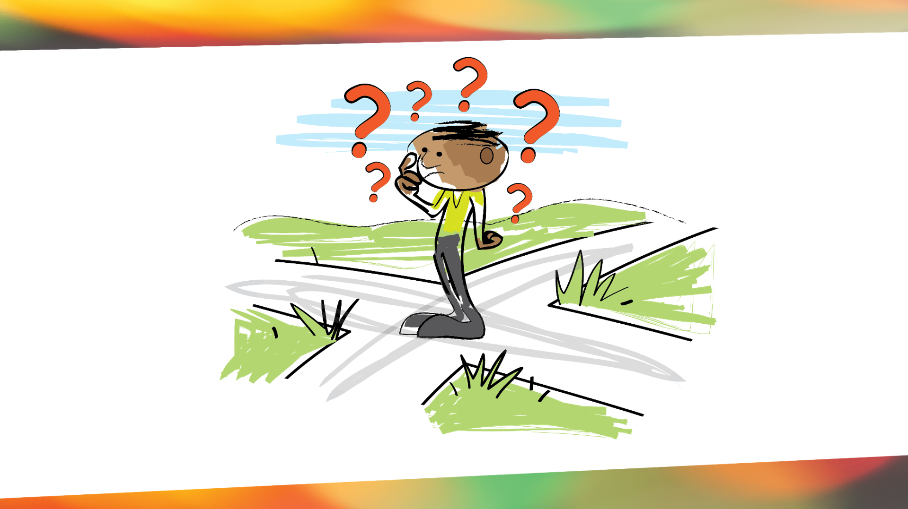

Slide 15
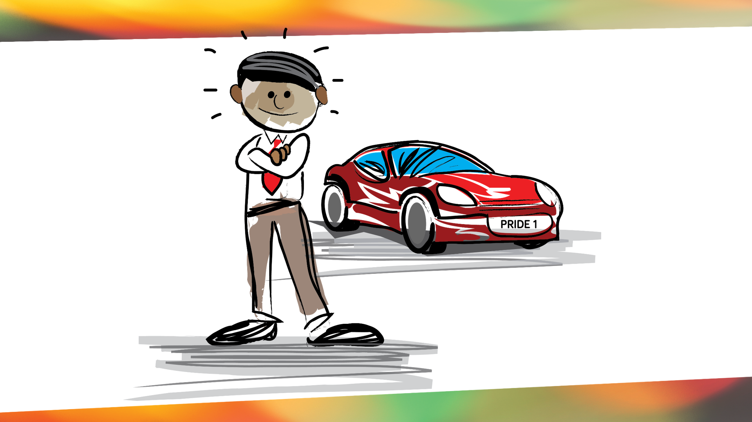
Faulty World Lens
Performance + Accomplishments = Significance
Status + Recognition = Security
Appearance + Admiration = Acceptance
Notes:
Culture

Slide 16
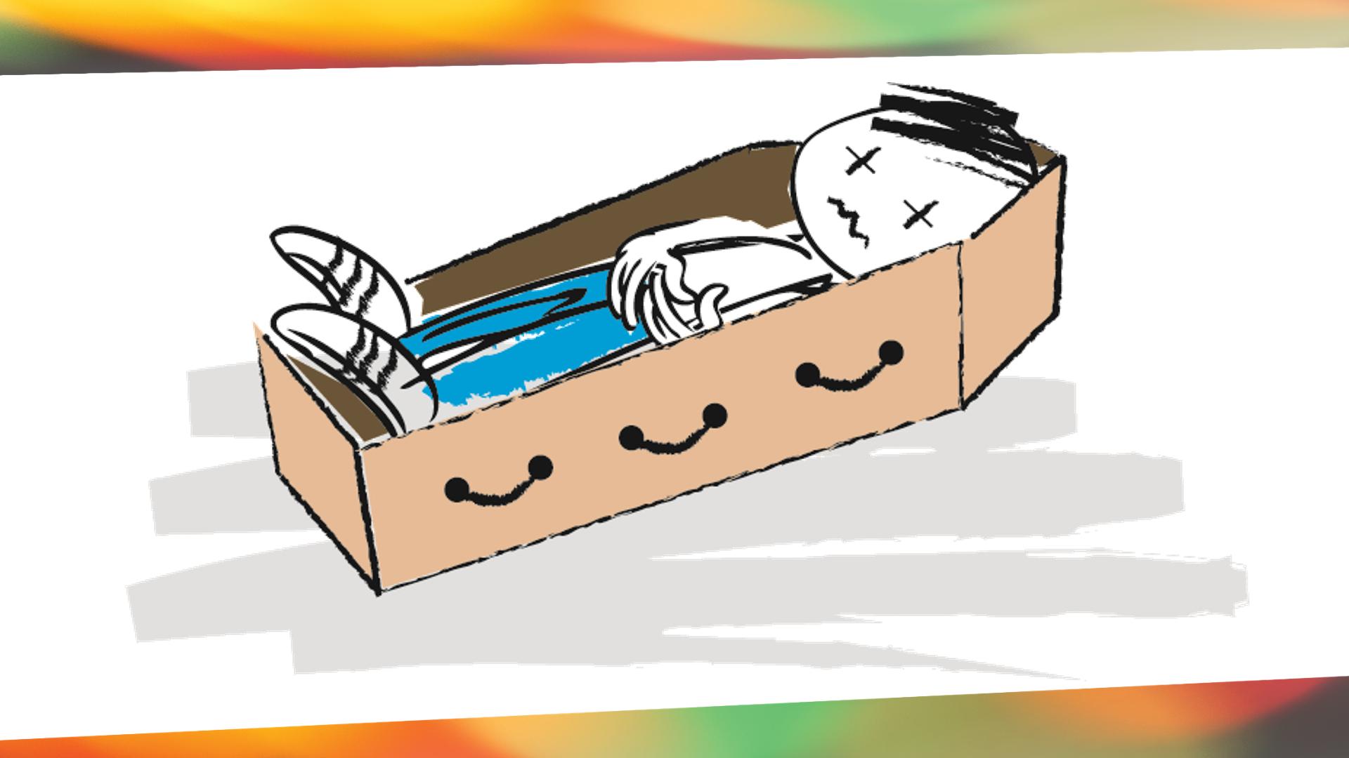
Notes:
If you lens fails you at death you need to reconsider.

Slide 17
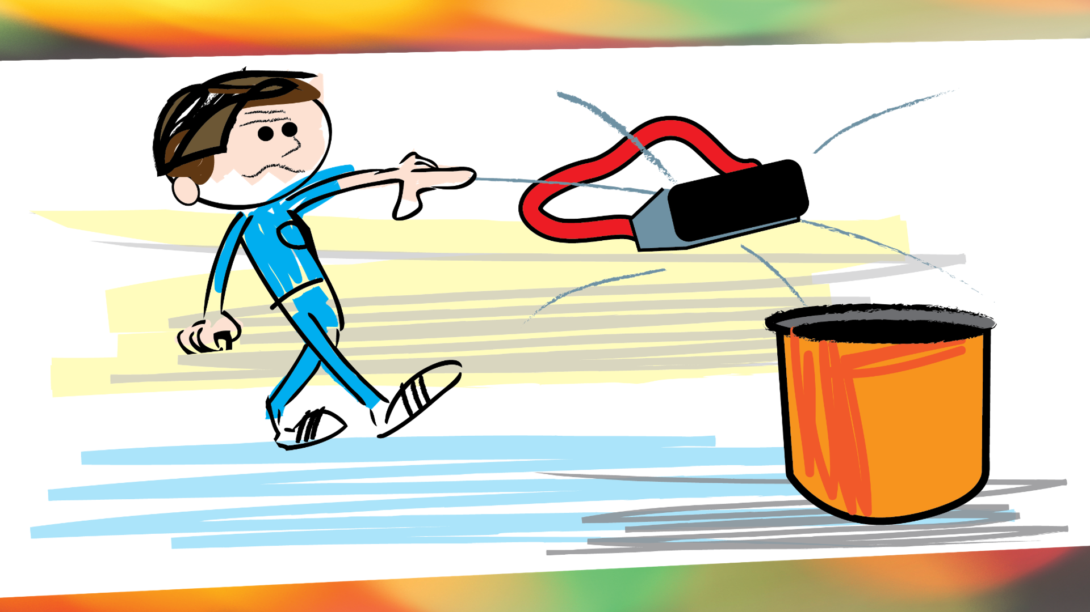

Slide 18
Pause for Thought
Discuss how the lust of the flesh, the lust of the eyes, & the pride of life can distract us from Christ and from keeping an eternal perspective.

Slide 19
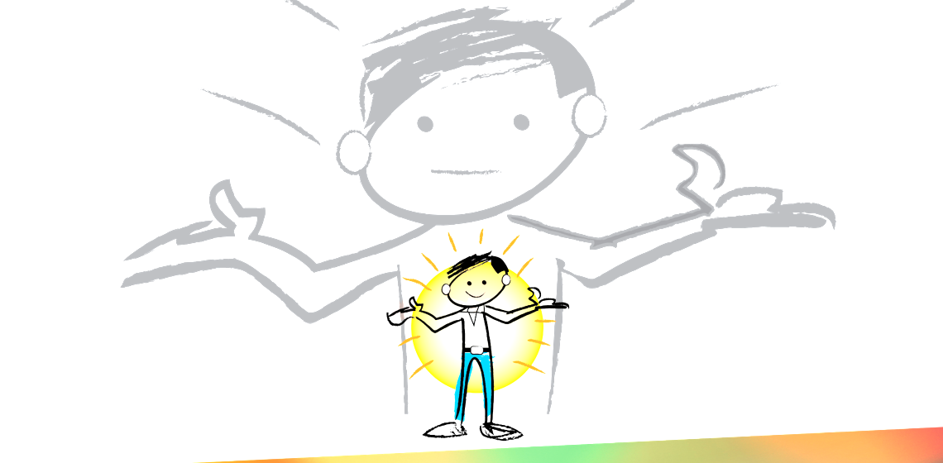
A Freedom Story
Sarah Williams
Genesis 3
Notes:
Sarah Williams Story

Slide 20

Spend some time in prayer throwing out your old worldview and choosing to see “reality”, the world as God reveals it in the Bible. Examples on Page 61

Slide 21
Next Week
Session 4
Flesh vs Spirit: Our Daily Choice

Slide 22
FREEDOM IN CHRIST Romans 12:2
Do not conform to the pattern of this world, but be transformed by the renewing of your mind. Then you will be able to test and approve what God’s will is—his good, pleasing and perfect will.

