Slide 1
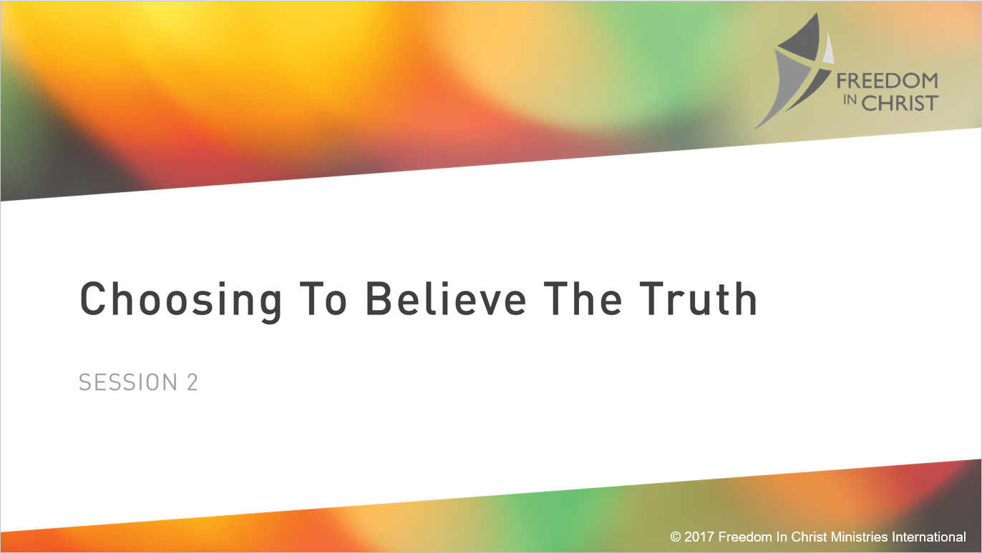

Slide 2
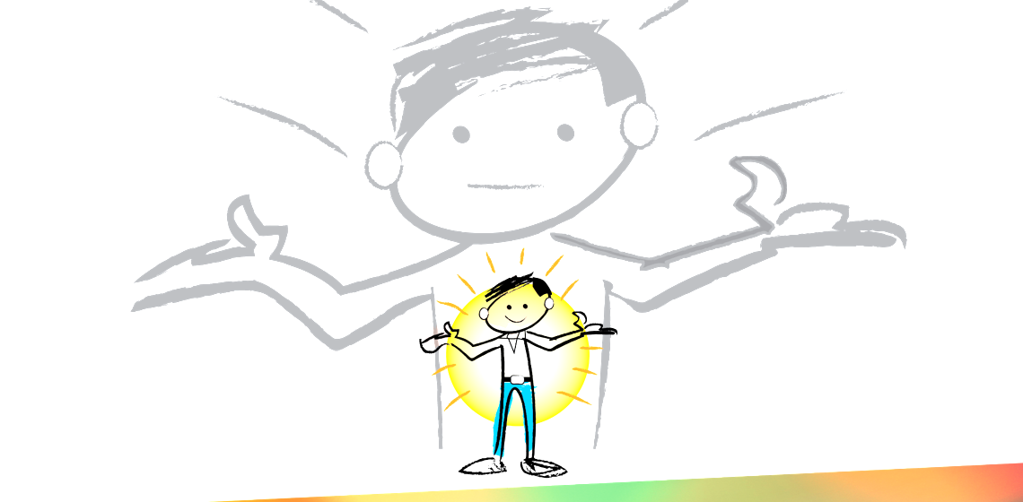
Heavenly Father, tonight I choose to submit my thoughts and understanding to you alone. Lord, I say that, “I believe.” Yet I often live as If I don’t believe. By your Spirit, I ask you to increase my faith. Tonight I choose to believe what your Word says about me. I ask this is the mighty name of Jesus. Amen
Genesis 3
Notes:
We were created with this God given needs. Eve before sin entered the world these are legitimate needs that are at the core of us. Men and women are searching for these. All social media post are answering these needs. These are not wrong, but as we will see how we go about trying to get this meet are the root cuase of much of our struggle.

Slide 3

When a woman gets married she takes on a new name? List all the documents that she will have to change her name on.
Notes:
For example her drivers license. Get as creative as possible. Give them 3 minutes. Have table with the most read theirs off then the other tables can fill with ay missed.

Slide 4
2 Corinthians 5:17 (ESV)
Therefore, if anyone is in Christ, he is a new creation. The old has passed away; behold, the new has come.
Notes:
You are a new creation. God love’s you unconditionally because of the cross. If you performed better, would God love you more? No. God’s love has nothing to do with what we do. Even on my worst day God’s still loves me the same.
However God’s love for me doesn't mean I’m the person he wants me to be. That is directly time to the choices we make. And the choices come down to what we believe. What we really belive.

Slide 5
What you believe is not necessarily what you think or say you believe. What you believe is what you actually do.
Page 37
Genesis 3

Slide 6

Hebrews 11:6
Without faith it is impossible to please God, because anyone who comes to him must believe that he exsits and that he rewards those who earnestly seek him

Slide 7
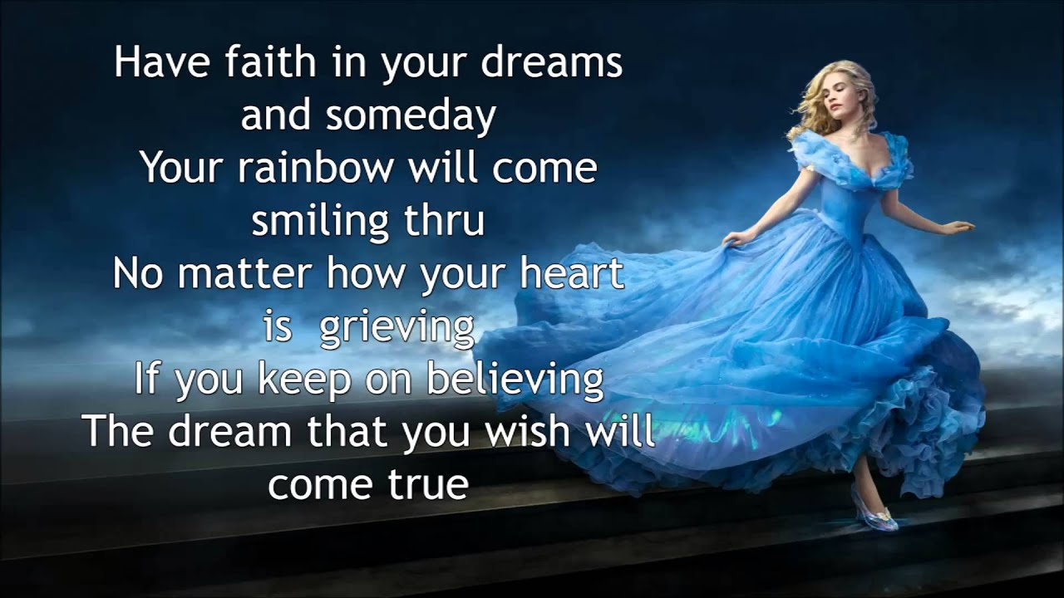
Notes:
Faith isn’t trying really hard to believe to make something true.

Slide 8
Faith is finding out what is already true and making the CHOICE to believe it; whether if feels true or not.
Genesis 3

Slide 9
A Freedom Story
Genesis 3
Notes:
We were created with this God given needs. Eve before sin entered the world these are legitimate needs that are at the core of us. Men and women are searching for these. All social media post are answering these needs. These are not wrong, but as we will see how we go about trying to get this meet are the root cuase of much of our struggle.

Slide 10
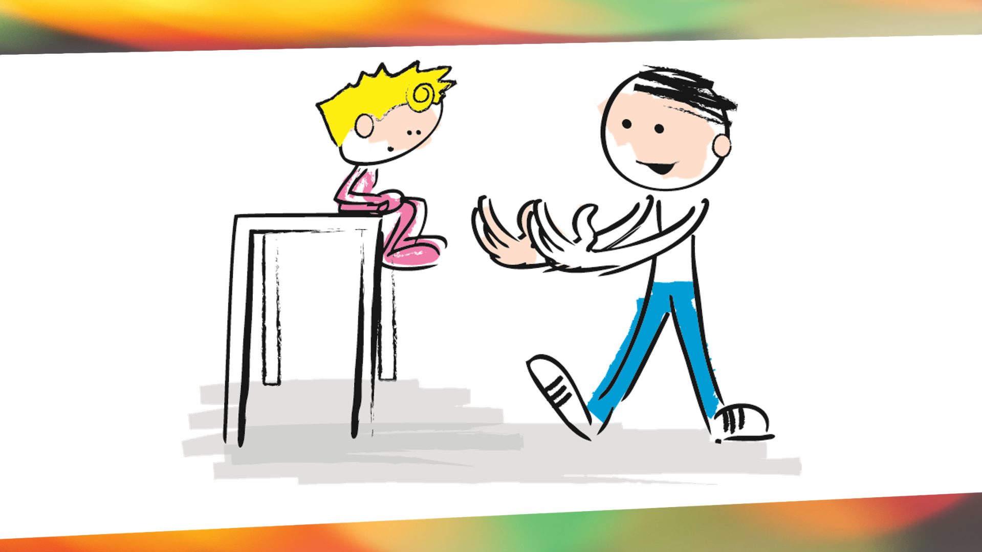
Notes:
Growing Faith
A Child Jumps the Dad catches her
Moves further back and the child jumps agan
Eac time her faith will keep growing as long as her father is faithful to catch.
Her that is how our faith is grown.

Slide 11
The critical issue with faith is not so much that we believe but what/who we believe in.
Page 38
Genesis 3

Slide 12

Notes:
Actually Faith is much more practical than that. We all live by faith everyday.
We all got here tonight by faith. Faith in the stop light that its red for other cars.
Faith the others drivers will see the red light.
Faith they will press the break
Fiath their card will stop and not hit you.
Traffic lights can go wrong. Other faith objects like our parents, church, friends, spouses, and children can let us down.
However Heb 13:8 says “Jesus Christ is the same yeterdday today and forever.” That is why he is the one in whom we can put our faith and he will never fail us. He never chanes. He has never afiled to be and d all that He said eh would be and no.

Slide 13
Discuss this Thought
“If you want to know what someone really believes, don’t listen to what they say, but look at what they actually do.”

Slide 14
You don’t feel your way into good behavior,
You believe and behave and your feelings will follow.
Genesis 3

Slide 15
Faith is finding out what is already true (in God’s Word) and making the CHOICE to believe it; whether if feels true or not.
Genesis 3

Slide 16
Who I Am in Christ Statements
You can’t believe them if you don’t’ know them ☺

Slide 17
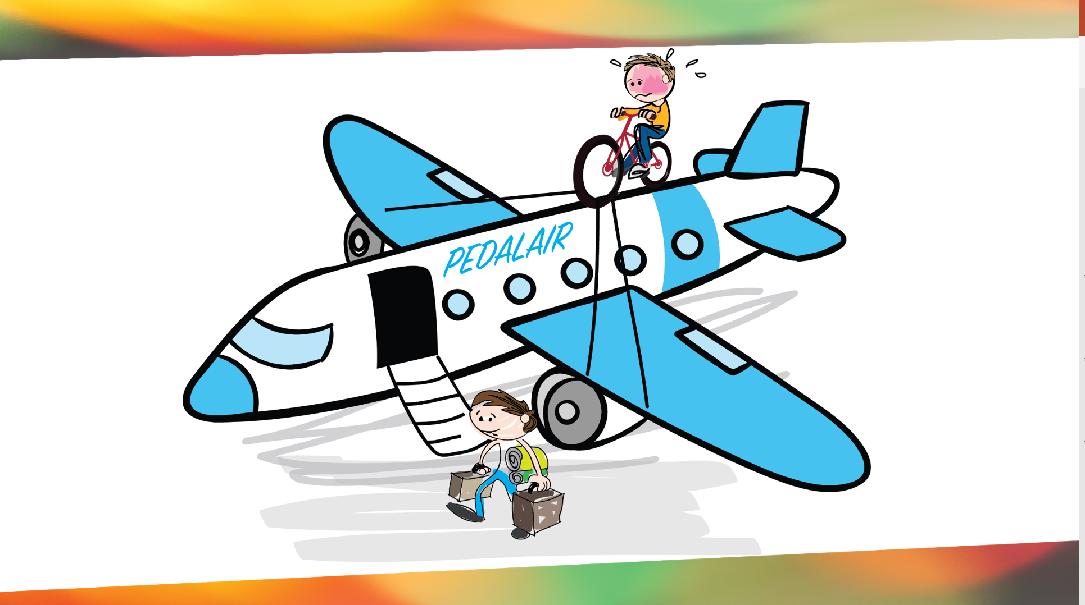
Notes:
The issue of faith is not if we belive or not. Everyone belives in something. Some peole choose to blive there is no such thing as a God that created and that we evloved from animals. That’s faith.
No the critical ies is

Slide 18
Quick Question
How do we put our faith in God?

Slide 19
FREEDOM IN CHRIST
^{Faith in the Word of God}
^{Luke 7}

Slide 20
Why is it important to believe what the Bible says is true, even when it may not feel like it?
Pause for Thought

Slide 21
In what circumstances or seasons in your life have you noticed your faith grow the most?
Pause for Thought
Notes:
For example her drivers license. Get as creative as possible. Give them 3 minutes. Have table with the most read theirs off then the other tables can fill with ay missed.

Slide 22
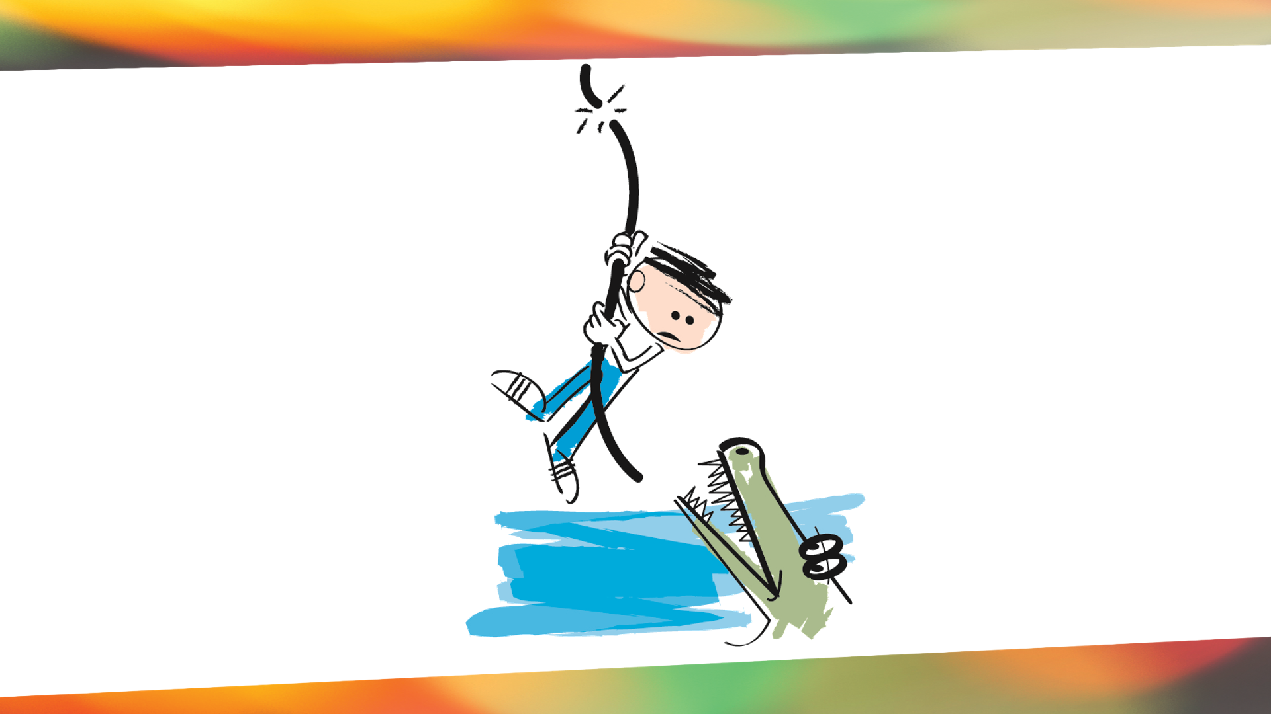

Slide 23
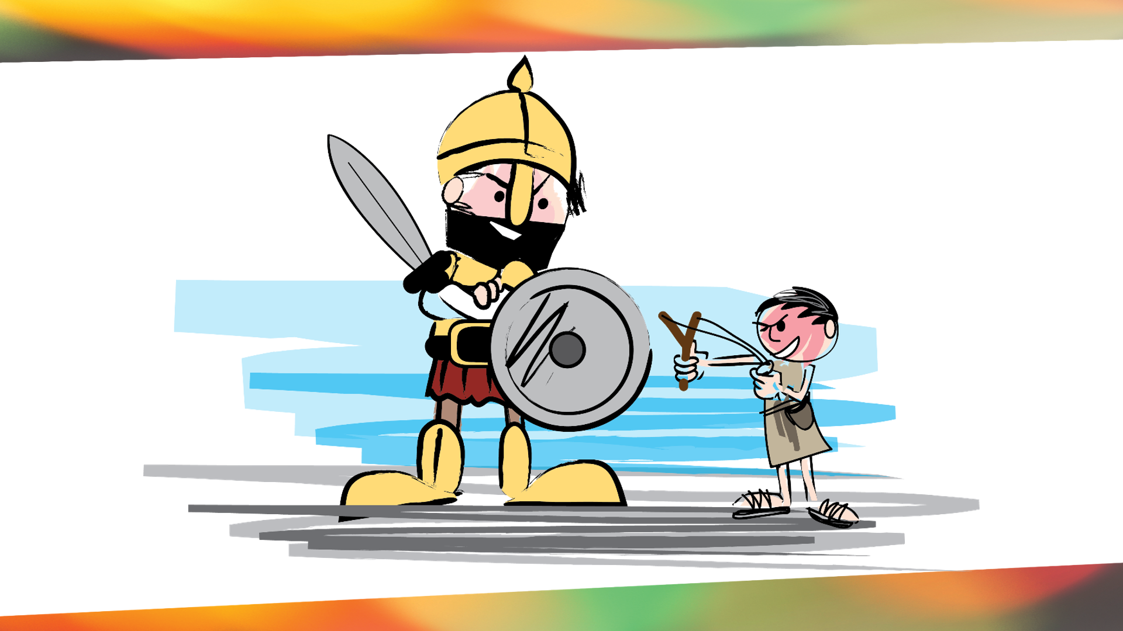

Slide 24
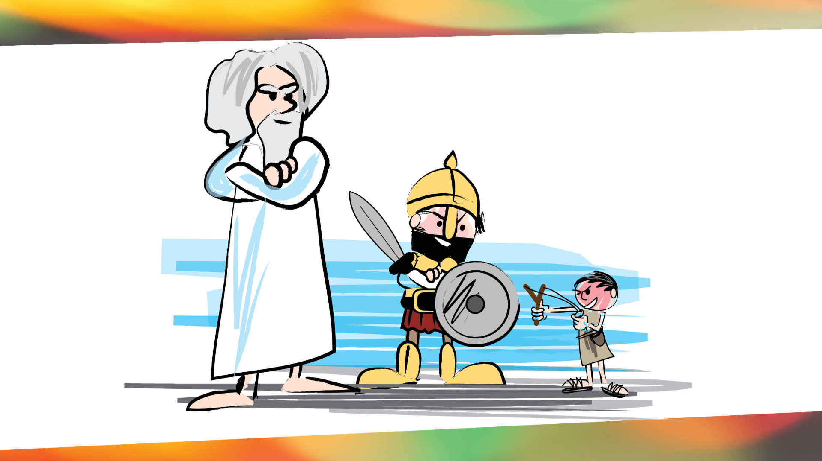

Slide 25


