Slide 1

Notes:
WANTED: DEAD OR ALIVE?
Who You Say I Am
https://www.youtube.com/watch?v=IcC1Bp13n_4&t=0s&list=PLEBIAoGmDp6hW9FAbcVVf4iC8E6LaGZoP&index=30

Slide 2
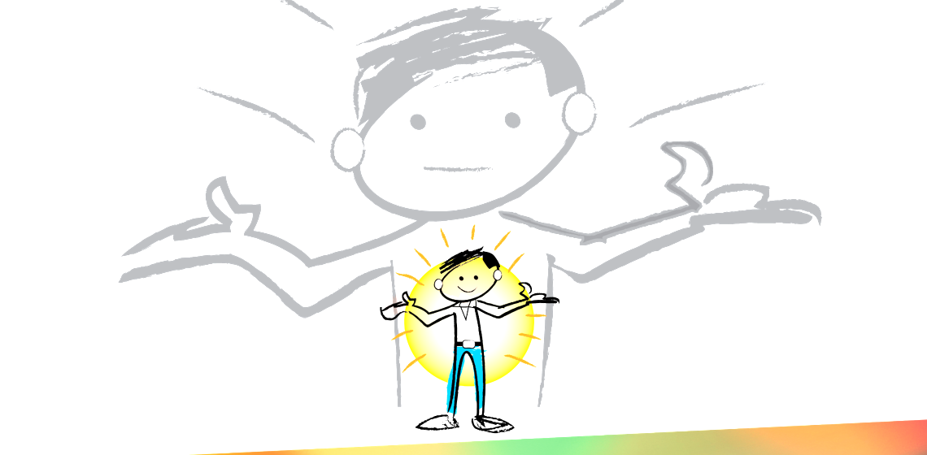
Heavenly Father, I pause now in the midst of a busy week. I acknowledge that there is nothing more important than fellowship with you. During this time, I ask you to help me to see myself as you see me. Your words found in the scriptures define me. I resist to temptation to be defined by anyone or anything else. I ask for the faith to believe what you say about me. I pray this in the life giving name of Jesus. Amen
Genesis 3

Slide 3

Make introductions around the table; tell a little bit about yourself.
Notes:
Ice Breaker: Introductions around the table
“Introduce yourself and tell a little bit about yourself”
What are some things we used to describe ourselves: Work, Relationships, Hobbies – but those are all things we are apart of but not who we are. Lets go back to Genesis to see what the Bible teaches about “Who we are?”
Really the frist part that we are going to cover tonight could be called. Identity Crisis.

Slide 4
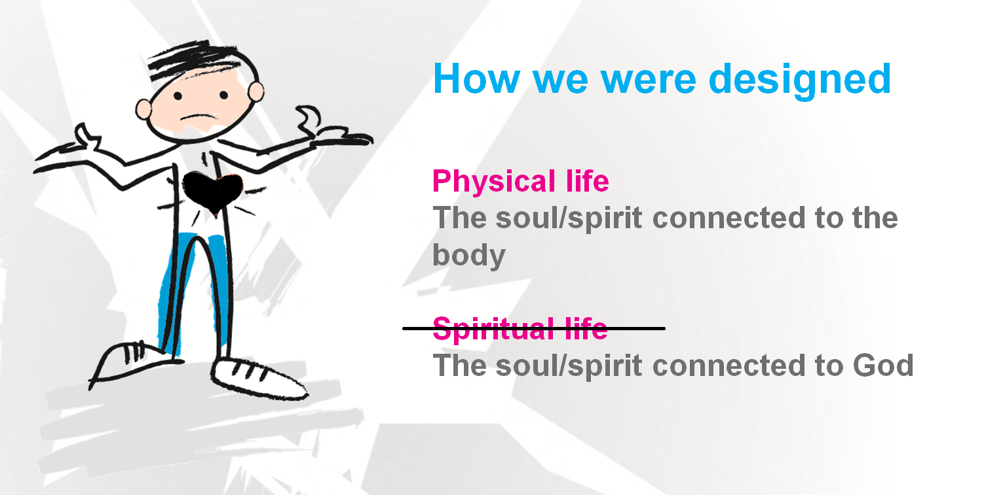
FREEDOM IN CHRIST
Consequences of The Fall
Notes:
The Bible doesn’t present present the Human problem as bad people who need to get better.
Depressed people who need pick me up.
Or sick people who need to get well. But DEAD people (Spiritual Dead) who need life.

Slide 5
Acceptance was replaced by Rejection
Not ______ Enough
Significance was replaced by Insignificance
Guilt & Shame
Security was replaced by Insecurity
Fear & Anxiety
Genesis 3
Notes:
We were created with this God given needs. Eve before sin entered the world these are legitimate needs that are at the core of us. Men and women are searching for these. All social media post are answering these needs. These are not wrong, but as we will see how we go about trying to get this meet are the root cuase of much of our struggle.

Slide 6
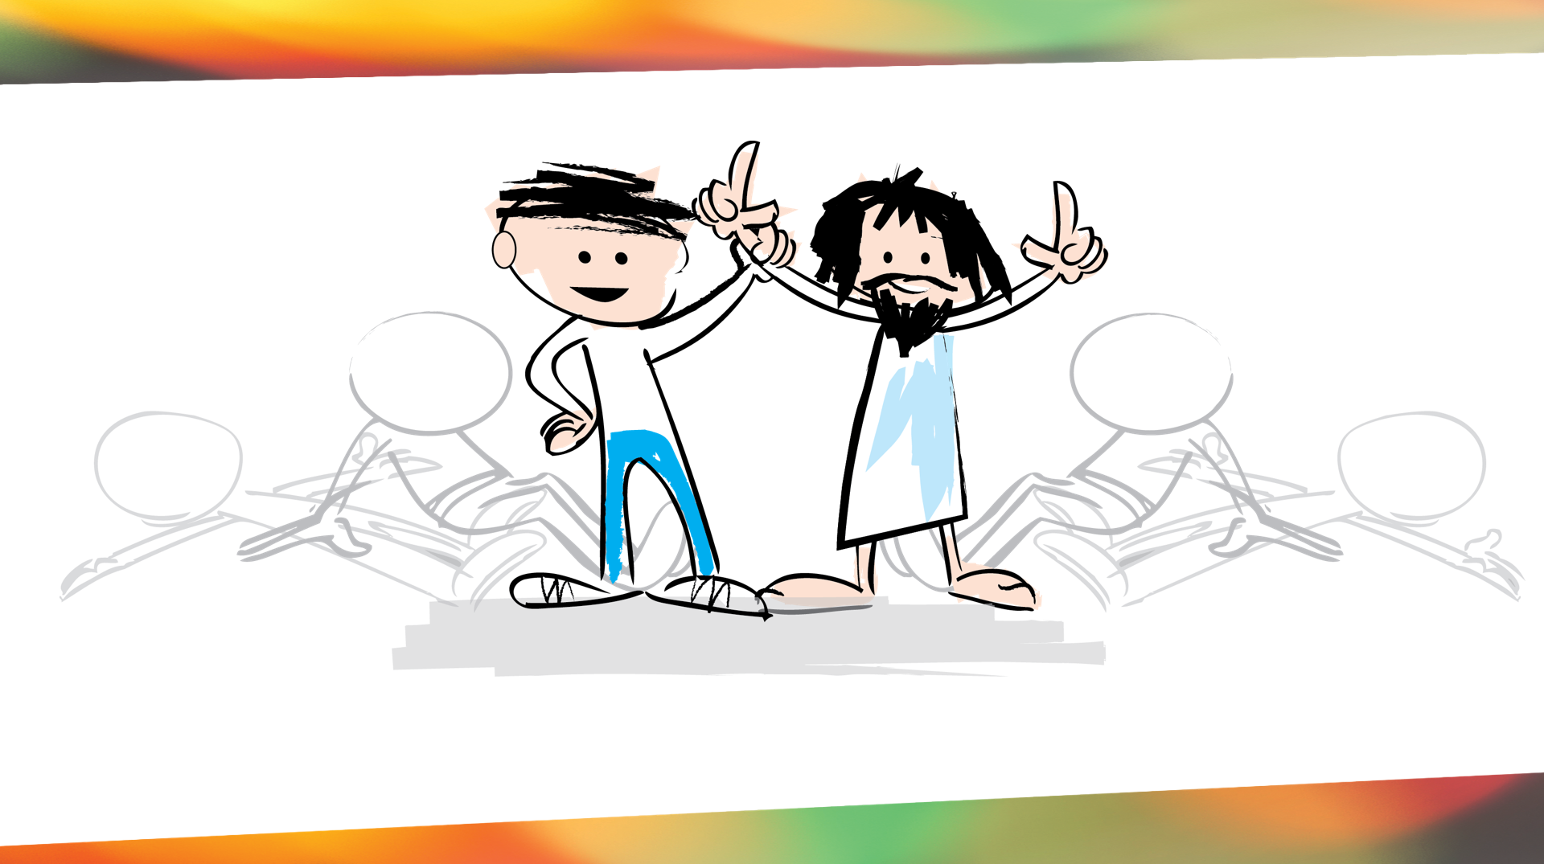
Page 26

Slide 7
FREEDOM IN CHRIST 1 John 5:11-13
¹¹ And this is the testimony: God has given us eternal life, and this life is in his Son.
¹² Whoever has the Son has life; whoever does not have the Son of God does not have life.

Slide 8
FREEDOM IN CHRIST
What Jesus Came To Do
“And this is eternal life, that they know you, the only true God, and Jesus Christ whom you have sent.” John 17:3

Slide 9
FREEDOM IN CHRIST
What Jesus Came To Do
“I have come that they may have life and have it more abundantly.” John 10:10
“I am the resurrection and the life. He who believes in me will live, even though he dies.” John 11:25
Notes:
Not just quantity eternal but qualitative. A whole new life here and now

Slide 10
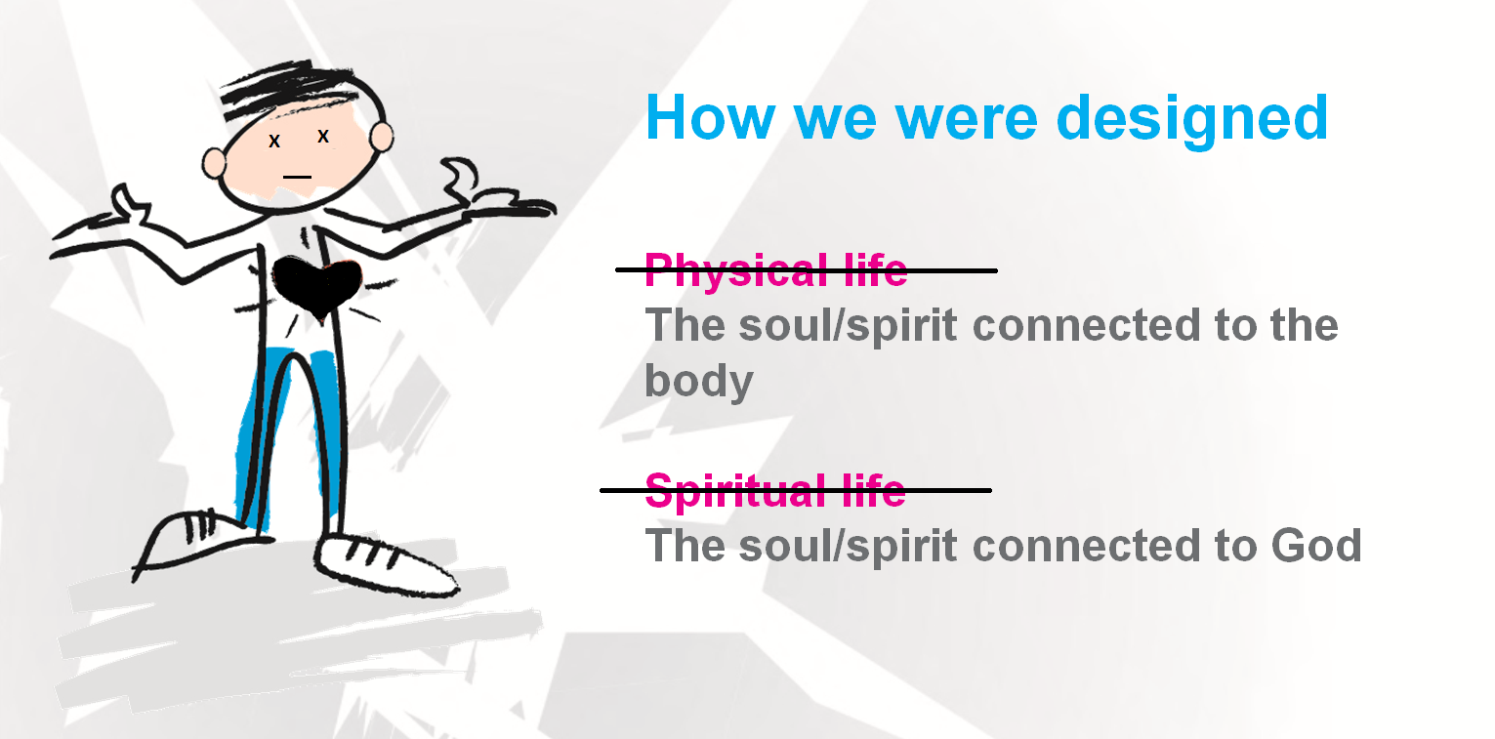
FREEDOM IN CHRIST
DEATH
Notes:
They died first Spiritually and then eventually Physcially.

Slide 12
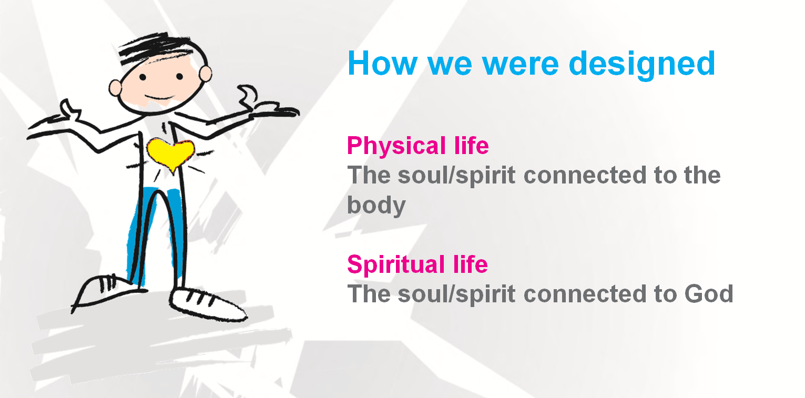
FREEDOM IN CHRIST
LIFE
Notes:
They died first Spiritually and then eventually Physcially. Man is restored first Spiritual and then/evenally (in history) Physcially

Slide 13
Pause for Thought
Why is it important for us to understand Jesus’s invitation to us is far more than a ticket to heaven when we die?
Page 30
Notes:
What’s at stake if you don’t get this?

Slide 14
Acceptance – They had an intimate relationship with GOD. They could talk with HIM at any time.
Significance – They were given purpose: to rule (have dominion) over GOD’s earth.
Security – They were totally safe and secure in GOD’s presence. God provided for all their needs – physical, spiritual, and emotional.
Genesis 3
Notes:
We were created with this God given needs. Eve before sin entered the world these are legitimate needs that are at the core of us. Men and women are searching for these. All social media post are answering these needs. These are not wrong, but as we will see how we go about trying to get this meet are the root cuase of much of our struggle.

Slide 15

Notes:
The word the bible uses to refer to us is Saints.
Romans 1:7Verse Concepts
to all who are beloved of God in Rome, called as saints: Grace to you and peace from God our Father and the Lord Jesus Christ.
1 Corinthians 1:2Verse Concepts
To the church of God which is at Corinth, to those who have been sanctified in Christ Jesus, saints by calling, with all who in every place call on the name of our Lord Jesus Christ, their Lord and ours:
Colossians 1:2Verse Concepts
To the saints and faithful brethren in Christ who are at Colossae: Grace to you and peace from God our Father.
Ephesians 1:1Verse Concepts
Paul, an apostle of Christ Jesus by the will of God, To the saints who are at Ephesus and who are faithful in Christ Jesus:
Philippians 1:1Verse Concepts
Paul and Timothy, bond-servants of Christ Jesus, To all the saints in Christ Jesus who are in Philippi, including the overseers and deacons:
Jude 1:3Verse Concepts
, I felt the necessity to write to you appealing that you contend earnestly for the faith which was once for all handed down to the saints.
!!! THE GOSPEL IS NOT ABOUT GRADUALLY BEOMCING SOMEONE DIFFERENT – It starts will recognizing that you actually became someone different the moment you received Christ.!!!!

Slide 16
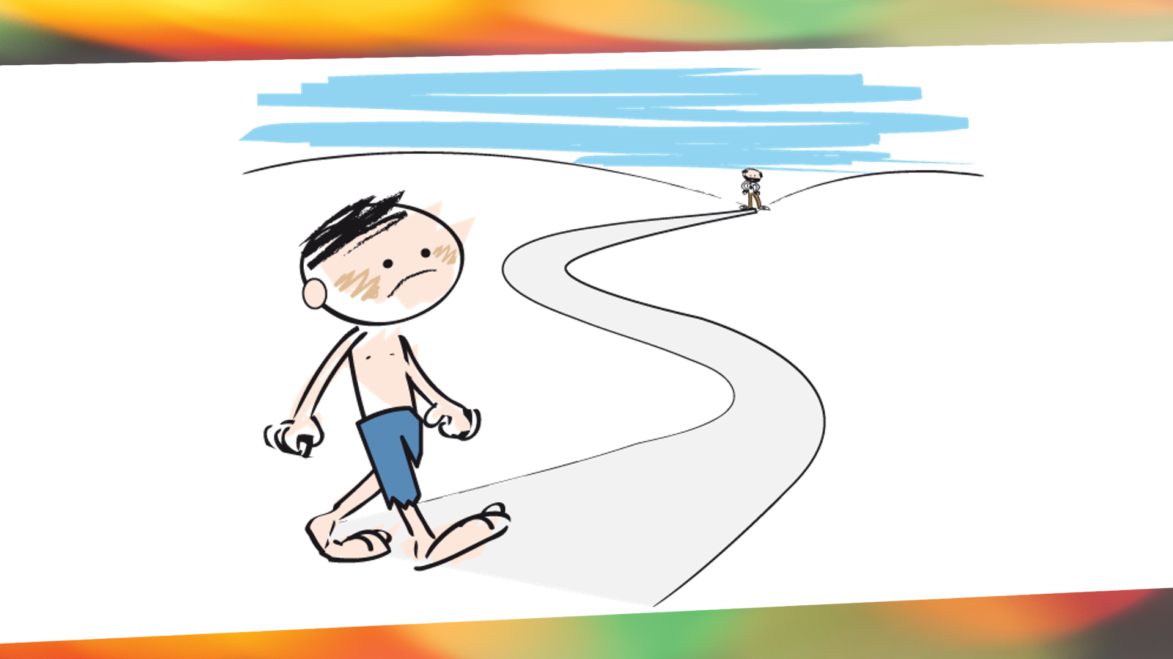
Luke 15:11-24
The Prodigal Son

Slide 17
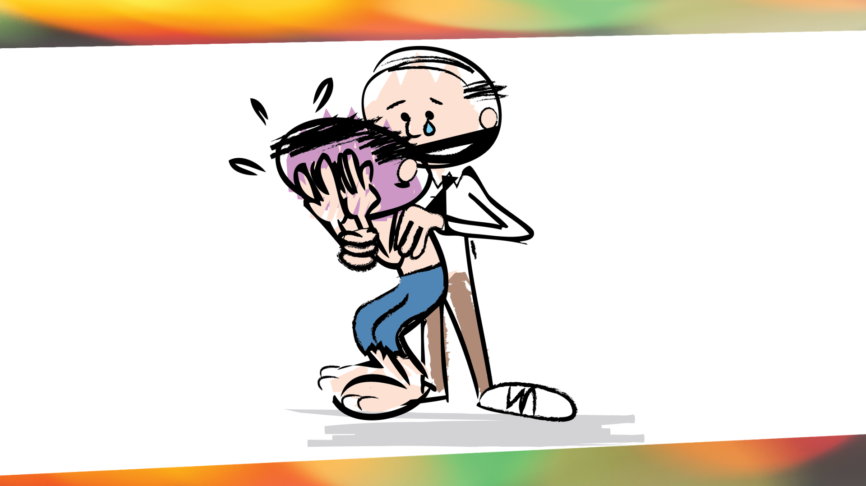

Slide 18
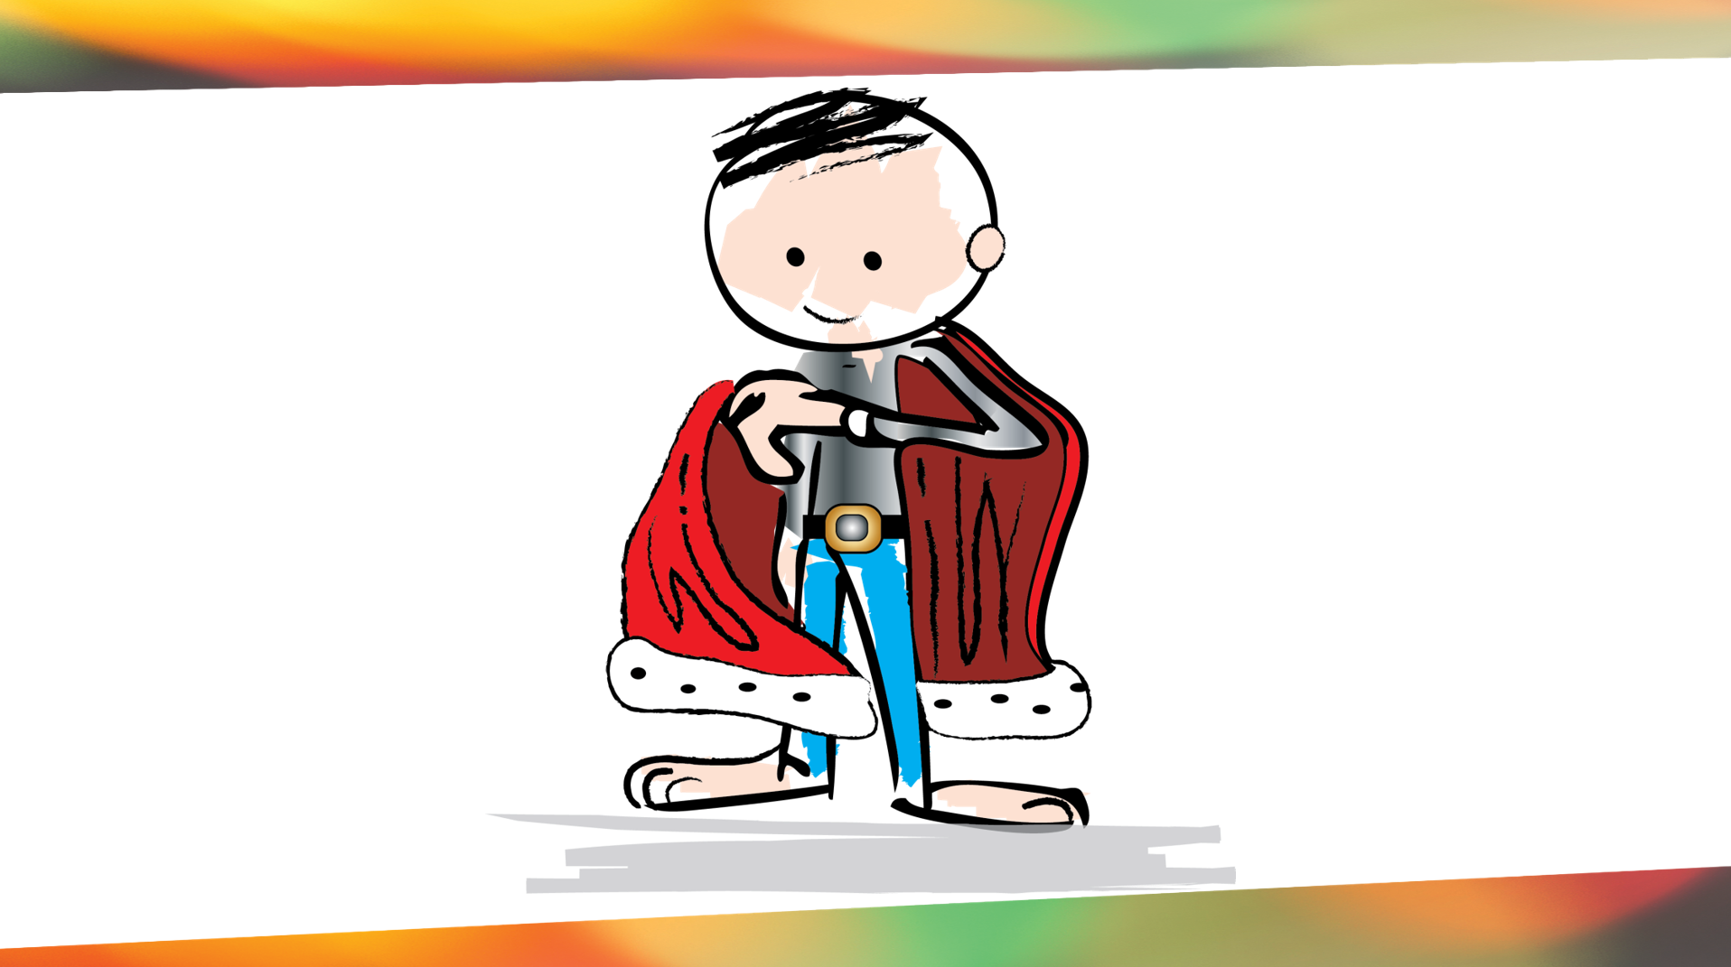
Notes:
Quick Question: Did the robe make him acceptable because it covered up all the dirt? No. The dirt was on the outside. It wasn’t the robe that made him son. He was already the son/ the child of the father by virtue of being born into the Father’s family.
Regardless of the mistakes you’ve made or how much you made have messed up your life, the truth is that, if you have been born as the Father’s child, you are accepted in chirst you are a Son/Daughter of God Himself. You are Holy at the deepst level. It’s true that the Bible talks about the blood of Jesus covering us, but the truth is that “Covering” is an old testament is a picture that is taken from the old testament, the sacrifice of aminals and the blood. It is that, but in the new testament, the AMAZING fact says that when we are saved and adopted as his children. His blood coverd us on the outside, but his Spirit made us alive on the inside.

Slide 19

Luke 15:24
For this son of mine was dead and is alive again; he was lost and is found.’ So they began to celebrate.

Slide 20
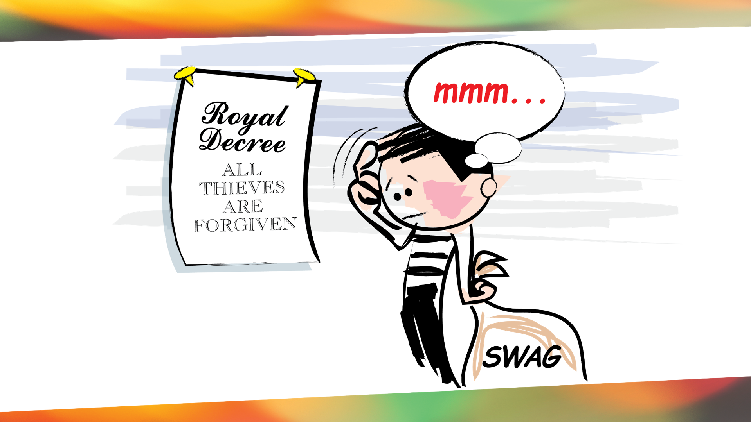

Slide 21
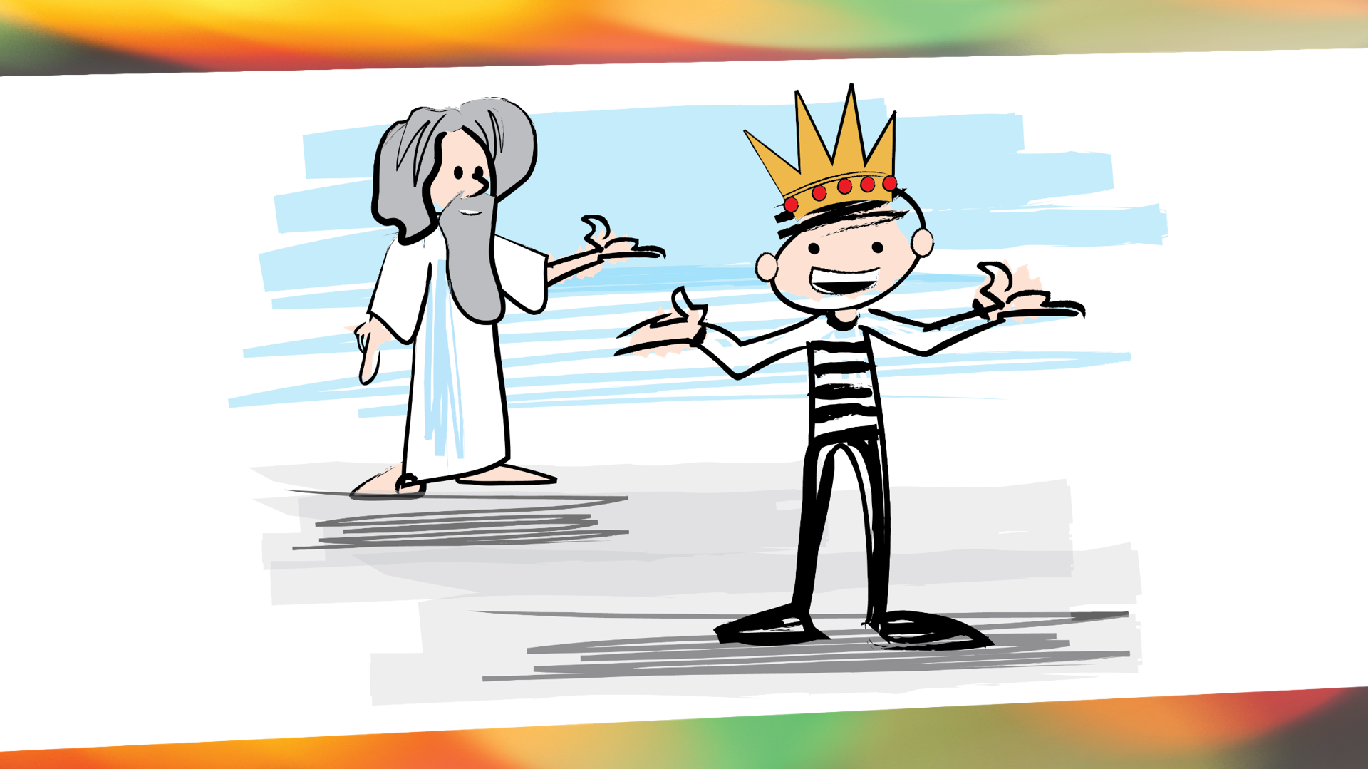

Slide 22
2 Corinthians 5:17 (ESV)
Therefore, if anyone is in Christ, he is a new creation. The old has passed away; behold, the new has come.

Slide 23
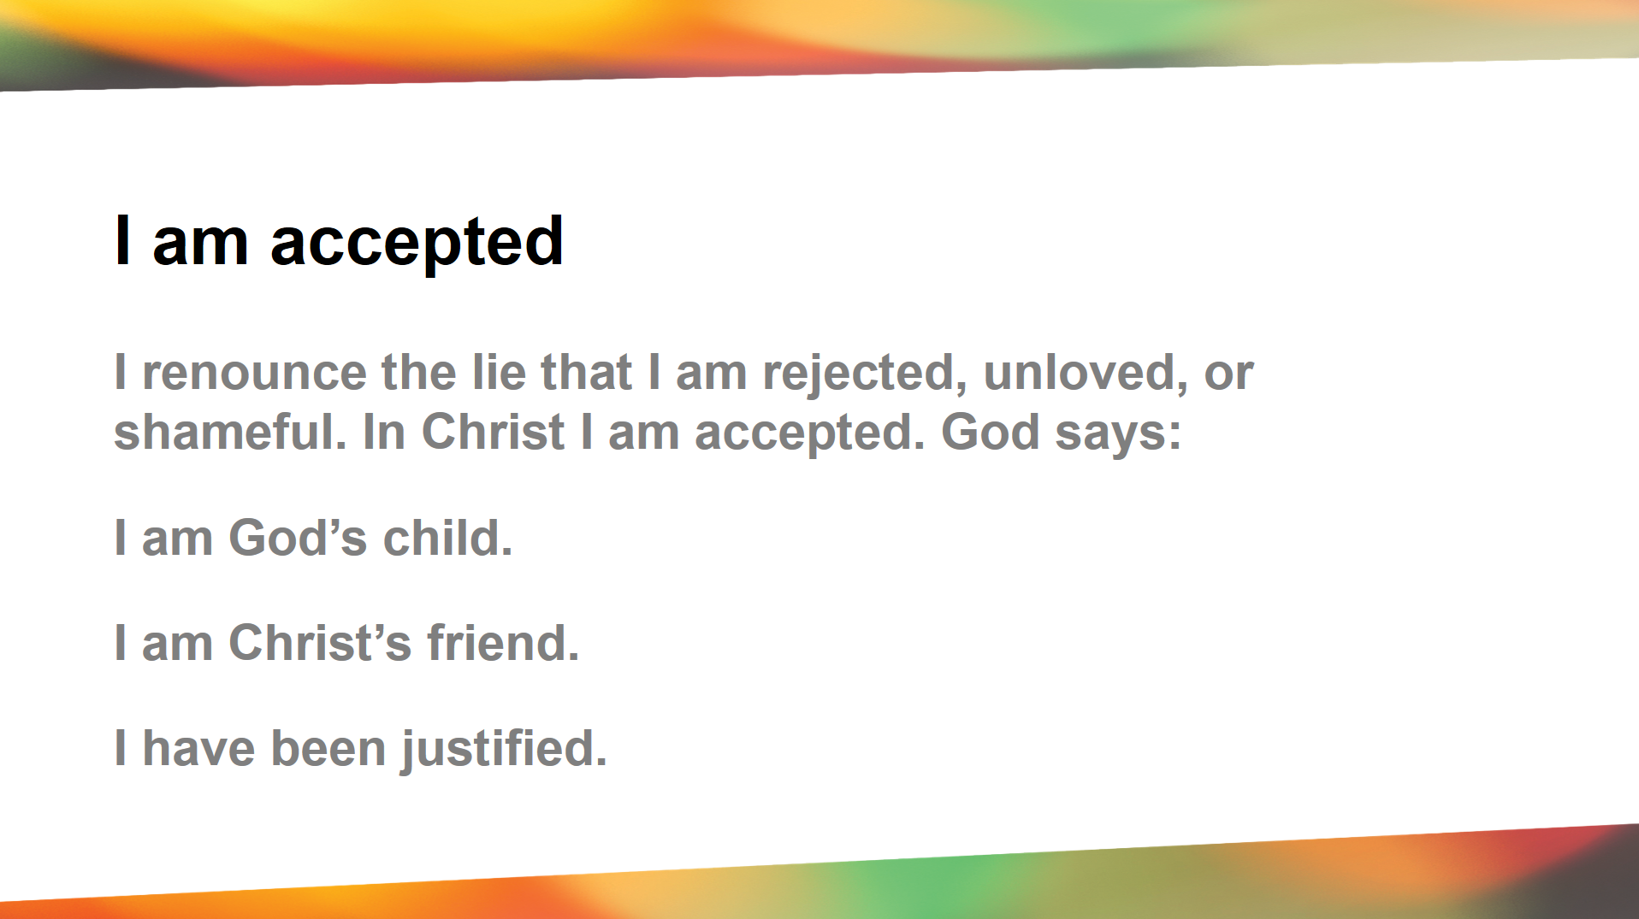
Page 33
&
In The FIC App

Slide 24
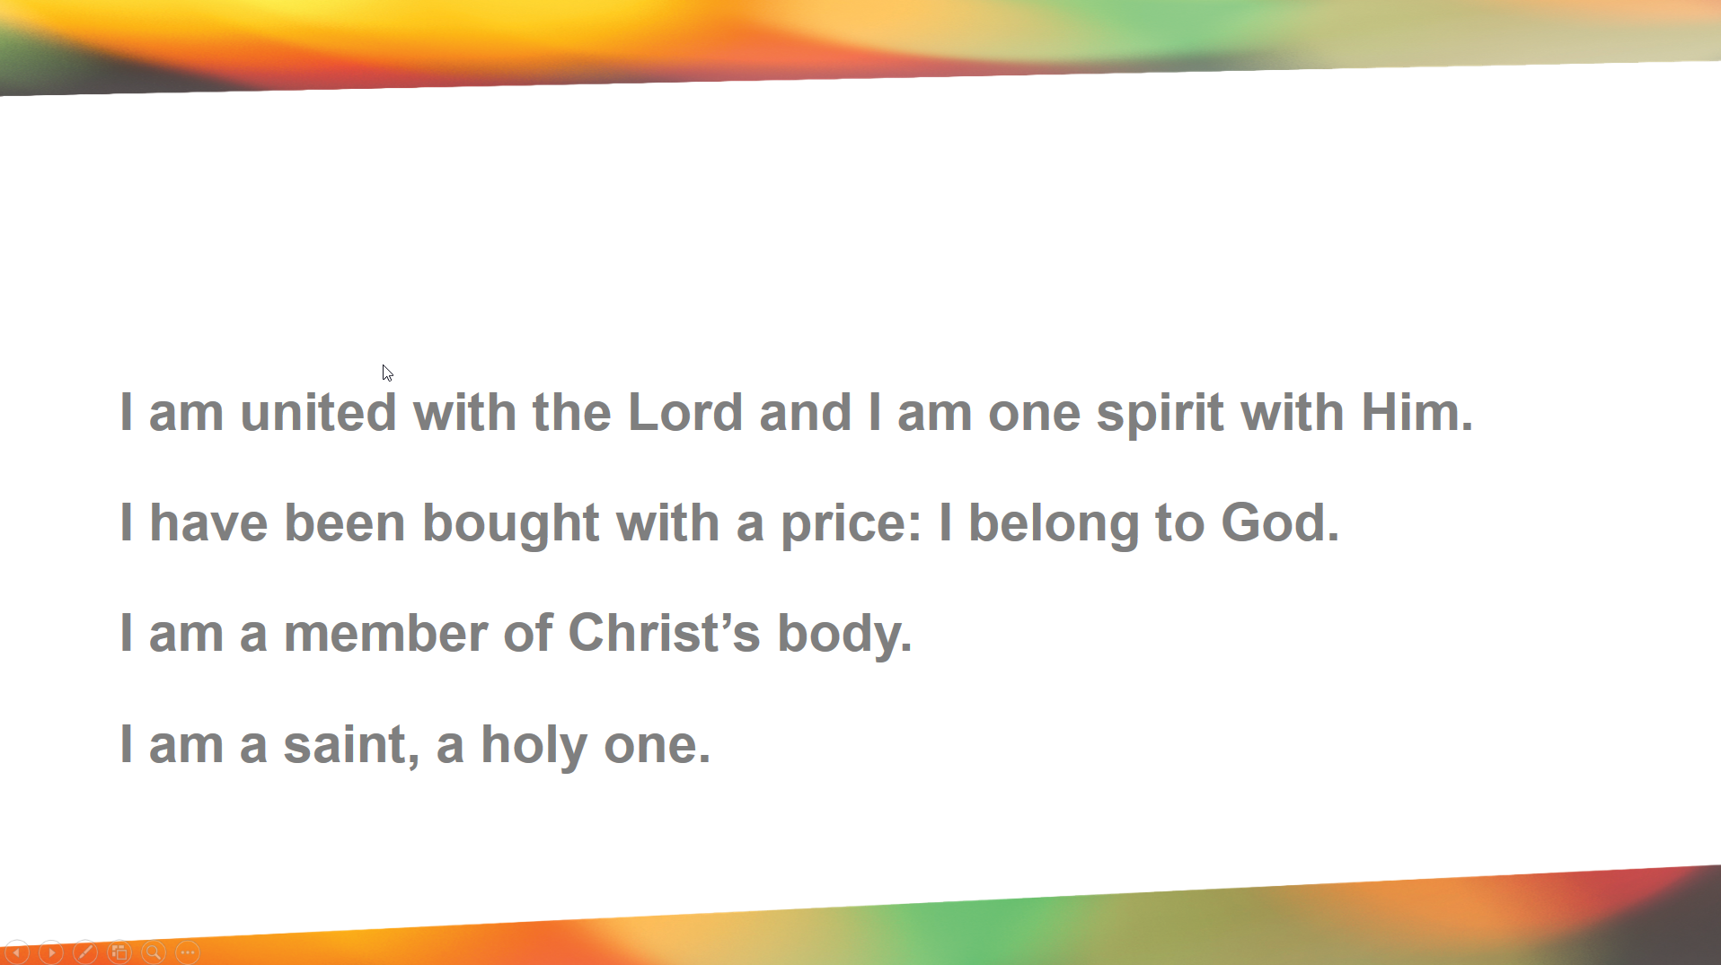

Slide 25
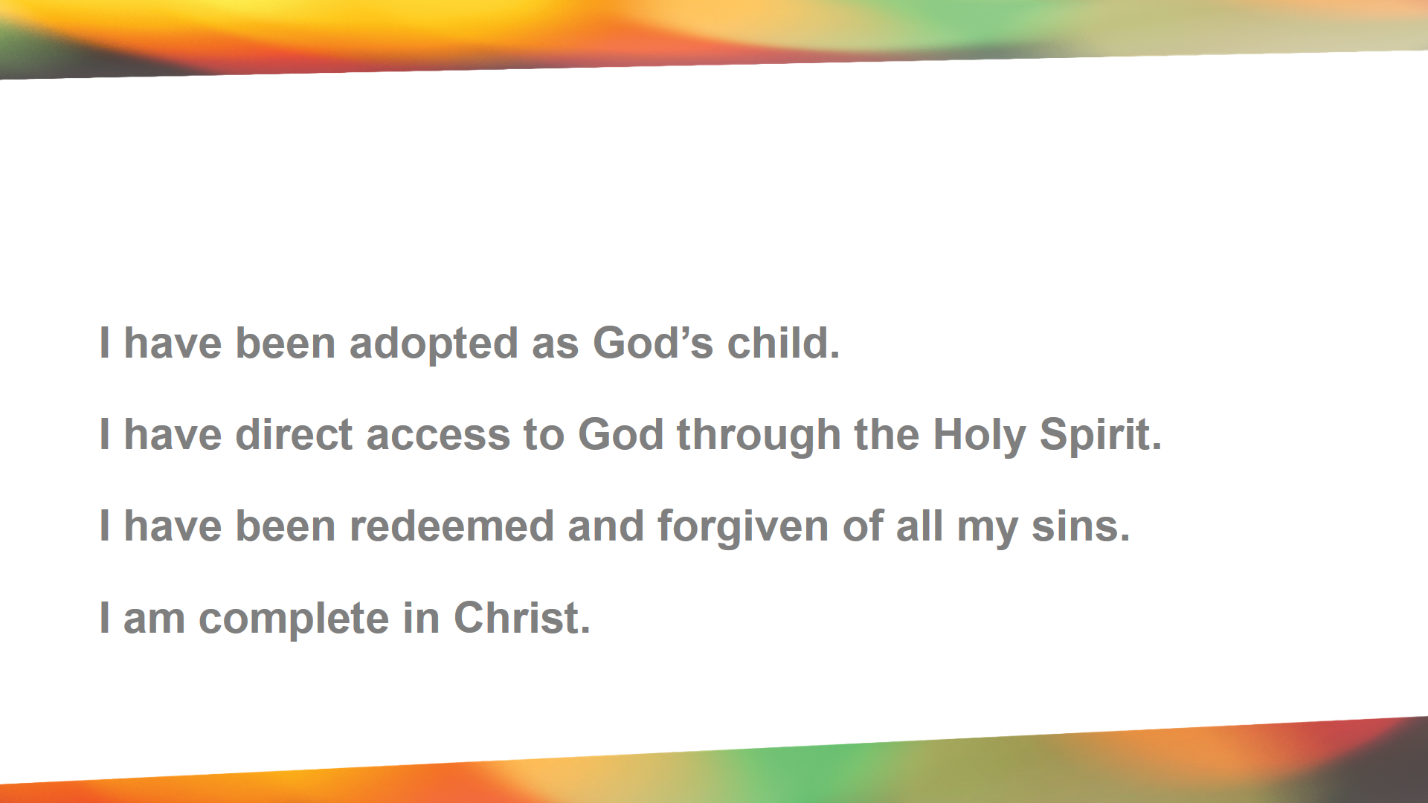

Slide 26
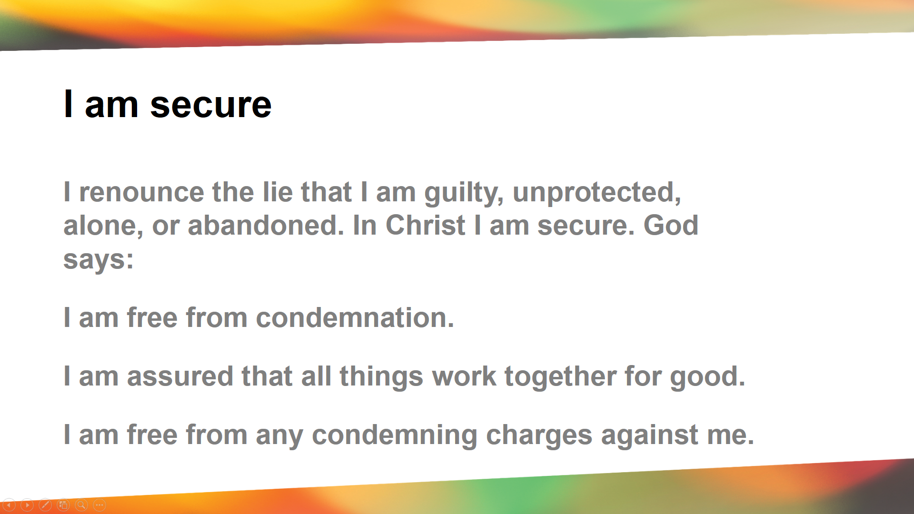

Slide 27
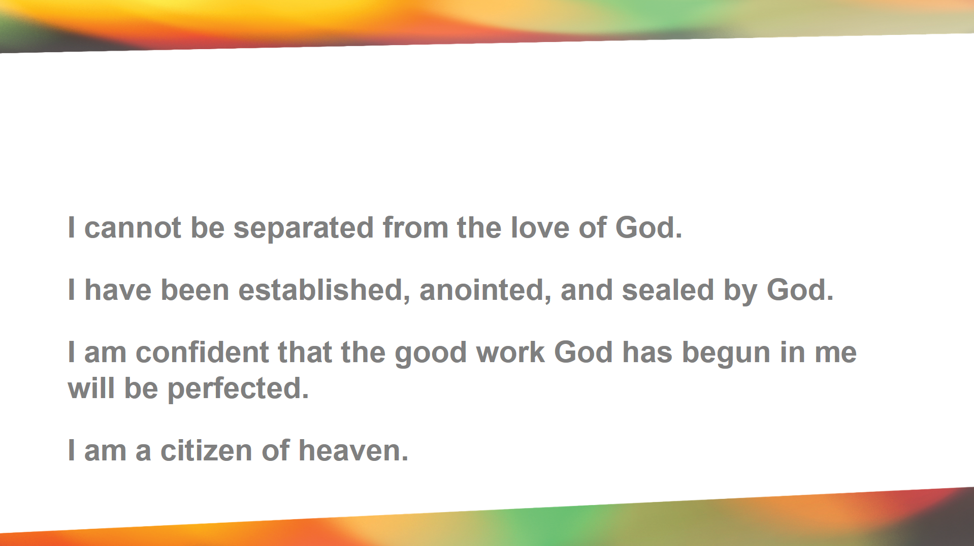

Slide 28
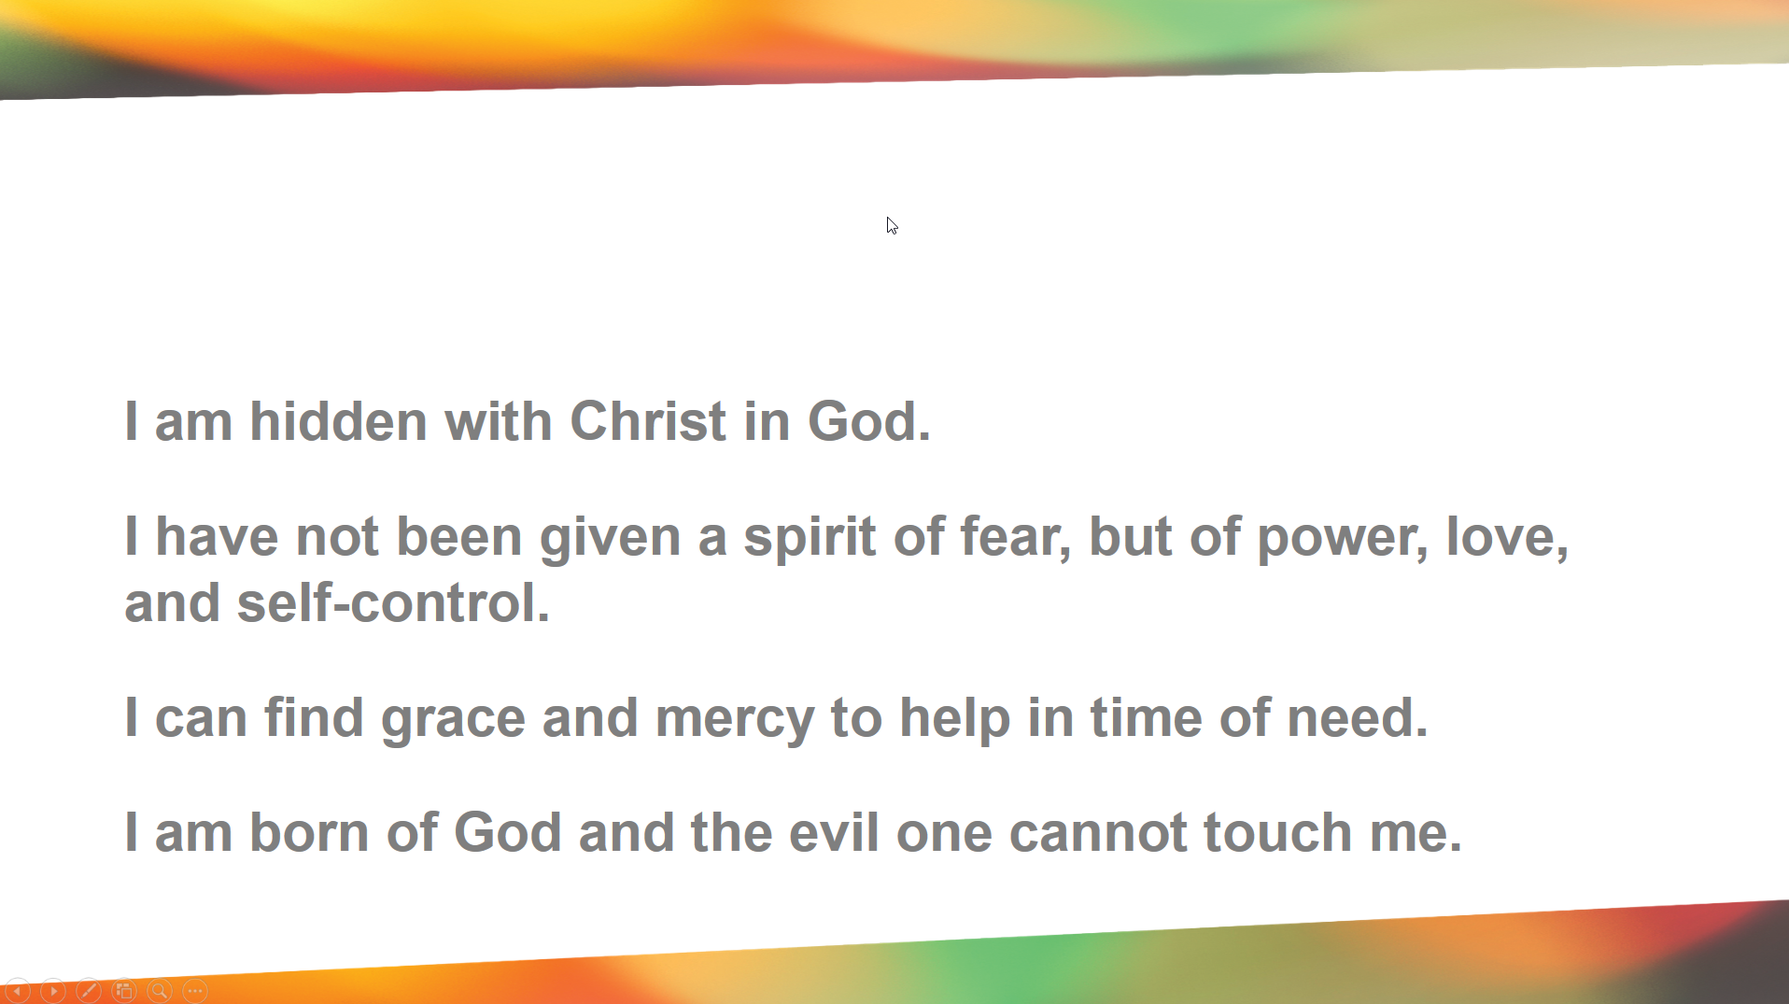

Slide 29
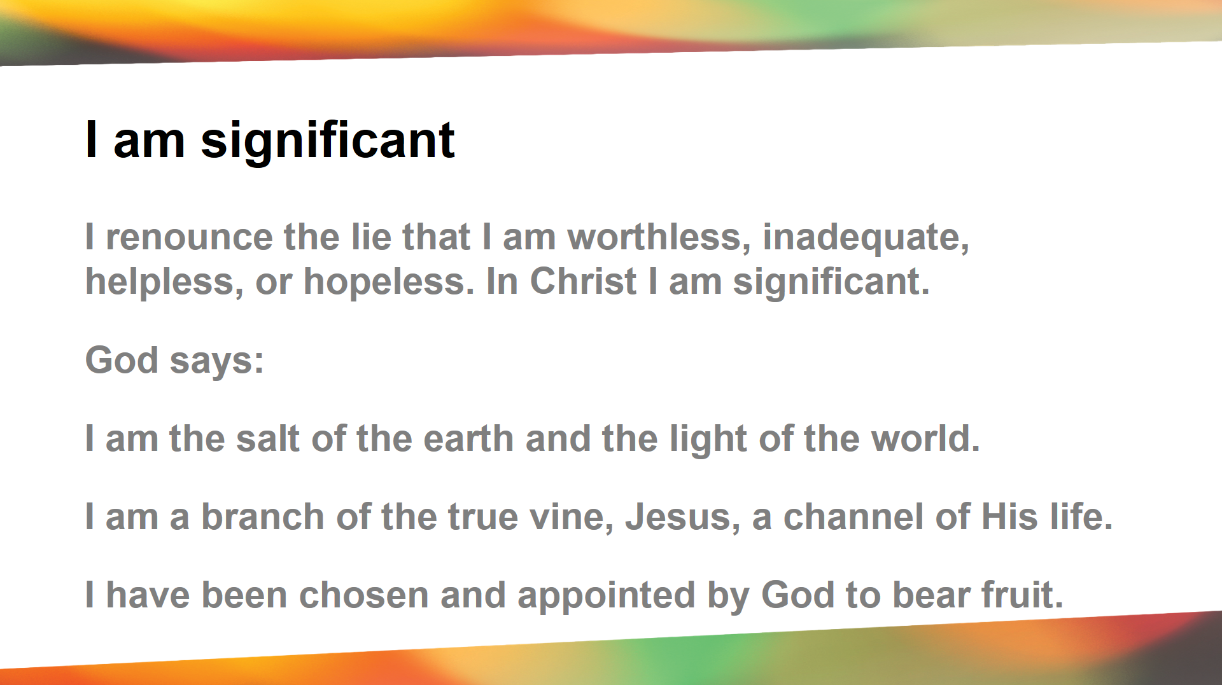

Slide 30
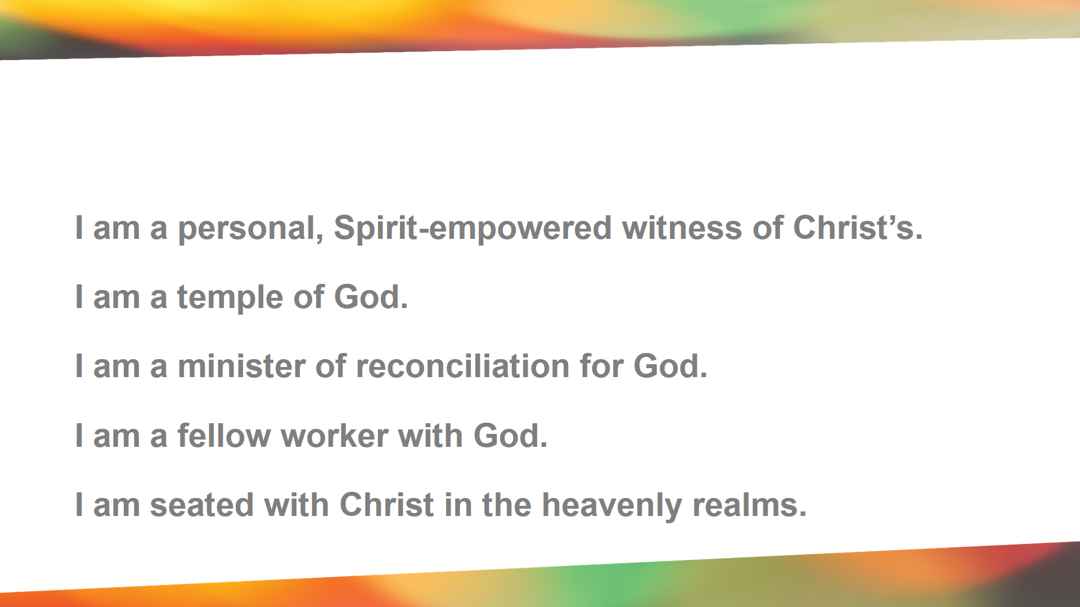

Slide 31
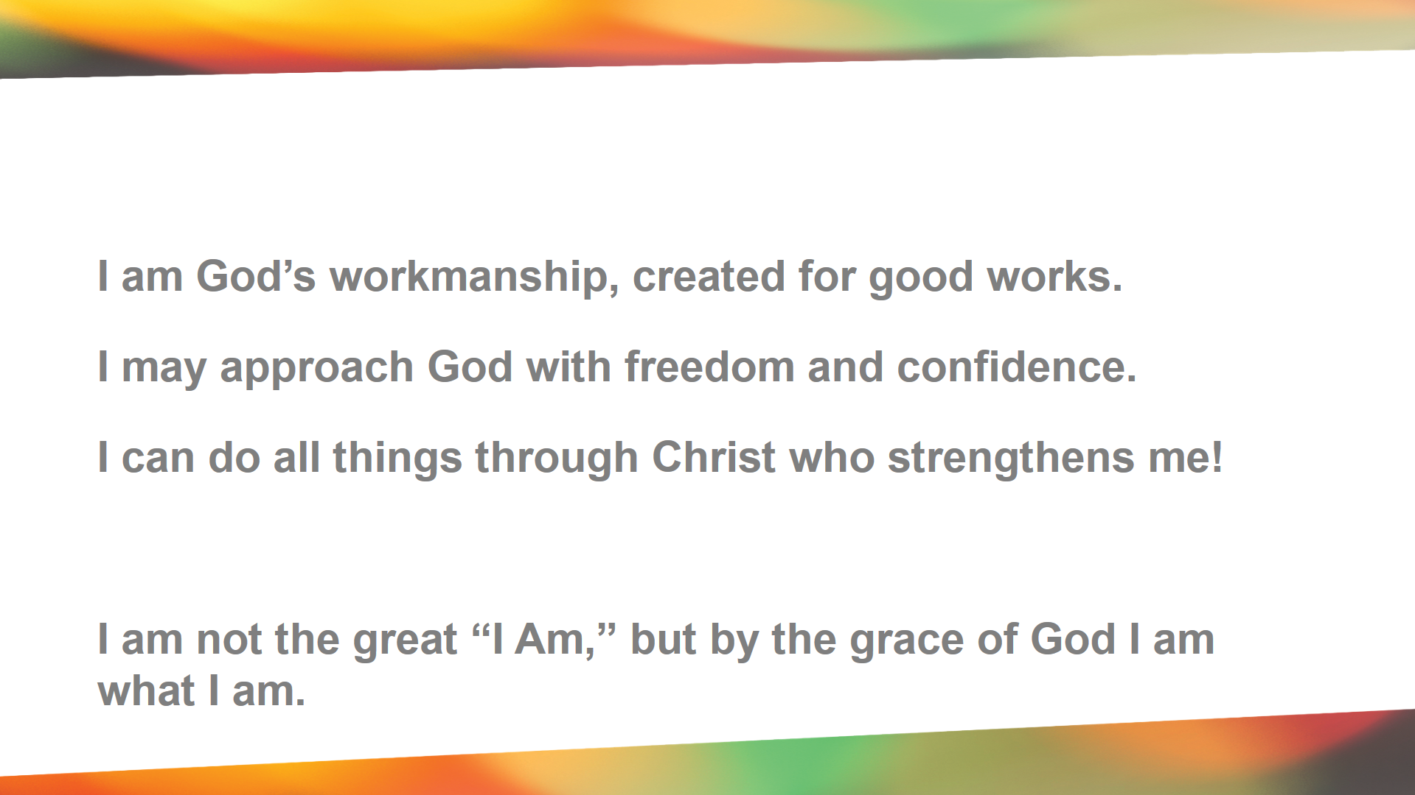

Slide 32
Pause for Thought
How might believing these statements change how we see ourselves?
Page 30
Notes:
I would be wrong to think more of yourself that you should. In pride and arrogance. But it was would be equality as wrong to think less of yourself than God has stated in his word.

Slide 33
Pause for Thought
As a Christian, why is it important to see your primary identity as a
“Saint who sometimes sins”
rather than a
“No good, rotten sinner”?
Page 30

Slide 34
Christian growth does not happen first by behaving better, but by believing better. When our focus becomes overcoming our sin instead of looking to our Savior, we start to losing our battles.

Slide 35
Pause for Thought
The fact that we can still sin, often causes us to have serious doubts about our new identity in Christ.
Notes:
It causes us to have doubts because we think behavior is the key to acceptance. Our behavior is the result of God’s acceptance of us, not the other way around.

Slide 36
Pause for Thought
So what changes in my relationship with God, when I, as a child of God, sin?
Notes:
God : Hiding (Shame based identity)
Here’s and interesting fact, we can’t really self identify, We were created to get our identity outside of ourselves; that why we do Jobs, and Hobbies, and Family our bodies. That’s natural, what makes it damaging are the thing we look to to get this identity.
How they related to each other: Suspicion and Blame
How the now related to themsleves: Unhealthy self-awareness: Also self-aware of others noticing us. Social media drives this. It’s not us seeing ourselves worshiping God. Its worshiping God.
It’s not us seeing ourselves praying. Its praying. There is a healthy self-forgetfulness that takes place where we are not trying to make our image and focus on the one in whose image we are made.

Slide 37
Pause for Thought
NOTHING!
Notes:
OBJECTIONS, BUT…. You don’t know what Ive done.
It doesn’t change who you are in Christ
You don’t know what ‘s been done to me.It doesn’t
It doesn’t change who you are in Christ
You don’t know the failures I’ve had as a Chrisitan
Chrsit loved you when youere a sinner. That hsn’t changed now that you are a saint
I’m scared I will fial again in a major way.
When Christ done one for all our sins Romans 6:10 How may of our sins were yet to be committed?
Wouldn’t I be filled with pride if I really blvied these things about myself?
NO you won’t be pridful if you belive these truths, but I can tesll with with certainty that you will be defeated if you don’t belive them.
No, Your new identity in Christ is not something that you have earned. It is a free gift that has been made possible by the grace of God alone. Believing and receiving this grace brings great humility not pride.

Slide 38
Relationship = Connection (Position in Christ)
Notes:
Maybe write on the board
Your connection with God, is your basis for intimacy with him.

Slide 39
Fellowship = Intimacy
(Progressive spiritual grow)
Relationship = Connection (Position in Christ)
Notes:
Maybe write on the board
Your connection with God, is your basis for intimacy with him.

