Slide 1

Introduce Yourselves
“Circles are better than rows.”
Notes:
Ice Breaker: Introductions around the table
“Introduce yourself and tell a little bit about yourself”
What are some things we used to describe ourselves: Work, Relationships, Hobbies – but those are all things we are apart of but not who we are. Lets go back to Genesis to see what the Bible teaches about “Who we are?”
Really the frist part that we are going to cover tonight could be called. Identity Crisis.

Slide 2


Slide 3
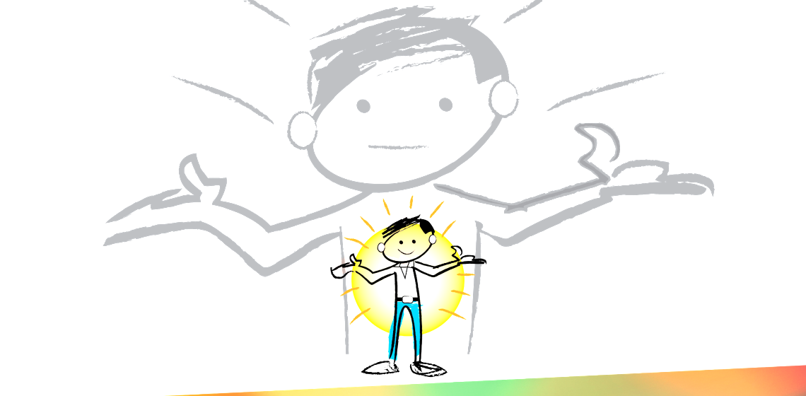
Father as I start this course,
I want to grow in my relationship with you.
Open my spiritual eyes.
Show me who You are and who I am.
Let this not be another “class” where I learn
only facts about you.
My desire is to know you.
In the Name of Jesus I pray, Amen
Genesis 3
Notes:
We were created with this God given needs. Eve before sin entered the world these are legitimate needs that are at the core of us. Men and women are searching for these. All social media post are answering these needs. These are not wrong, but as we will see how we go about trying to get this meet are the root cause of much of our struggle.

Slide 4
Genesis 2
7 the LORD God formed the man from the dust of the ground and breathed into his nostrils the breath of life, and the man became a living being.
Notes:
Jesus response to the Sadducees in Mark chapter 12 verses 26 through 27 and he says am I not the God of Abraham I’m not the God of Abraham the God of Isaac in the God of Jacob he’s not the God of the dead bit of the living
Eternal living God who never dies….

Slide 5

Living Being – Soul/Spirit-Psyche
Physical Life – Soul/Spirit connected with the Body
Spiritual Life – Soul/Spirit connected with God.
Notes:
Image Bearers

Slide 6
FREEDOM IN CHRIST Genesis 1
²⁶ Then God said, "Let us make man in our image, in our likeness, and let them rule over the fish of the sea and the birds of the air, over the livestock, over all the earth, and over all the creatures that move along the ground."
Notes:
To be image bears is the highest virtue
intelligence and creativity to the Adam and Eve

Slide 7
FREEDOM IN CHRIST Genesis 1
²⁷ So God created man in his own image,
in the image of God he created him;
male and female he created them.
28 GOD blessed them and said to them, “Be fruitful and increase in number; fill the earth and subdue it…
29 Summary – Subdue Plants and Animals
31 GOD saw all that he had made, and it was very good.

Slide 8
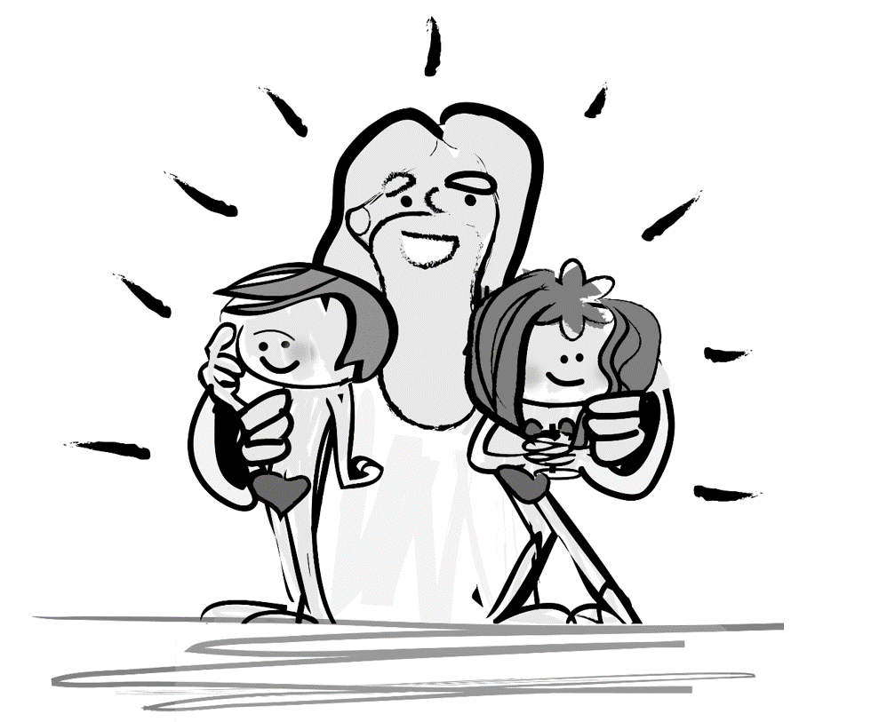
Notes:
If you think about it Significance, Security and Acceptance are a part of what it means to have Life. God didn’t just create us as biological creatures, but with mind, wills, and emotions and part of what it means to live means to have Significance Security and Acceptance.

Slide 9
Acceptance – They had an intimate relationship with GOD. They could talk with HIM at any time.
Genesis 3
Notes:
We were created with this God given needs. Eve before sin entered the world these are legitimate needs that are at the core of us. Men and women are searching for these. All social media post are answering these needs. These are not wrong, but as we will see how we go about trying to get this meet are the root cuase of much of our struggle.

Slide 10
Acceptance – They had an intimate relationship with GOD. They could talk with HIM at any time.
Significance – They were given purpose: to rule (have dominion) over GOD’s earth.
Genesis 3
Notes:
We were created with this God given needs. Eve before sin entered the world these are legitimate needs that are at the core of us. Men and women are searching for these. All social media post are answering these needs. These are not wrong, but as we will see how we go about trying to get this meet are the root cuase of much of our struggle.

Slide 11
Acceptance – They had an intimate relationship with GOD. They could talk with HIM at any time.
Significance – They were given purpose: to rule (have dominion) over GOD’s earth.
Security – They were totally safe and secure in GOD’s presence. God provided for all their needs – physical, spiritual, and emotional.
Genesis 3
Notes:
We were created with this God given needs. Eve before sin entered the world these are legitimate needs that are at the core of us. Men and women are searching for these. All social media post are answering these needs. These are not wrong, but as we will see how we go about trying to get this meet are the root cuase of much of our struggle.

Slide 12
FREEDOM IN CHRIST Genesis 2
15 The LORD God took the man and put him in the Garden of Eden to work it and take care of it.
16 And the LORD God commanded the man, "You are free to eat from any tree in the garden;
17 but you must not eat from the tree of the knowledge of good and evil, for when you eat of it you will surely die."
Notes:
By attempting to be God themselves. The man and woman didn’t become like God at all…… they became less of themselves.
We are born less than we were created to be.

Slide 13
FREEDOM IN CHRIST Genesis 3
1 Did God really say that you must not eat from any tree in the garden?
Notes:
God – Elohim and LORD God is Jehvovah Elohim. Elohim expresses love in general toward all of creation, but to Adam and Eve he is said to be Jehovah God, Expressing specific intimate love.

Slide 14
FREEDOM IN CHRIST Genesis 3
7 Then the eyes of both of them were opened, and they realized they were naked; so they sewed fig leaves together and made coverings for themselves.
8 Then the man and his wife heard the sound of the LORD God as he was walking in the garden in the cool of the day, and they hid from the LORD God among the trees of the garden.
9 But the LORD God called to the man, "Where are you?"
Notes:
Educated beyond our heart's connectivity.
Covering and Hiding from God and each other.
Why the where are you?

Slide 15
10 He answered, "I heard you in the garden, and I was afraid because I was naked; so I hid."
11 And he said, "Who told you that you were naked? Have you eaten from the tree that I commanded you not to eat from?"
12 The man said, "The woman you put here with me--she gave me some fruit from the tree, and I ate it."
13 Then the LORD God said to the woman, "What is this you have done?" The woman said, "The serpent deceived me, and I ate."

Slide 16
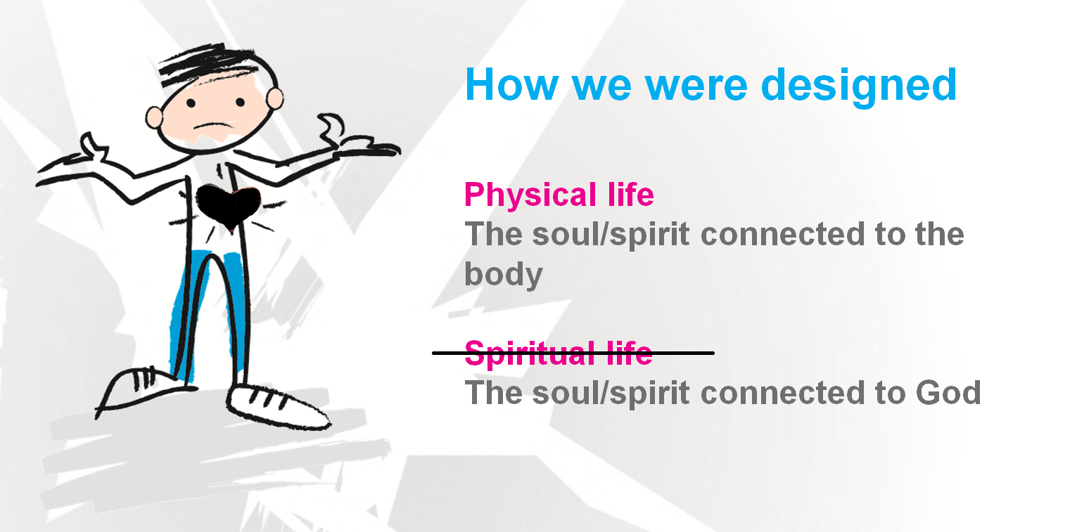
FREEDOM IN CHRIST
Consequences of The Fall
Notes:
By attempting to be God themselves. The man and woman didn’t become like God at all…… they became less of themselves.
We were born less than we were created to be. This is why we need freedom. Man still had his Soul/ He still had his Spirit, but it was no longer connected to God.
While man still bears the image of that connection to God, he is no longer connected to him.

Slide 17
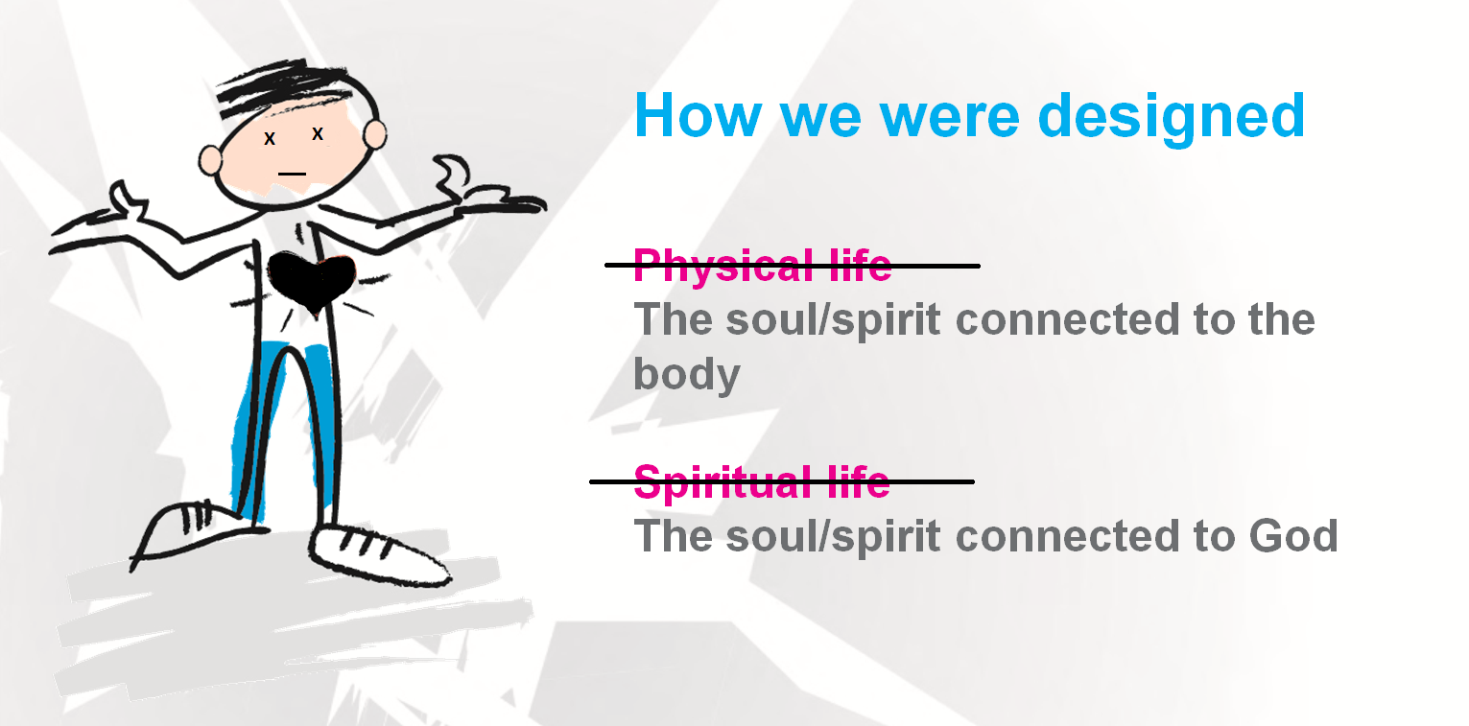
FREEDOM IN CHRIST
Consequences of The Fall
Notes:
They died first Spiritually and then eventually Physcially.

Slide 18
Adam and Eve’s descendants are now born “darkened in their understanding”. (Ephesians 4:18)
Knowing God was no longer about intimate understanding (relationship).
Notes:
You can know information from the word of God and not KNOW the God of the word.
Bible knowledge can keep yourself and others fooled into thinking we KNOW him .

Slide 19
A person may know facts about God,
But still not know Him personally/intimately.
Notes:
You can know information from the word of God and not KNOW the God of the word.
Bible knowledge can keep yourself and others fooled into thinking we KNOW him .

Slide 20
Pause for Thought
In what ways did “the fall” effect Eve’s relationships with God to Change?
Page 25
Notes:
God : Hiding (Shame based identity)
How they related to each other: Suspicion and Blame
How the now related to themsleves: Unhealthy self-awareness: Also self-aware of others noticing us. Social media drives this. It’s not us seeing ourselves worshiping God. Its worshiping God.
It’s not us seeing ourselves praying. Its praying. There is a healthy self-forgetfulness that takes place where we are not trying to make our image and focus on the one in whose image we are made.

Slide 21
Pause for Thought
In what ways did “the fall” effect Eve’s relationships with God to Change? And Adam?
Page 25
Notes:
God : Hiding (Shame based identity)
How they related to each other: Suspicion and Blame
How the now related to themsleves: Unhealthy self-awareness: Also self-aware of others noticing us. Social media drives this. It’s not us seeing ourselves worshiping God. Its worshiping God.
It’s not us seeing ourselves praying. Its praying. There is a healthy self-forgetfulness that takes place where we are not trying to make our image and focus on the one in whose image we are made.

Slide 22
Acceptance was replaced by Rejection
Not ______ Enough
Significance was replaced by Insignificance
Guilt & Shame
Security was replaced by Insecurity
Fear & Anxiety
Genesis 3
Notes:
You are not enough!
know enough
have enough
healthy enough
happy enough
not undepressed enough
the lie that drives, divides, and destroys my time, attention, my life.
We were created with this God given needs. Eve before sin entered the world these are legitimate needs that are at the core of us. Men and women are searching for these. All social media post are answering these needs. These are not wrong, but as we will see how we go about trying to get this meet are the root cuase of much of our struggle.

Slide 23
Pause for Thought
What are common ways women often search for acceptance, significance, and security?
Page 25
Notes:
God : Hiding (Shame based identity)
Here’s and interesting fact, we can’t really self identify, We were created to get our identity outside of ourselves; that why we do Jobs, and Hobbies, and Family our bodies. That’s natural, what makes it damaging are the thing we look to to get this identity.
How they related to each other: Suspicion and Blame
How the now related to themsleves: Unhealthy self-awareness: Also self-aware of others noticing us. Social media drives this. It’s not us seeing ourselves worshiping God. Its worshiping God.
It’s not us seeing ourselves praying. Its praying. There is a healthy self-forgetfulness that takes place where we are not trying to make our image and focus on the one in whose image we are made.

Slide 24
What about you?
Genesis 3
Notes:
We were created with this God given needs. Eve before sin entered the world these are legitimate needs that are at the core of us. Men and women are searching for these. All social media post are answering these needs. These are not wrong, but as we will see how we go about trying to get this meet are the root cuase of much of our struggle.

Slide 25

Rejection, Insignificance, or Insecurity
IDENTIFY which of these if often the
PRIMARY driving force
behind your unhealthy behavior?
Genesis 3
Notes:
We were created with this God given needs. Eve before sin entered the world these are legitimate needs that are at the core of us. Men and women are searching for these. All social media post are answering these needs. These are not wrong, but as we will see how we go about trying to get this meet are the root cuase of much of our struggle.

Slide 26
Ask Jesus to open your spiritual eyes that you may see begin to see that your ultimate
Acceptance, Security, or Significance
in your relationship with Him.
Genesis 3
Notes:
We were created with this God given needs. Eve before sin entered the world these are legitimate needs that are at the core of us. Men and women are searching for these. All social media post are answering these needs. These are not wrong, but as we will see how we go about trying to get this meet are the root cuase of much of our struggle.

Slide 27

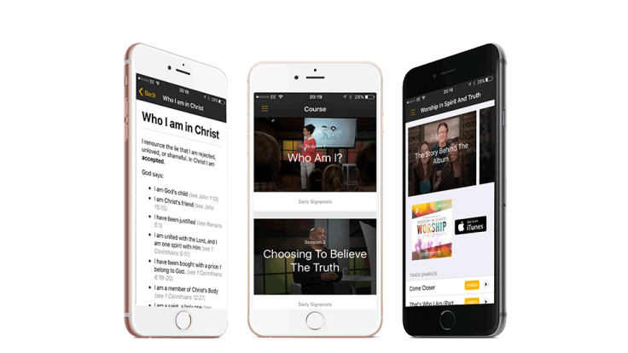
Who I Am in Christ
Daily Review
Page 33
Or
in the App

