Slide 1


Slide 2


Terah’s Story
Genesis 11:27-32

Slide 3
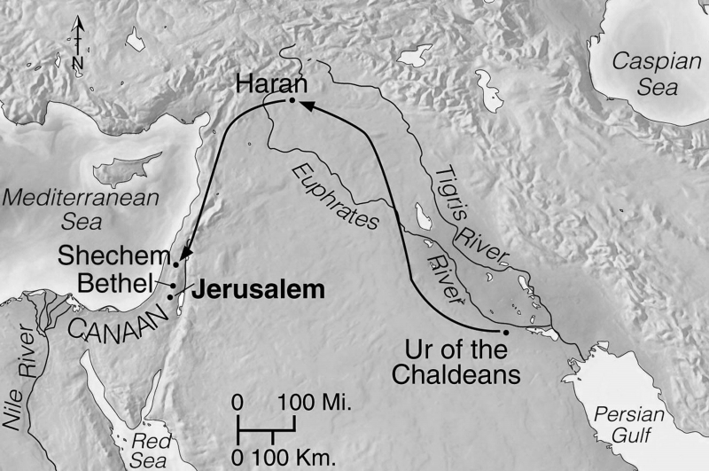
Genesis 11:27-32
^{Terah’s} Story

Slide 4
Stuck
^{Our} Story
Freedom in Christ
Salvation

Slide 5


Slide 6
Christian Growth
What are some things that can cause us to be “stuck” in our relationship with Jesus?

Slide 7
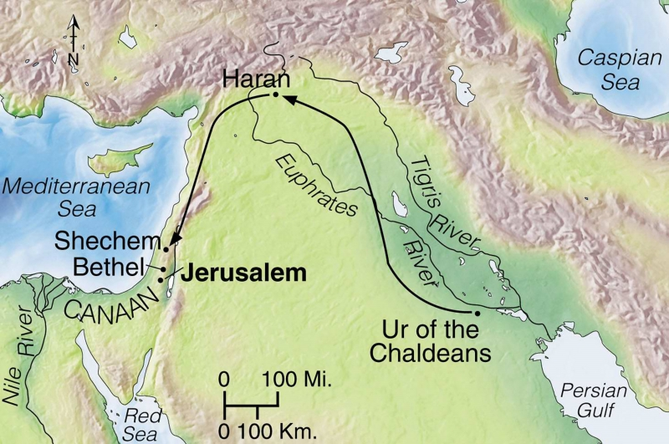
Genesis 11:27-32
^{Terah’s} Story

Slide 8
Joshua 24:2-3
Joshua said to all the people, “This is what the Lord, the God of Israel, says: ‘Long ago your ancestors, including Terah the father of Abraham ……. lived beyond the Euphrates River and worshiped other gods. But I took your father Abraham from the land beyond the Euphrates and led him throughout Canaan and gave him many descendants.

Slide 9
Christian Growth
Like Terah, idols in our life get us stuck spiritually and affect the people we love. Psalm 115:1-8

Slide 11

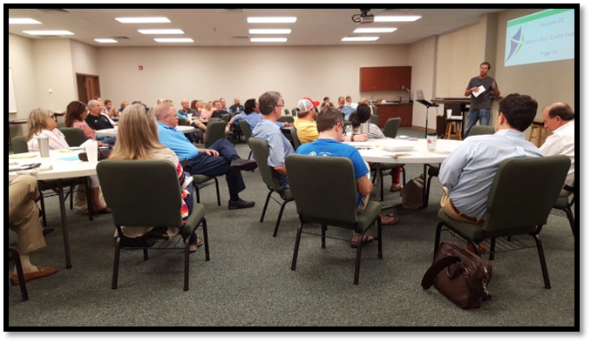
Truth is foundational biblical teaching about our identity in Christ and the nature of the spiritual battle we're in.

Slide 12
Freedom in Christ Course
Part A
Session 1: Who Am I? ✓
Session 2: Choosing to Believe the Truth✓

Slide 13
Quote
“In Christ”

Slide 14
Why Do We Struggle?
Part B
Session 3: The World’s View of Truth ✓
Session 4: Our Daily Choice (Flesh)✓
Session 4: The Battel for Our Minds✓

Slide 15
Breaking The Hold of the Past
Part C
Session 6: Handling Emotions Well (Oct 24st)
Session 7: Forgiving From the Heart (Oct 31st)
Session 8: Renewing the Mind (Nov. 7th)

Slide 16

Turning is about repentance and this is where we take back any ground we have given to the enemy through past sin so that he can't hold us back any more.

Slide 17
Growing as Disciples
Part D Session
Session 9: Relating to Others (Nov 14th)
Thanksgiving Break (Nov 21st)
Session 10: What’s Next(Nov. 28th)
Wrap Up-If Needed (December 5th)

Slide 18

Transformation is about the ongoing process of changing the way we think. We have to replace lies we have believed with truth of God’s word.
Freedom in Christ Course App

Slide 19
Quote
In practice we should constantly be reminding ourselves who we are. We need to talk to ourselves, and ask ourselves questions: “Don’t you know? Don’t you know that you have been united to Christ in His death and resurrection? Don’t you know these things? Don’t you know who you are?” We must go on pressing ourselves with such questions until we reply: “Yes, I do know who I am, a new person in Christ, and by the grace of God I shall live accordingly.” Pastor John Stott

